Slide 1
Scaling Digital Computing Beyond Moore’s Law

Slide 2
What Is Moore’s Law?
Moore’s Law that every 1.5-2 years digital computing gets exponentially better;
  2x better energy efficiency
  2x more functionality
  2x faster performance
All at the same price!! for over 50 years!
Notes:
We don’t even have a plan for this.
We have a lot of ideas
But we don’t have much time

Slide 3
Why is Moore’s Law going to end?

Slide 4
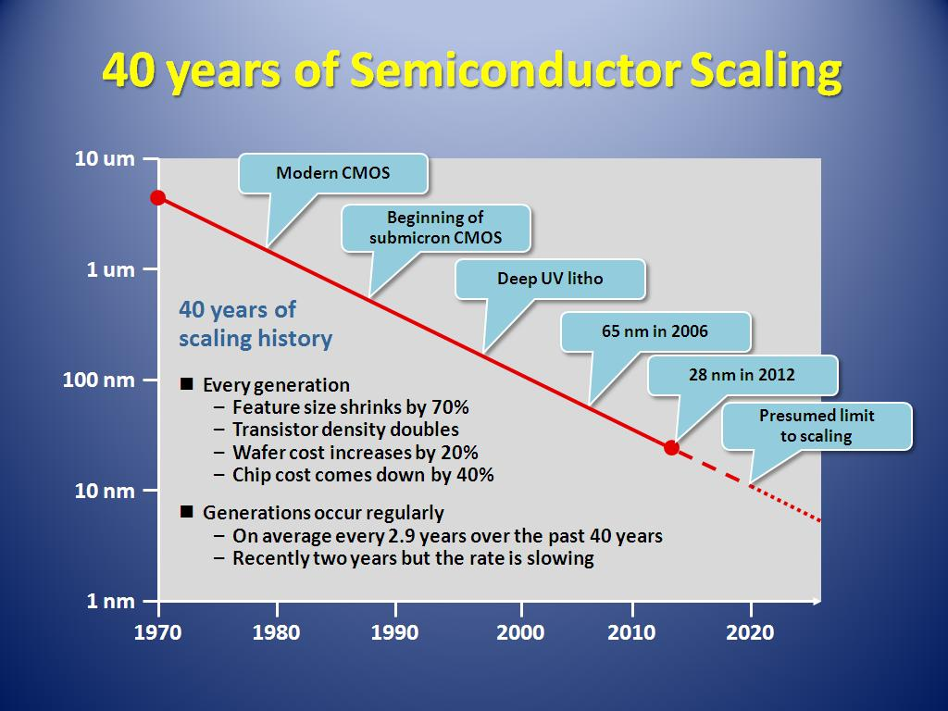
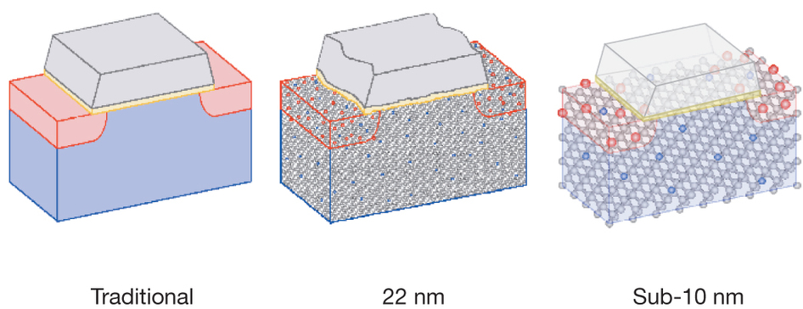
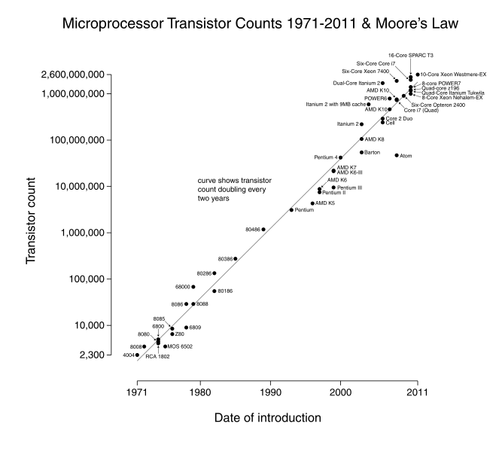
50
Atomic scale limit case for 2D Lithography Scaling
2027?
5nm

Slide 5
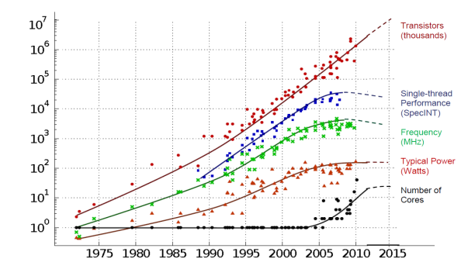
Technology Scaling Trends
(running out of steam on every front!)
Transistors
Thread Performance
Clock Frequency
Performance
Power (watts)
# Cores
Year
Figure courtesy of Kunle Olukotun, Lance Hammond, Herb Sutter, and Burton Smith
Notes:
Thomas said he wouldn’t show this diagram….. OK. I will then.
Well at least we’ve got Moore’s Law (lithography scaling)
But in 2025 we won’t have that any more, and our current play of doubling processor cores that gets us to exascale is no longer going to be available as a source of technology scaling.
Could extend this if you build out in 3D! But energy density is already at the limits, so you cant.
And data movement goes lower if you have photonics or if you have lower voltages….

Slide 6
What Will Happen if Moore’s Law Ends

Slide 7
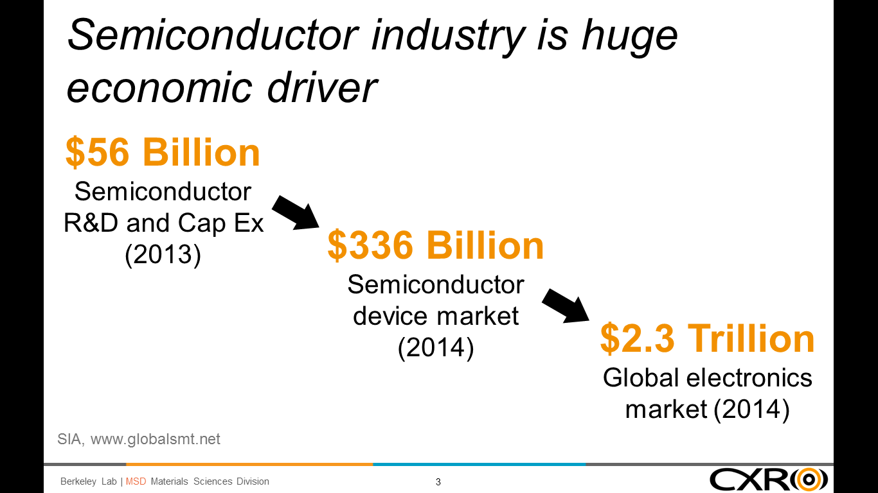
The semiconductor industry is crucial to the U.S. economy. Semiconductor sales constitute a $336B/yr. economic engine driving the $2.3T/yr. global electronics industry. Semiconductor products are currently the second largest class of U.S. exports

Slide 8
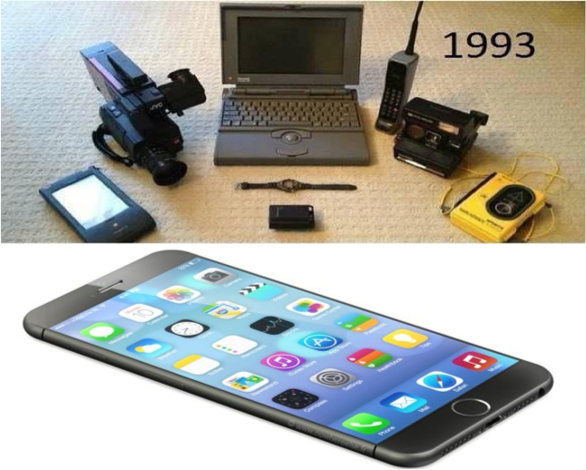
Technology Integration and Impact on Society
Imagine if Moore’s Law Ended 15 years ago?

Slide 9
Energy
IT projected to challenge future electricity supply
Even worse if Moore’s Law ends!!!
Projection based on consumer electronics + data centers
We need to be here!
www.alliancetrustinvestments.com/sri-hub/posts/Energy-efficient-data-centres
www.iea.org/publications/freepublications/publication/gigawatts2009.pdf
Notes:
Talk about your need for success (the scare diagram)
Its not just about reducing power consumption. Its about being able to meet the needs (that you other guys are depending upon)
What if we couldn’t deliver that. What if industry could not deliver the expanded compute capability that you demand?
Why do we believe this will happen?
You’ve exceeded your carbon budget. No iPhone upgrade for you!
Yout guys are contributing to the problem: Charlie wants to put IOT packages on top of telephone poles
the biosphere thing wants sensor data and then back-end resources to process the data?
no soup for you charlie
Show the economoic and energy impact of employing even more pervasive IOT technology and associated data mining.
From the spreadsheet, total energy in 2030 is 33,000 PWhr, of which 9.5 PWhr is ICT related (28.6%).
Had 30% of of the project electric supply by 2030 just based on current trends and it went up to 50% with Moore's Law ending, but that part certainly much more speculative.
With Beyond Moore, we assume we can get ~ 2X reduction to 5.3 PWhr, which is 15.9% of 33 PWhr, but this number is ‘fungeable’. (we could assume more).
The reduction of 9.5 – 5.3 = 4.2 PWhr; 4.2 PWhr / 33 PWhr = 12.6%.
The graph is drawn a little lower, but I think it’s ok.
This is achieved with only a 3.5 - 6X reduction in energy per external data rate (Cisco reference) in 2030 vs. the existing trends, the spread depends on the ‘path’ to the energy savings. (greater in early years vs. later years).

Slide 10
Moore’s Law is an techno-economic theory. There are ways to continue scaling of digital technology after the end of classical lithographic scaling
We must find the new path to scaling
Before it impacts our economy
Before someone else does

Slide 11
Numerous Opportunities to Continue Moore’s Law Technology! (but winning solution is unclear)
Revolutionary Heterogeneous HPC architectures & software
New Materials and Efficient Devices
10+ years (10 year lead time)
Photonic
ICs
More Efficient Architectures
and Packaging
First 10 years

Slide 12
Call To Action
The upcoming end to Moore’s Law will have a severe impact on U.S. industry and competitiveness
The importance of this issue and its technical complication will require innovative approaches to keep the U.S. in a leadership position
Solving a problem of this scale will require “whole of government” approach and to consider implementing a robust public/private partnership to apply the best research from industry and government research facilities to allow the U.S. to successfully make this technology transition
Such breakthroughs will enable continued affordability of our information economy and US economic competitiveness.

Slide 13
Backup Slides

Slide 14
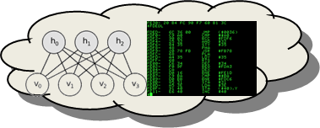

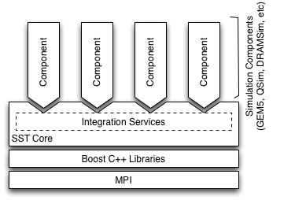
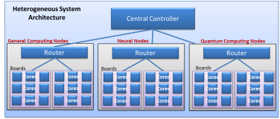
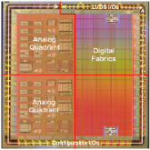

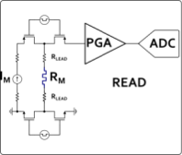
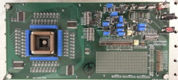
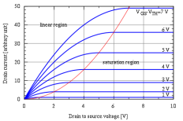
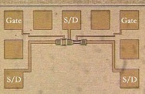

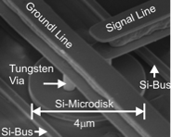
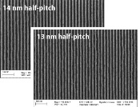

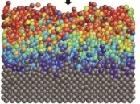

Beyond Moore Codesign Framework
Application Performance Modeling
10,000x improvement:
20 fJ per instruction equivalent
Modeling
Computer System Architecture Modeling
Next generation of Structural Simulation Toolkit
Heterogeneous systems HPC models
Systems
Component Level Models
Gem5, McPAT, HiHAT, CACTI, NVSIM
Component Fabrication
Processors, ASICs
Photonics
Memory
Circuit/IP Block Design and Modeling
SPICE/Xyce model
Test Circuit Fab and Measurement
Subcircuit measurement
Compact Device Models
Single device electrical models
Variability and corner models
Devices
Device Measurements
Single device electrical behavior
Parametric variability
TEM/EELS
Device Physics Modeling
Device physics modeling (TCAD)
Electron transport, ion transport
Magnetic properties
Device Structure Integration and Demonstration
Novel device structure demonstration
Process Module Modeling
Diffusion, etch, implant simulation
EUV and novel lithography models
Process Module Demonstrations
EUV and novel lithography
Diffusion, etch, implant simulation
Materials
Atomistic and Ab-Initio Modeling
DFT – VASP
MD – LAAMPS
Fundamental Materials Science
X-ray: XRD, XPS, HAXPES
Microscopy: TEM, SEM, EELS
Scanning probe technique
Experimental
Notes:
Explain how this integrated framework leverages the labs strength and MISSION, and engages both modeling and experimental science
There are many indiviual activities happening in each of these areas, but there is nothing that integrates them together.
In the Charter of the National Strategic Computing Initiative, the DOE is identified as a lead agency for computing systems,
with a mission to create integrated efforts that LEAD to fully integrated systems.
It is our job… it is our MISSION to address this first order energy challenge...

