Slide 1
Solving the Information Technology Challenge Beyond Moore’s Law

Slide 2
Goals for the Meeting
1) Review and finalize current “Solving the Information Technology Challenge Beyond Moore’s Law” document.
2) Create a “missing” chapter that describes how we work together as an integrated whole. (materials, devices, hardware, software, manufacturing)
  better story for how each area interact,
  what artifacts they exchange to promote a functioning co-design framework.
3) Improve the description of features of our collaboration that differentiates it from the Beyond Moore activities at other agencies.
  unique capabilities of DOE,
  how better cross-discipline interaction generates more impactful results
4) Update the 2016 Big Ideas Summit whitepaper to prepare for BIS17
  due Jan 4

Slide 3
Morning Agenda

Slide 4
Afternoon Agenda

Slide 5
This Session
Ramesh: Describe presentation to Council for Competitiveness Meeting in Chicago
Rick: Interagency workshop at DARPA on Beyond Moore Technology + feedback from HQ
Denis: Overview of NSF/SRC E2CDA.
And then we start break-outs

Slide 6
Call To Action
The upcoming end to Moore’s Law will have a severe impact on U.S. industry and competitiveness
The importance of this issue and its technical complication will require innovative approaches to keep the U.S. in a leadership position
Solving a problem of this scale will require “whole of government” approach and to consider implementing a robust public/private partnership to apply the best research from industry and government research facilities to allow the U.S. to successfully make this technology transition
Such breakthroughs will enable continued affordability of our information economy and US economic competitiveness.

Slide 7
Breakout Group Charge
Create a “missing” chapter that describes how we work together as an integrated whole. (materials, devices, hardware, software, manufacturing)
  Better story for how each area interact,
  Artifacts exchanged to promote a functioning co-design framework.
  Measurable Metrics that we can improve
Improve the description of features of our collaboration that differentiates it from the Beyond Moore activities at other agencies.
  Unique capabilities of DOE,
  Better cross-discipline interaction generates more impactful results
SMART Criteria
  Specific – target a specific area for improvement.
  Measurable – quantify or at least suggest an indicator of progress.
  Assignable – specify who will do it.
  Realistic – state what results can realistically be achieved with available resources.
  Time-related – specify when the result(s) can be achieved.

Slide 8
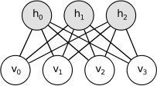
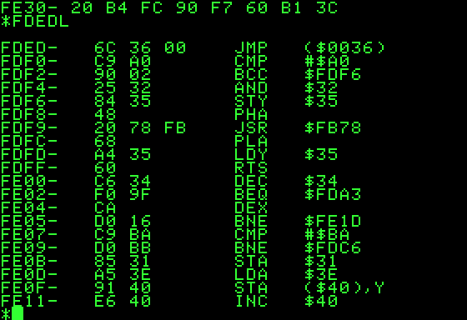
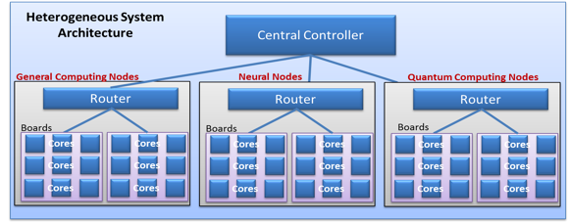
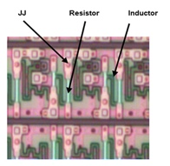
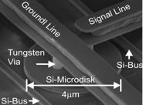

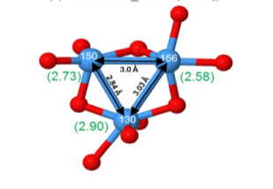







Multiscale CoDesign Framework
Programming paradigms
Systems/Applications
(ASCR, ASC)
System architecture modeling
Component hetero-integration
Devices/Manufacturing
(AMO, ARPAe)
Multiscale CoDesign Framework
Device demonstration
Device physics
Materials
(BES)
Fundamental material science
Notes:
So this really is a multiscale problem that would need a multi-lab effort. Looking at the problem, we start at the bottom fundamental materials science that then feeds into device physics and then up to logic device demonstration followed by large scale heterogeneous integration and then system architecture modeling and finally programming paradigms. All these capabilities currently exist throughout the lab complex.
Materials and Device Development approach: as Blake will say, it is very artisinal.

Slide 9
Better Description of Interfaces
Develop Metrics for Success

Slide 10
Breakout Locations
Breakout 1: Software WG + Hardware WG
  Room 3054
Breakout 2: Materials WG + Devices WG
  Room 4016
Breakout 3: Hardware WG + Devices WG
  Room 3034
Breakout 4: Advanced Manufacturing
  Room 4022

