Slide 1
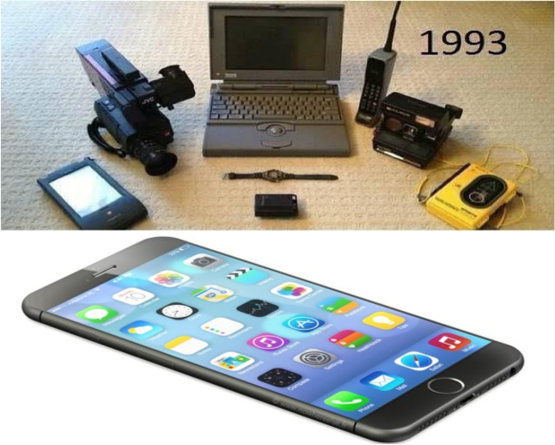







Beyond Moore DOE Internal Lab Focused Workshop
LBNL Capabilities and Interests

Slide 2
LBNL Capabilities and Interests: Summary
Primary Expertise & Interest Areas
Advanced Materials
Broad range of probes: Xray, Electron, near field,…
Advanced manufacturing techniques
New Device Architectures
Computer architecture/simulation
Algorithms, Applied Math
Most Differentiating Factor
The Materials Project
CAMERA
User Facilities (ALS/CXRO/Foundry/NERSC)
Industry Connections
Open silicon nanofab: UCB
Open computer architecture (RISCV)
Main Contribution/Role
Rapid design and search for novel electronic and manufacturing materials
Characterization and fundamental limits of materials and devices
Design and fabrication of novel computer architectures
Next generation manufacturing R&D and workforce (students)

Slide 3
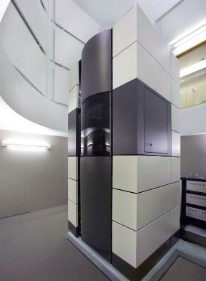
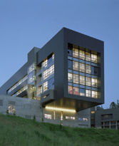
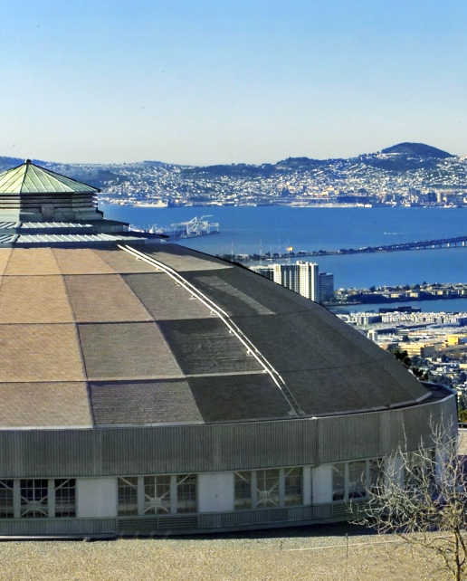




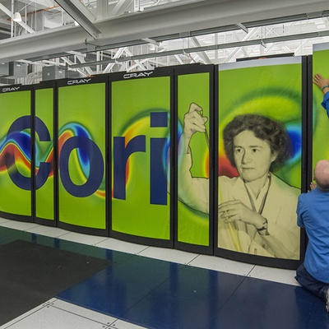
Key LBNL facilities

Slide 4
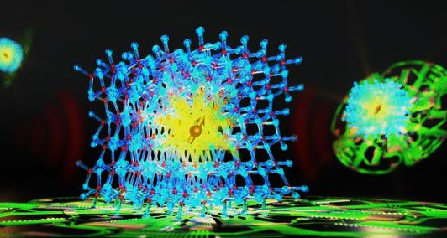
Materials Discovery

Slide 5
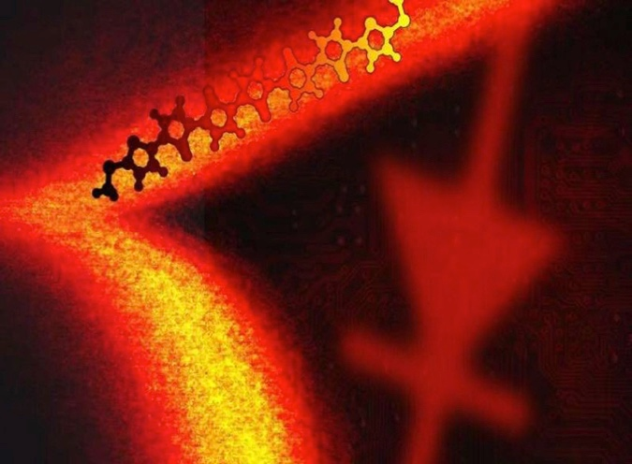
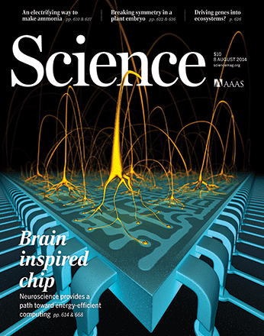
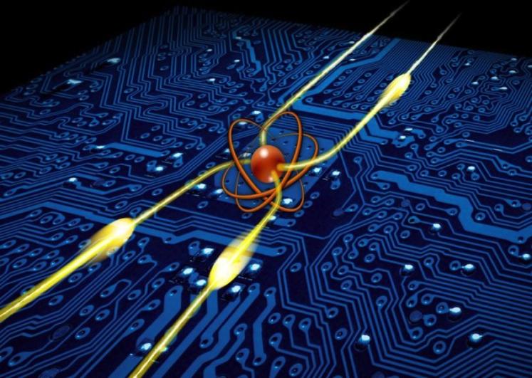
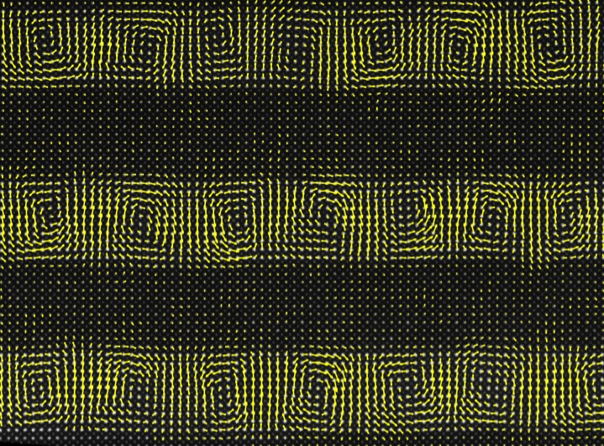
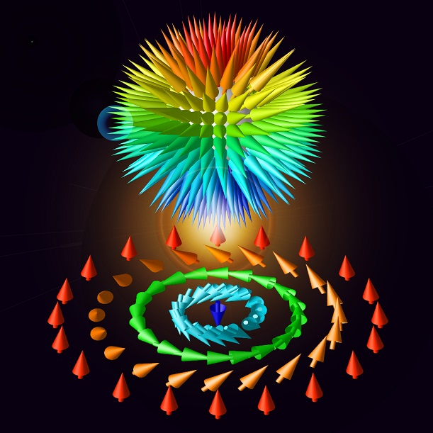
Fundamental Materials Science Drivers
Manipulate information at the limits of Energy : 1 AttoJoule switch
Hierarchical ground states for multistate memories and logic
Control of electron wavefunctions
Energy-efficient synthesis of new forms of matter with tailored properties
Control of correlations
and emergent behavior @mV scale
Notes:
Attojoule device is 6 orders of magnitude lower than today’s devices.

Slide 6
Energy Scales in Materials
H=H_{Kin}+V_{e-ion}+U_{e-e}+H_{Hund}+H_{s-s}+H_{e-ph}+H_{s-o}
Electric Field
1 V/μm
10 V/μm
0.1 V/nm
1 V/nm
Magnetic Field
1 T
10 T
100 T
spin-orbital interaction
e-ion interaction
DM interaction
crystal field
kinetic interaction
spin-spin interaction
Hund’s interaction
Many body interactions
E-ph, ph-ph, …
e-e interaction
100 μeV
1 meV
10 meV
100 meV
1 eV
10 eV
Temperature
1 K
10 K
100 K
1000 K
Epitaxial Strain
0.01 %
0.1 %
1 %
10 %
Time Scale (Approx)
fsec
psec
nsec
μsec
Notes:
Broad Opportunities for Fundamental Science Breakthroughs
Harnessing S-O coupling : can the D-M coupling be manipulated with low energies?
Orbital degree of freedom
Control of correlations at meV scale
How to measure correlations?
Science with Bosons : Magnon, Phonons, etc
Negative capacitance with spin-charge coupling: what happens to the spin degree of freedom?
Ultrafast studies of negative capacitance

Slide 7
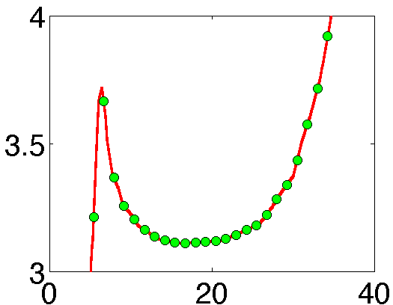
Thermodynamics of hysteretic systems
First proof of Negative Capacitance :
Salahuddin et al
New synthetic material systems
V_{C} (V)
t (μs)
Towards negative susceptibility in coupled charge-spin systems
A Khan et. al., Nature Materials, 2015
Mundy… Ramesh, Nature in press
Use-Inspired Computational Materials Discovery
Ultra-fast probes of Dynamics

Slide 8
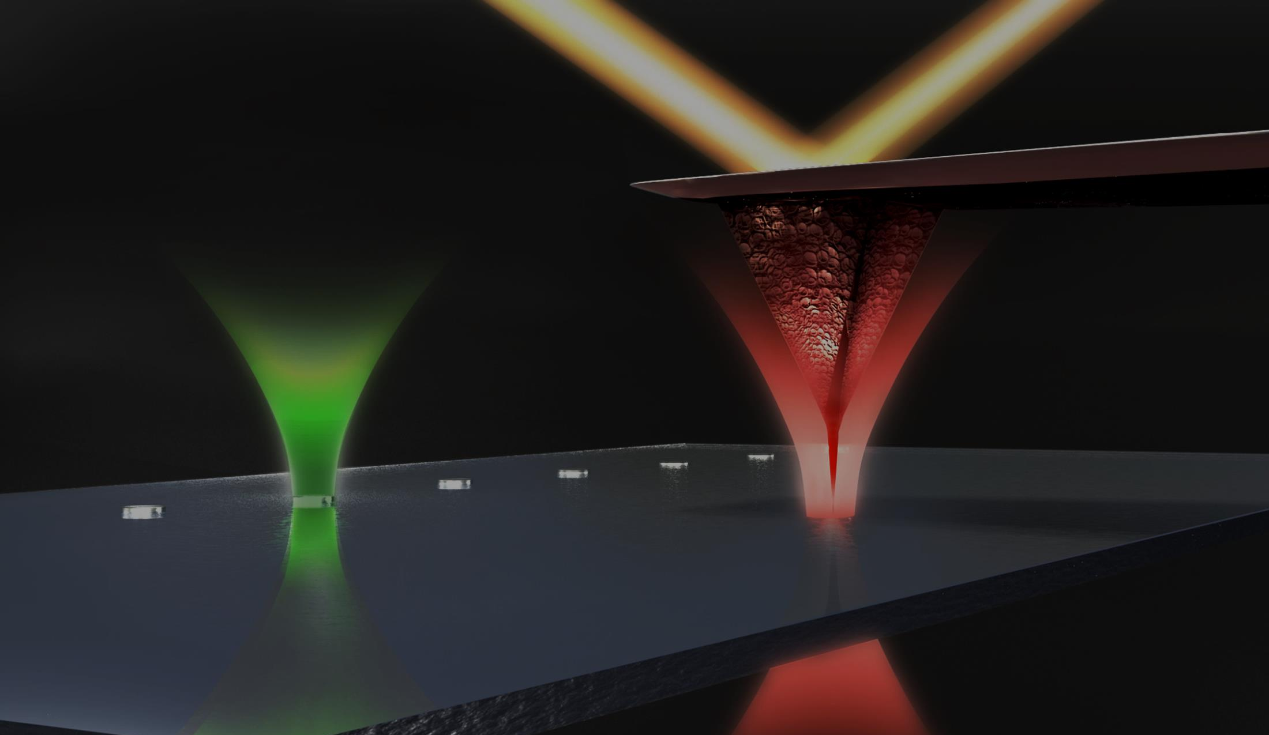
Materials Characterization
Notes:
Quote “you cannot fabricate what you cannot measure”

Slide 9
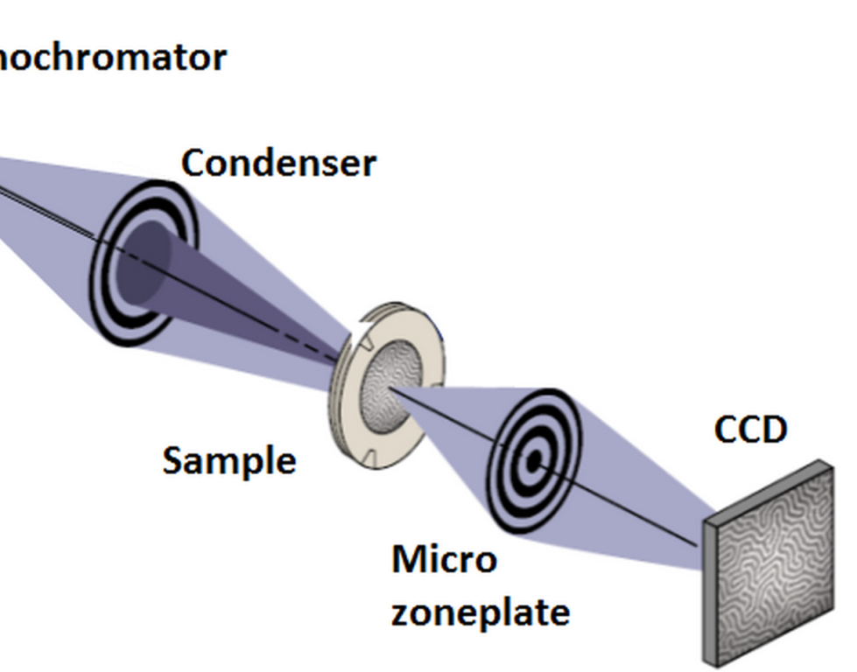
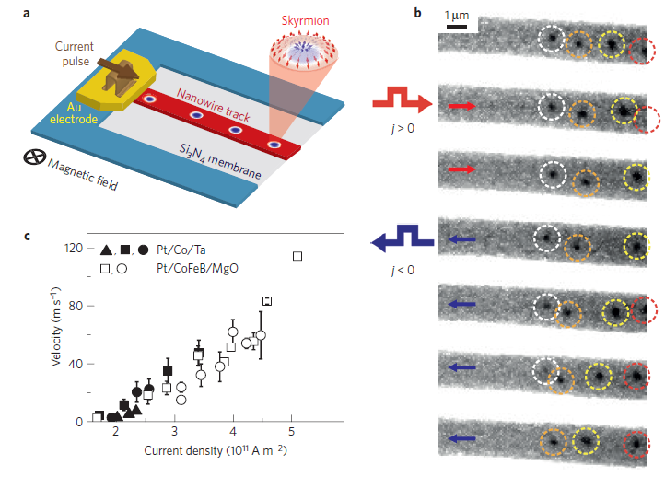

Soft-x-ray projection microscopy
Visualizing spintronic materials
dynamics of skrymion motion
~1 femtojoule switching demonstrated
Nature Materials 15, 501 (2016)
Notes:
~1 femtojoule demonstrated, theoretical limit for skrymion is ~1/10 to 1/100 of attojoule, CMOS is ~1 picojoule

Slide 10
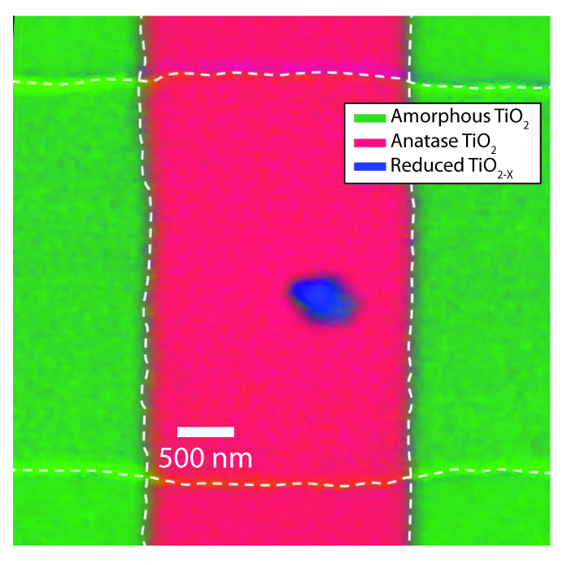
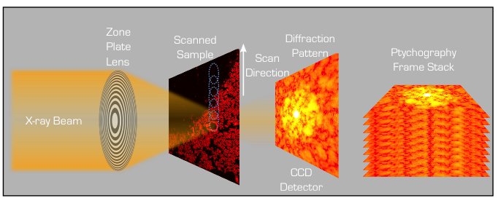
Soft-x-ray scanning microscopy Visualizing device materials and structure
top-down view of a memristor providing chemical and structural information
Ptychography
Adv. Mater. 28 (2016)

Slide 11
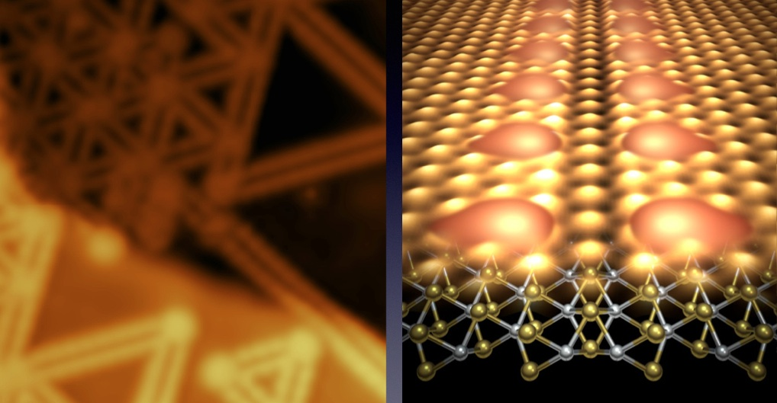
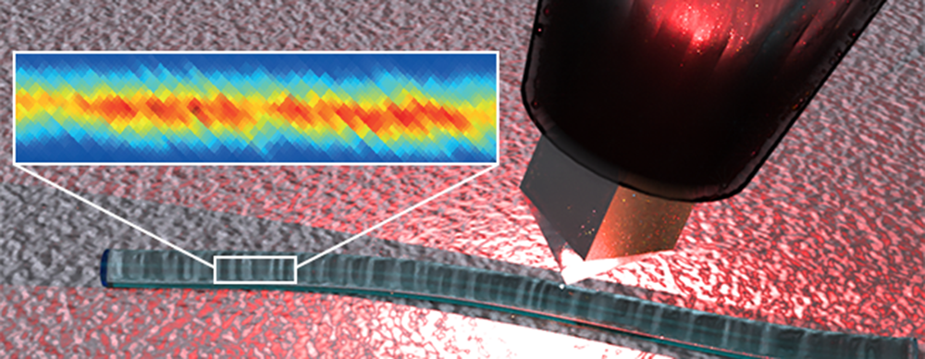

Mapping optical properties at the nanoscale
Plasmonic scanning probe microscopy
Charge density states in 2D materials
Nat Phys. 2016
Notes:
Found defects that effectively form single atom wide superconducting wires in Transition Metal Dichalcogenides (TMDs).

Slide 12
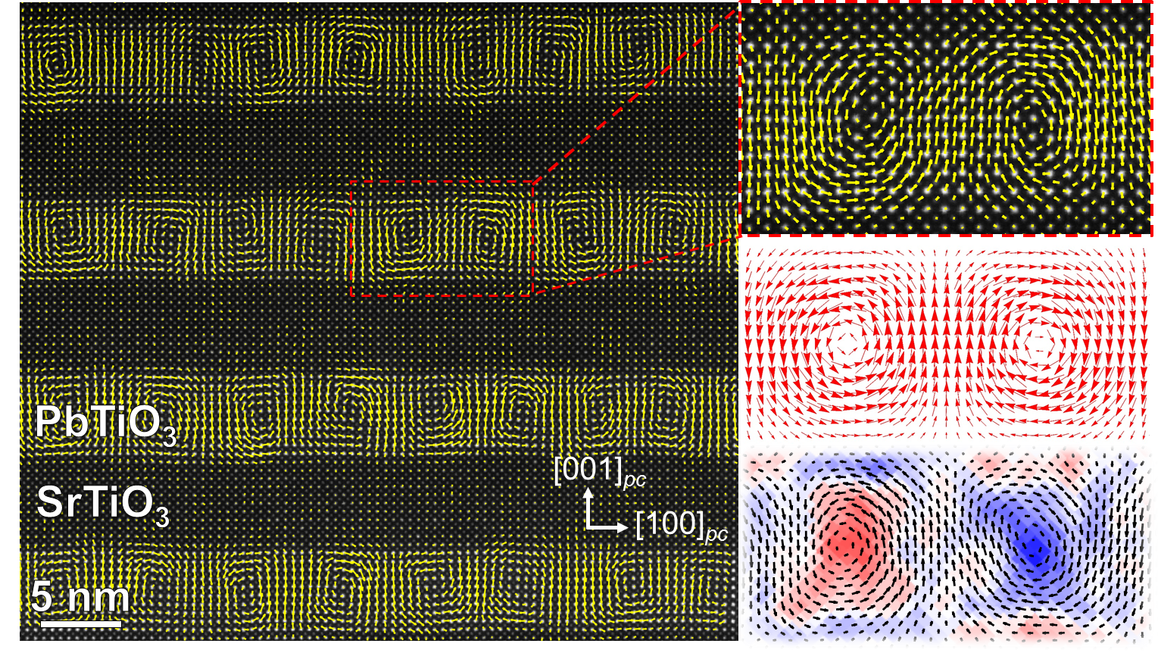
TEAM 05 Microscope (0.5-Å Resolution)
Notes:
0.5 Angstrom resolution

Slide 13
EUV Lithography: the future of manufacturing
Mask
k₁λ
Res. =
Demag. optic
NA
k₁ ≥ 0.25
Wafer

Slide 14
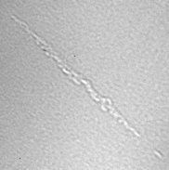
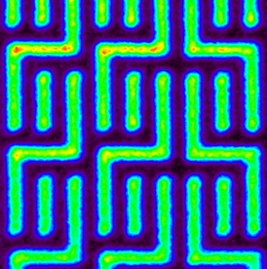
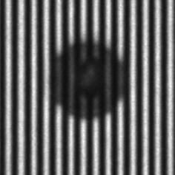
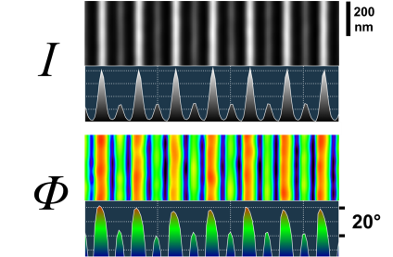
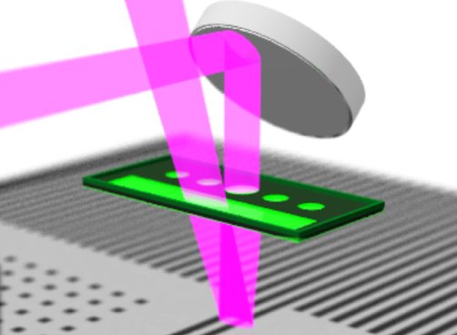
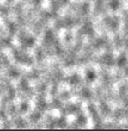
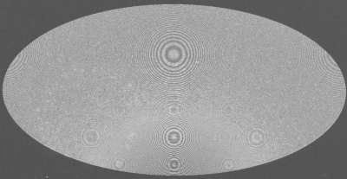

EUV mask research down to 2-nm node
Variable NA: 0.250–0.625
Coherence: Programmable
Magnification: Variable
Imaging modes: Bright, Dark, Zernike, DIC …
Blank Defects
OPC Calibration
Pattern Defects
SRAF @ phase
ML Roughness
Anamorphic
…

Slide 15
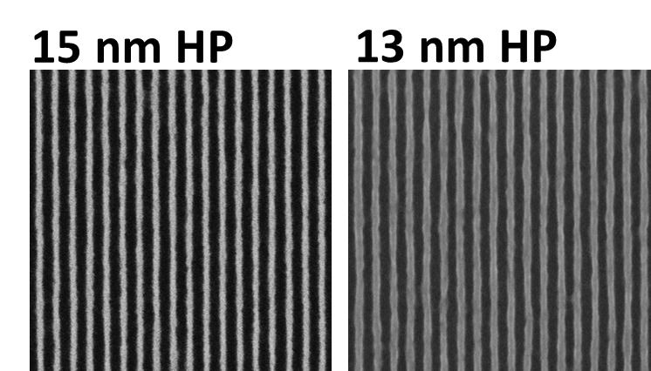




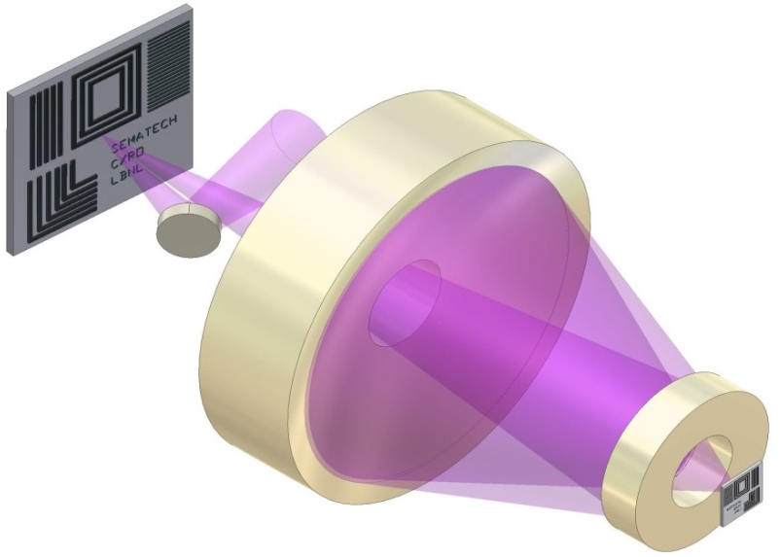
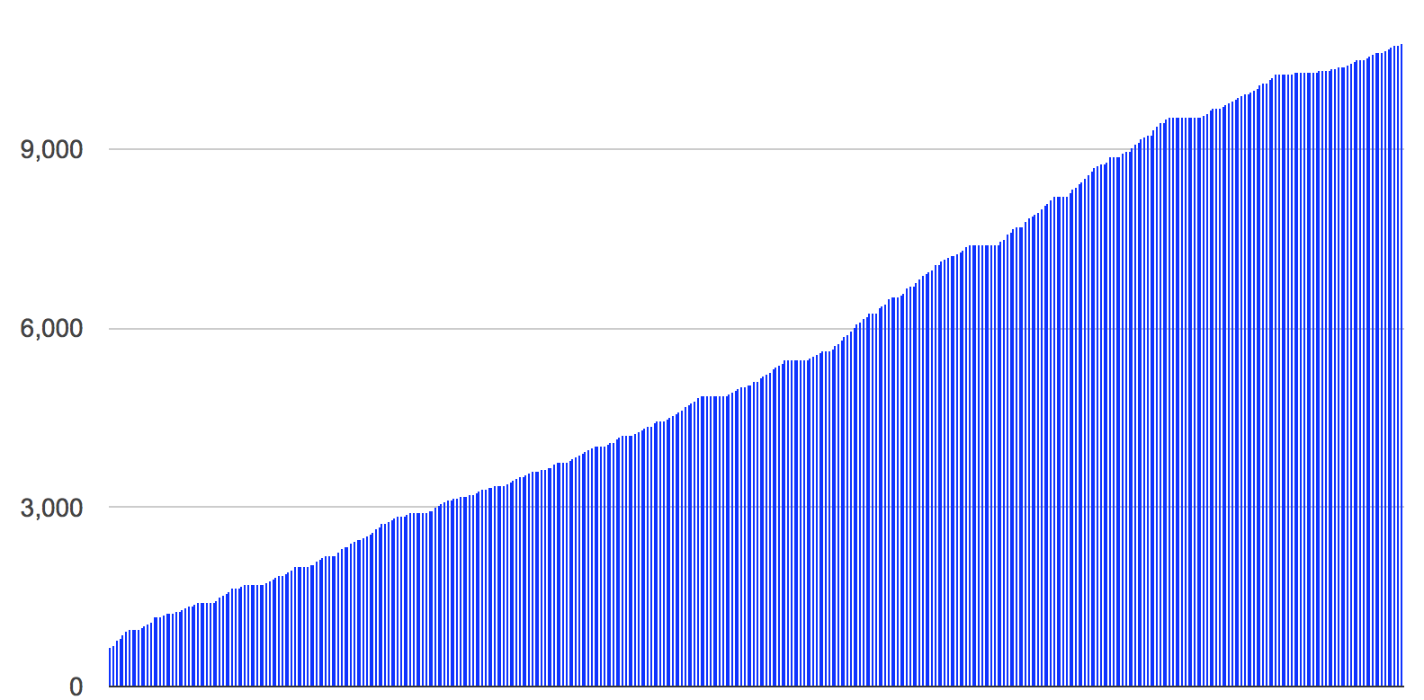
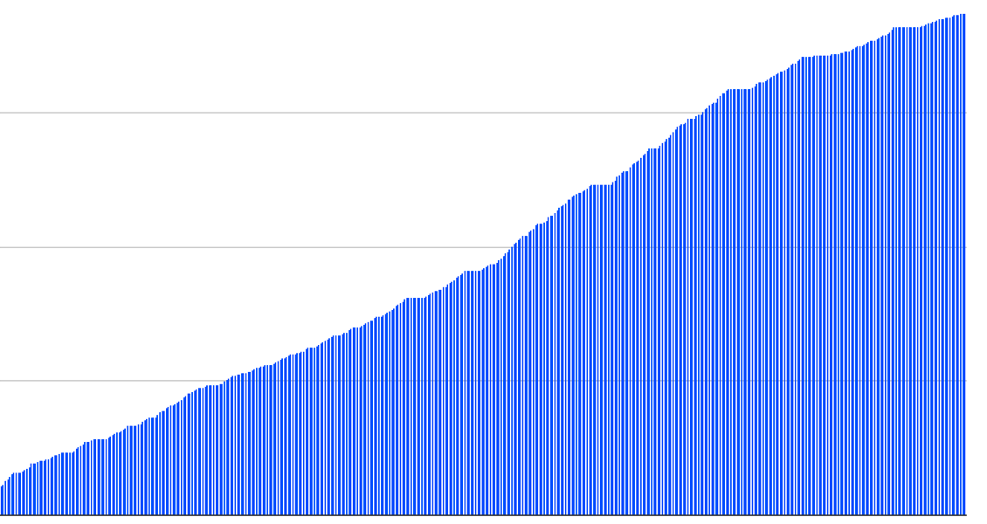



EUV 0.3-NA MET: engine for materials learning
Resolution limit = 13 nm
Programmable illumination
Ultraclean light source
Nearly 12,000 materials tested

Slide 16
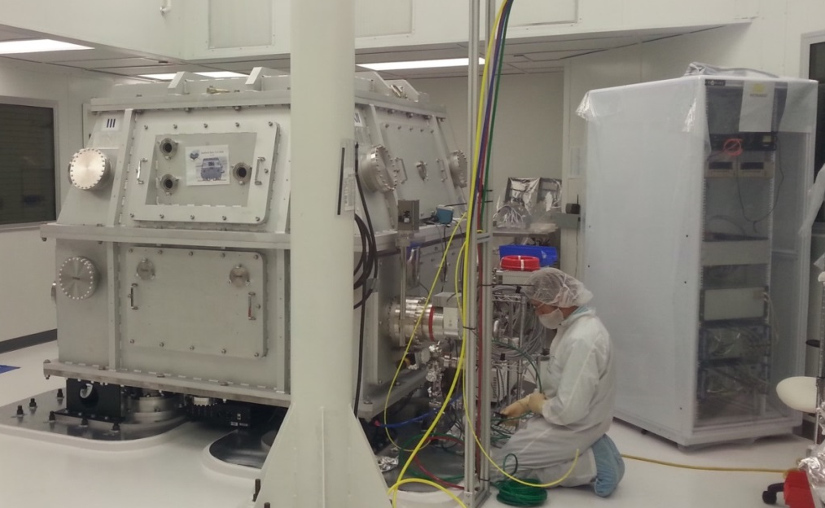

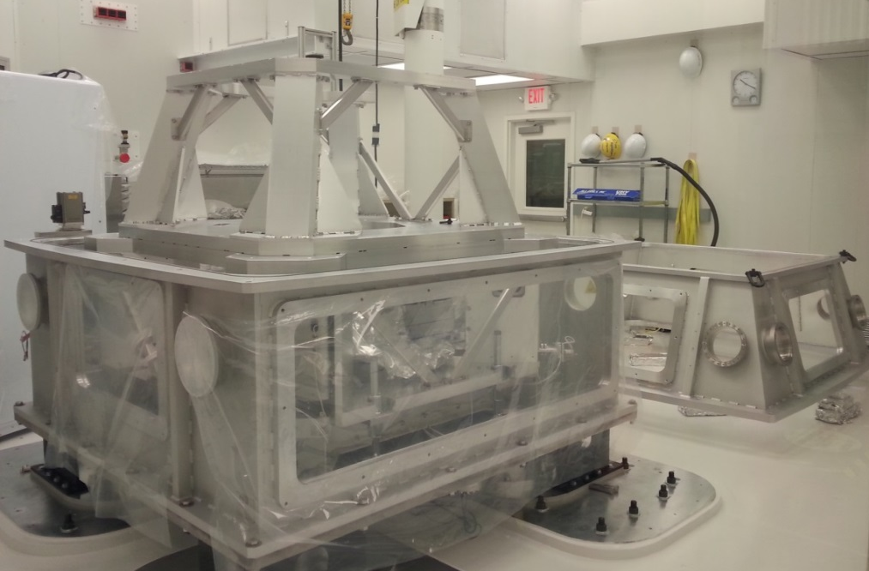
Coming soon
3-nm node patterning
Resolution limit = 8 nm
Programmable illumination
Integrated wavefront metrology
Robotic linked track

Slide 17
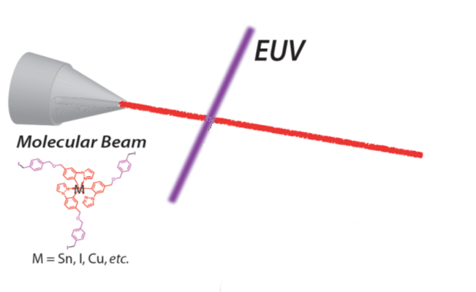
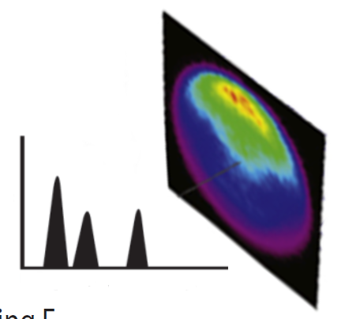
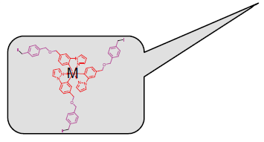

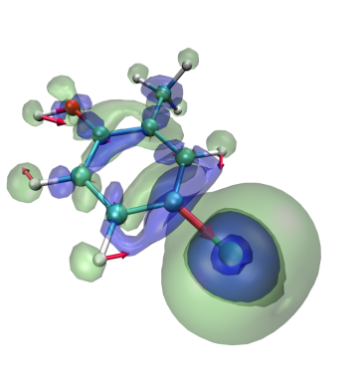




EUV
Resist
Research:
radiation chemistry
Measure
EUV
Count
Electron Energy
Molecular resist
Model
Synthesize

Slide 18
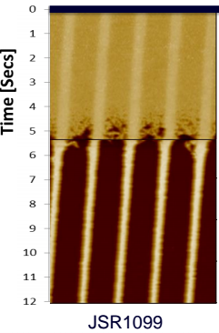
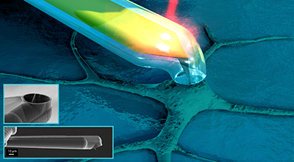
EUV Resist Research: dissolution chemistry
Start of developer injection
Encased cantilever for fast response in liquid

Slide 19
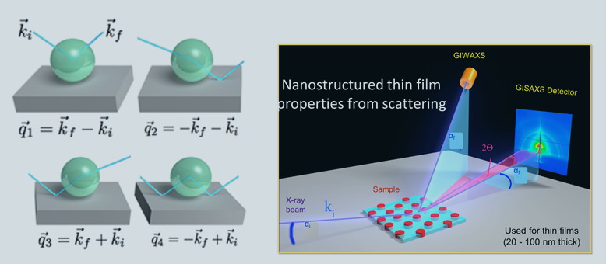
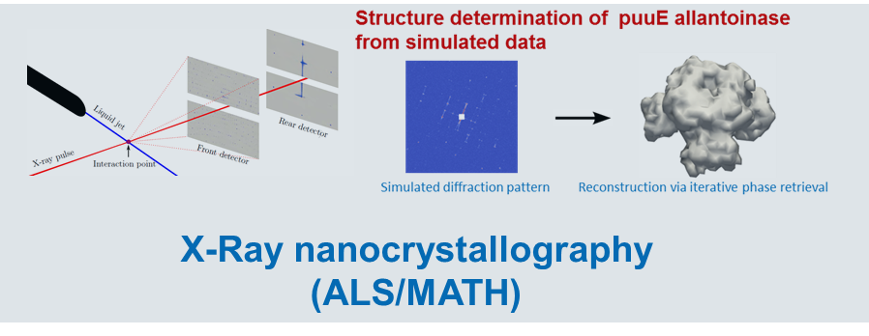
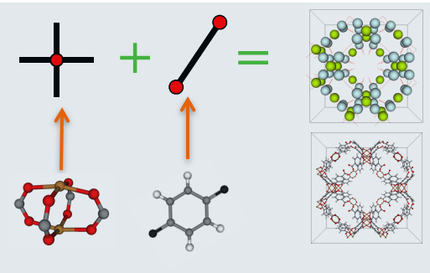
CAMERA Program: Leveraging Applied Math
Pytchography (ALS)
GISAXS (ALS)
Coherent Diffraction with Microscopy
Materials by design (Molecular Foundry)
X-ray crystallography (ALS)

Slide 20
Modeling and Simulation for Materials Discovery

Slide 21


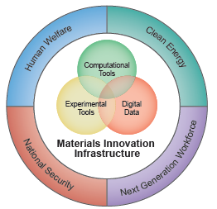
MGI & Materials Project: Achievements to Date
2011: “make the process of discovery & development of advanced materials faster, less expensive, more predictable”
“solutions in most pressing areas require advanced materials”
  > 70,000 relaxed compounds: validated energy, phase diagrams
  > 70,000 Pourbaix diagrams: world’s largest set
  > 43,000 band structures + higher accuracy 2,700 band gaps
  > 3,000 elastic tensors: world’s largest data set
High-Quality Materials DATA
Rapid DISSEMINATION
Ten Apps enabling material searching and design
First Materials data API ; community download > 8 million data
MPContribs framework: platform for data sharing
Over 20,000 registered users !
DESIGN
Design of novel functional materials
(photocatalysts, thermoelectrics, cathodes/electrolytes)

Slide 22
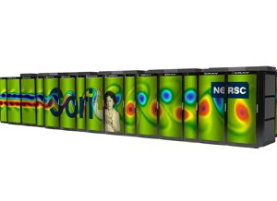
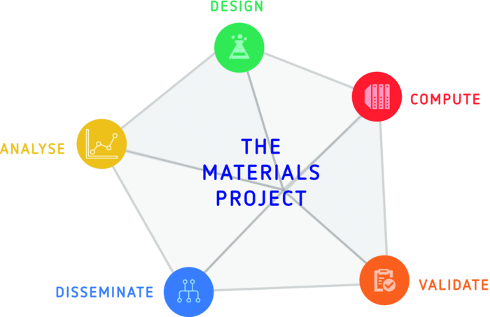
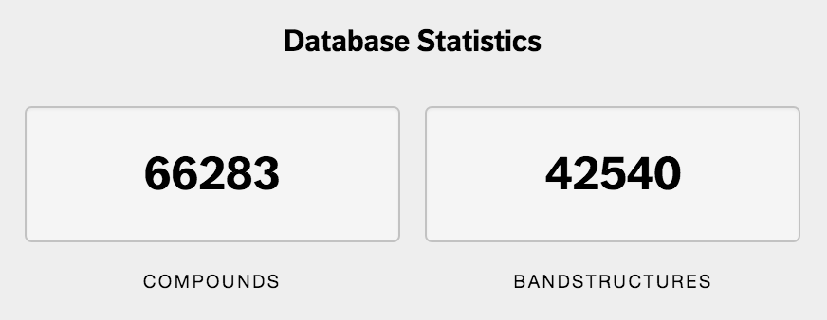


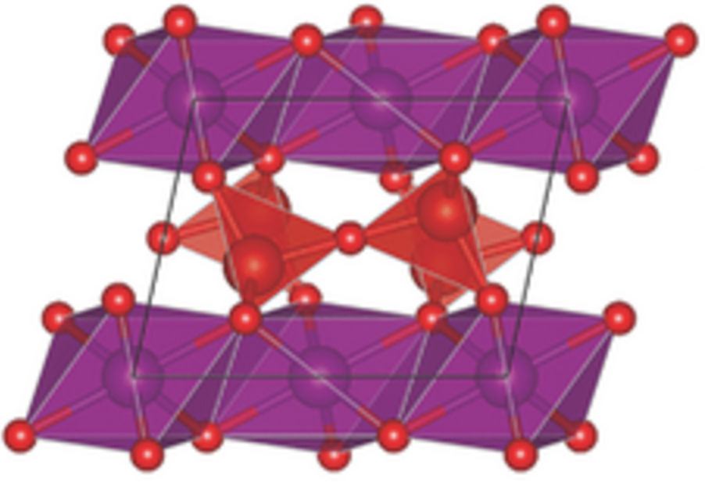
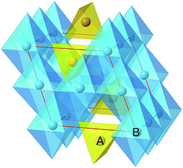
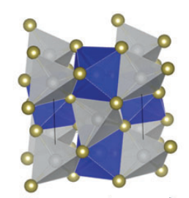
High-throughput screening of Novel Materials
Using first-principles calculations and Big Data Analytics on HPC
Earth-abundant photocatalysts
Beyond Li-ion batteries
Advanced thermoelectrics
Candidates and design principles for advanced materials
Capability to accelerate discovery of new materials by factor of 1000x
Notes:
A schematic of our general workflow. We use tools like pymatgen, fireworks, vasp, and mongodb in concert to generate large libraries of materials data, which we then can subject to filters to determine candidate materials for more thorough theoretical or experimental testing. Using these methods, novel photocatalysts (Mn2V2O7) for water splitting and thermoelectrics (TmAgTe2) have been confirmed by experiment to have properties appropriate for their respective applications.

Slide 23
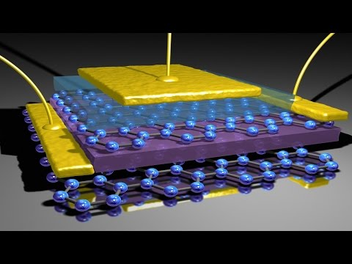
Device-Scale Modeling & Simulation
Accelerate development & optimization

Slide 24





Holistic Electronic Device simulations
HPC4MFG Example: LBL+Global Foundries
Combined several techniques for a holistic,
ab-initio, atomistic (beyond TCAT) device simulation
LS3DF Device-size selfconsistent ab initio calculations to
get atomistic potential profile, band alignment,
based boundary conditioned Poisson solver
Based on the potential profile, and scattering state calculations
to simulate the device transport, and leakage current etc.
Using electron-phonon coupling to calculate the heat generation
and dissipation at atomic scale
A shallow defect state in Si.
the electron (left) and hole (right) localizations in a bulk CH₃NH₃PbI₃ material. The small dots are atoms.

Slide 25

Systems and Architecture

Slide 26


Current Architectures are Wasteful
(how far can we push architecture scaling using specialization?)
Even on today’s systems, Energy consumed by ALU Is 1-10% of energy consumed to get the data to the ALU and describe the operations to perform.
How to lower the cost of creating specialized/domain-optimized hardware?
Notes:
Can pose as: If we only wanted to build a machine for 1 of our 5 kernels, how fast and energy efficient would it be?
How close to that optimum is a more general-purpose, programmable architecture?
The pie chart is for a simple general-purpose CPU. Not even a complex out of order core.

Slide 27




Open Hardware (Synthesis & Simulation)
OpenSOC
Chisel
RISC-V
DSL for rapid prototyping
of circuits, systems, and
arch simulator components
Open Source Extensible ISA/Cores
Open Source fabric
To integrate accelerators
And logic into SOC
Back-end to synthesize
HW with different devices
Or new logic families
Re-implement processor
With different devices or
Extend w/accelerators
Platform for experimentation
with specialization
to extend Moore’s Law

Slide 28






Combining Compact Device Models with Hardware Architectural Simulators
Carbon nanotubes
Compact
Device Model
Tunnel FETs
Negative cap FETs
Superconducting logic

Slide 29
Concept: Solid State Virtual Fluid
Extreme (spatial) Specialization + New Devices + New programming models
Lawrence Berkeley National Laboratory
Stanford University
Compiles to MicroOps
Executes in Wavefronts
Notes:
Note: This is using images from the “PDECell_Images.pptx located in proposal/Figures/PDEcell_Images.pptx
Maximizes data locality by exploiting physical spatial locality of the problem space. The structure of the computational system closely matches that of the physical system it is modeling.
Addresses heat-density challenges by using lower-energy density device technology.
Addresses logic density challenge using monolithic 3D integration (and lower energy density
devices) to build out compute devices in the 3rd dimension.
Also addresses logic density and performance challenges through extreme specialization of the computational elements to meet the degrees of freedom of the target problem.
Addresses memory bandwidth challenge by integrating the compute and memory technology at the most fundamental level inside of the device (no distinction). This is even more tightly integrated than Processor-in-Memory in that the integration occurs within each tiled computational element.
Addresses logic complexity challenge and numerical precision challenge by using a streaming integer representation, which greatly reduces the complexity of the arithmetic units and eliminates sources of numerical round off error inherent in floating point representations.
Addresses the strong-scaling challenge (the need to scale performance only utilizing increased parallelism) using specialization of the compute elements to reduce the number of steps required to execute each clock cycle, and adopting the limit-case for strong scaling as its base design point (one computational element per computational cell for the problem domain)
How It Works/Innovative Claims/Risks
Provide additional information regarding technical approach and relevant prior research results
Graphics and/or plots that highlight characteristics and performance of approach vs. state of art
Conceptual diagrams or process flows
Define key risks and potential mitigation strategies

Slide 30

Programming for specialized, low power, hardware
Stencil Language
C
7 Giants of Data (NRC) | 7 Motifs of Simulation
Basic statistics | Monte Carlo methods
Generalized N-Body | Particle methods
Graph-theory | Unstructured meshes
Linear algebra | Dense Linear Algebra
Optimizations | Sparse Linear Algebra
Integrations | Spectral methods
Alignment | Structured Meshes
Analysis
OpenCL
Code Gene
Special ISA
Domain-specific analysis and code generation, e.g., stencils
Identify common computational patterns
Fermi on Science kernels
1024
single-precision peak
512
double-precision peak
256
DGEMM
DP add-only
128
RTM/wave eqn.
64
Device bandwidth
27pt Stencil
32
7pt Stencil
16
GTC/pushi
8
SpMV
4
GTC/chargei
2
¹/₃₂
¹/₁₆
¹/₈
¹/₄
¹/₂
1
2
4
8
16
32
Performance models, e.g., rooflne
Autotuning performance optimization
Notes:
New world order

Slide 31





Methods and Algorithms for increased parallelism and reduced data movement
Higher order methods
Parallel-in-Time methods: meshes and DFT
“C shadow”
“B shadow”
Real analytic, with rapidly convergent Taylor expansion
“A shadow”
Localized methods, e.g., MLC and LS3DF
Communication-Avoiding algorithms: linear algebra, graphs, particles

Slide 32
LBNL Capabilities and Interests: Summary
Primary Expertise & Interest Areas
Advanced Materials
Broad range of probes: Xray, Electron, near field,…
Advanced manufacturing techniques
New Device Architectures
Computer architecture/simulation
Algorithms, Applied Math
Most Differentiating Factor
The Materials Project
CAMERA
User Facilities (ALS/CXRO/Foundry/NERSC)
Industry Connections
Open silicon nanofab: UCB
Open computer architecture (RISCV)
Main Contribution/Role
Rapid design and search for novel electronic and manufacturing materials
Characterization and fundamental limits of materials and devices
Design and fabrication of novel computer architectures
Next generation manufacturing R&D and workforce (students)

Slide 34






Focus on HPC Critical Applications

Slide 35
Extreme Specialization: Spatial Architectures
Physical Form Matches Function

Slide 36
Accelerating Discovery Process
Model
Simulate
Synthesize
Prototype
Characterize
Measure

