Slide 1
Beyond Moore DOE Internal Lab Focused Meeting
Bill Harrod
DOE / ASCR
Sandia National Laboratories | Albuquerque, NM
July 27, 2016

Slide 2
Introduction
Computing is the backbone of national security (and the foundation of today’s world) – there is a relentless need for increasing performance, capacities and capabilities
We are now at a major turning point in semiconductor technology – it is unclear what directions “post-CMOS technology” will take, but … this period of flux offers the opportunity to partner with industry – CMOS lives beyond Moore’s Law
The previously reliable advances achieved by Moore’s Law has engendered laziness in design efforts – which has made architectural innovation now ripe for exploitation
Almost all new computing platforms will face the following five fundamental challenges: Performance, Efficiency, Memory/Storage, Resilience, and Concurrency
Manufacturability and Cost of new device technology are the ultimate challenges
Notes:
Computing - The process of utilizing computer technology to complete a task.
High Performance Computing - most generally refers to the practice of aggregating computing power in a way that delivers much higher performance than one could get out of a typical desktop computer or workstation in order to solve large problems.

Slide 3
Convergence of Compute and Data-intensive Science Critical to 21st Century Science, National Security, Economic Competiveness
Compute-intensive has always involved data-intensive
Can’t be decoupled even if we could afford to do so
Data-intensive problems face many of the same technology challenges as compute-intensive
Some are even worse for “big-data”
Energy use is the grand challenge
Data movement and memory issues dominate computing, resulting in computing inefficiencies
“… it would be a mistake to think of them [“big data” and “big compute”] as independent activities. Instead, their requirements are tightly intertwined since they both contribute to a shared goal of scientific discovery.” (ASCAC report on Synergistic Challenges in Data-Intensive Science and Exascale Computing page 5)

Slide 4
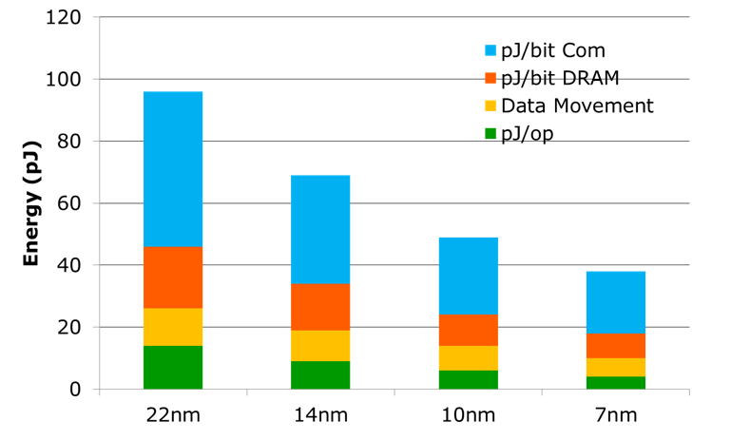
From Giga to Exa, via Tera & Peta
1.5x from transistor
670x from parallelism
Basic compute loop
Exa
Peta
8x from transistor
128x from parallelism
Tera
32x from transistor
32x from parallelism
Giga
Shekhar Borkar, Intel

Slide 5
Executive Order - July 29, 2015
EXECUTIVE ORDER
- - - - - - -
CREATING A NATIONAL STRATEGIC COMPUTING INITIATIVE
By the authority vested in me as President by the Constitution and the laws of the United States of America, and to maximize benefits of high-performance computing (HPC) research, development, and deployment, it is hereby ordered as follows:
The NSCI is a whole-of-government effort designed to create a cohesive, multi-agency strategic vision and Federal investment strategy, executed in collaboration with industry and academia, to maximize the benefits of HPC for the United States.

Slide 6
National Strategic Computing Initiative July 29, 2015
INTENT
National
“Whole-of-government” / “whole-of-Nation” approach
Public/private partnership with industry and academia
Strategic
Leverage beyond individual programs
Long time horizon (decade or more)
Computing
HPC = most advanced, capable computing technology available in a given era
Multiple styles of computing / all necessary infrastructure
Scope: everything necessary for fully integrated capability
Theory and practice, software and hardware
Initiative
Above baseline effort
Link and lift efforts
STRATEGIC THEMES
Create systems that can apply exaflops of computing power to exabytes of data
Keep the U.S. at the forefront of HPC capabilities
Improve HPC application developer productivity
Make HPC readily available
Establish hardware technology for future HPC systems

Slide 7
Future Hardware Technology Challenges NSCI
Extending CMOS
Serious problems as transistor lengths approach 5nm (Feature size 1.5nm)
International Technology Roadmap for Semiconductors predicts 2028
Other Possibilities
Memristors, carbon nanotubes, cryogenic operation, quantum computing
All show promise, but nowhere near commercial deployment
HPC technology must fit within much larger context of consumer products
Other Impacts
New architectures
New programming models based on localized data
Need for fault tolerance at higher hardware and software layers
New algorithms, languages, software

Slide 8
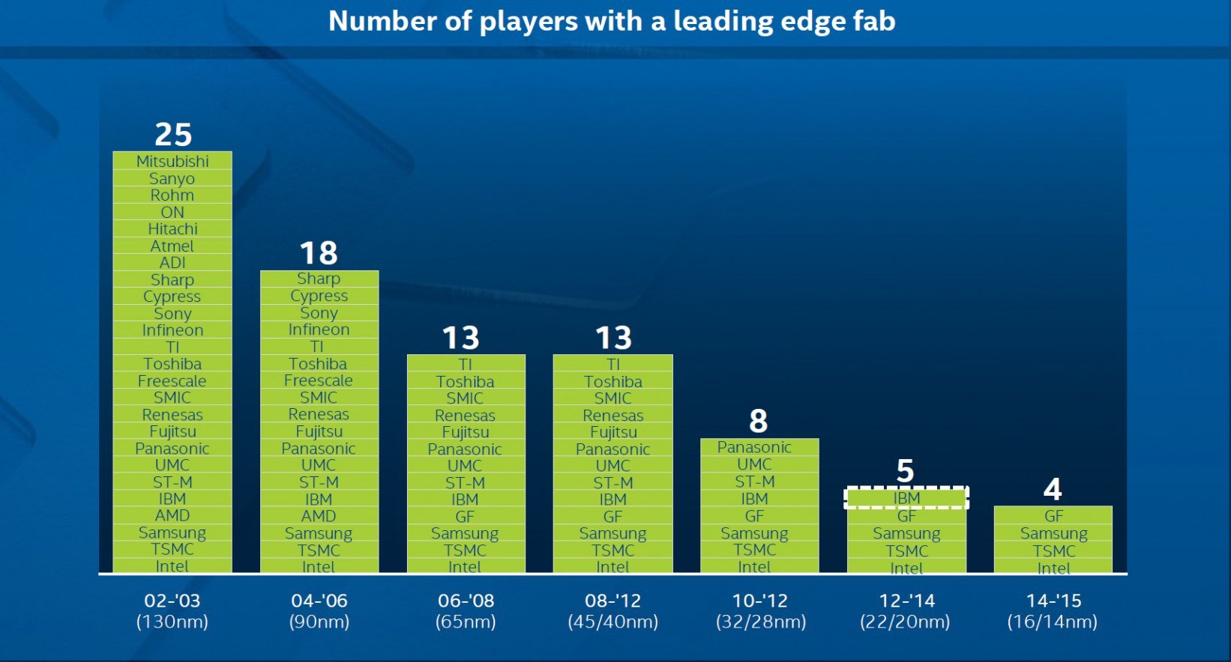
Uncertainty Threatens US Economic Growth
2015 - Q4 update | Amounts in US$M |  |  |  | Year on Year Growth in %
 | 2014 | 2015 | 2016 | 2017 | 2014 | 2015 | 2016 | 2017
Americas | 69,324 | 68,738 | 69,664 | 71,996 | 12.7 | -0.8 | 1.3 | 3.3
Europe | 37,459 | 34,258 | 33,698 | 34,536 | 7.4 | -8.5 | -1.6 | 2.5
Japan | 34,830 | 31,102 | 31,277 | 32,125 | 0.1 | -10.7 | 0.6 | 2.7
Asia Pacific | 194,230 | 201,070 | 201,453 | 207,792 | 11.4 | 3.5 | 0.2 | 3.1
Total World - $M | 335,843 | 335,168 | 336,092 | 346,450 | 9.9 | -0.2 | 0.3 | 3.1
The world has changed – technology is changing at a dramatic rate
Dennard Scaling has ended
End of Moore's Law looming
The IT marketplace is also changing dramatically
PC sales have flattened
Handhelds dominate growth, H/W and S/W
Internet of Things (IoT): explosive growth
HPC vendor uncertainty
Semiconductors were America’s number three manufactured export over the last five years
2014 sales were $172.9 billion
51 percent of the $335.8 billion global market
Nine out of the top 20 semiconductor companies are American
Worldwide OEM Electronics Assembly Market 2015 - Estimated at > $1.4 Trillion
Worldwide semiconductor market Source WSTS: 02/25/2016
Source: Intel
Notes:
On a revenue basis, China imported 65% of the global semiconductor market production ($218.4 billion versus $335.8 billion) in 2014, as most electronic products are made in China.

Slide 9
Sunway TaihuLight System
Developed by National Research Center of Parallel Computer Engineering & Technology
Installed at National Supercomputing Center in Wuxi
Cost shared: Central government, City of Wuxi, Jiangsu province
Specifcations:
ShenWei (Sunway) 26010 processor
Peak = 125.4PF (peak); 93PF LINPACK
1.31 PB memory
15MW power usage
Chilled water cooling
5-level interconnection network
~$270M for R&D + acquisition

Slide 10
Sunway Supercomputer Early Applications
Four application domains targeted
Advanced manufacturing: CFD, CAE applications
Earth system modeling and weather forecasting
Life science
Big data analytics
Three Gordon-Bell applications* submitted:
Climate: a fully-implicit nonhydrostatic dynamic solver for cloud-resolving atmospheric simulation;
Climate/weather/seismic: a highly effective global surface wave numerical simulation with ultra-high resolution; and
Materials processing/other: large scale phase-field simulation for coarsening dynamics based on Cahn-Hilliard equation with degenerated mobility
*The prestigious Gordon Bell Prize ($10,000) is awarded each year to recognize outstanding achievement in high-performance computing, rewarding innovation in applying high-performance computing to applications in science, engineering, and large-scale data analytics

Slide 11
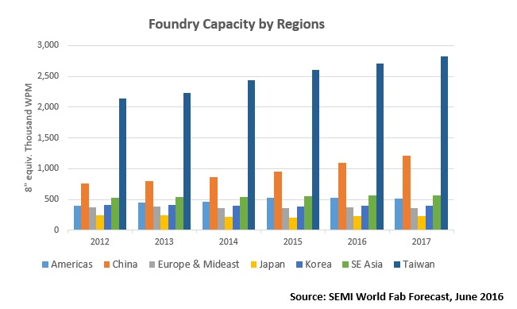
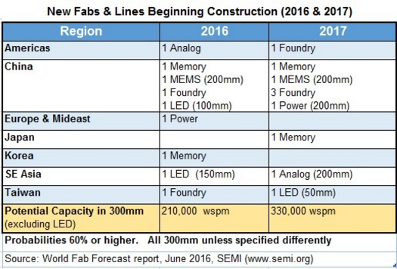
China Investments in Chip Fabrication Facilities

Slide 12
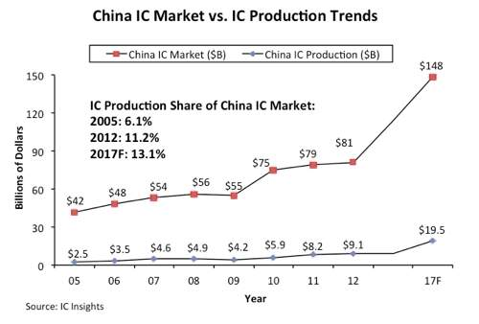
China: "National Guideline for Development of the IC Industry"
In the 1970s, China had several state-run chipmakers, but those concerns were far behind the West in terms of IC technology. So starting in the 1980s, China began to embark on several initiatives to modernize its IC industry.
The latest effort was launched in 2014, when China unveiled what it called the “National Guideline for Development of the IC Industry.” The plan is to accelerate China’s efforts in a number of areas, such as 14nm finFETs, advanced packaging, MEMS, memory, and various IoT-related processors.
SMIC, Huawei, imec, and Qualcomm in Joint Investment on SMIC's New Research and Development Company
A Joint Collaboration is Set Up to Build China's Most Advanced Integrated Circuit Research and Development Platform. The current focus will be on developing 14nm logic technology.
China created a $19.3 billion fund, which will be used to invest in its domestic IC firms. Over the next decade, local municipalities and private equity firms could spend $100 billion across China's IC sector.
Source: Semiconductor Engineering .:. What China Is Planning

Slide 13
Proposed Areas of Investment by the US Government There is not a simple solution for regaining the performance growth
Materials Research
Computer Science
Advanced Manufacturing
Experimental and theoretical research to provide the knowledge base for the discovery and design of new materials
Computational approaches to semiconductor materials design
Short term focus on materials for augmenting silicon
Longer term focus on materials for new post-CMOS devices
Advanced computing for investigating new architectures
Communications and data centric architectures
New generation of heterogeneous architectures
From system on a chip and specialization designs to cabinet level
3D and 2.5D designs
New programming models, application software, system software and tools
Move revolutionary low-energy devices and architectures from Lab to Fab
Accelerate development and manufacturing base for semiconductor devices
Dramatically reduced vendor’s cost for advanced fabrication of new technologies
Public-private partnerships with electronics, opto-electronics, and computer industries
Notes:
WHY the Government instead of industry?
Big semiconductor companies follow low risk evolutionary approaches: too slow to meet energy needs
Small companies lack the resources and scale for this challenge

Slide 14
Final Words
The semiconductor industry is crucial to the U.S. economy – drives a > $2T/yr IT market
What’s after CMOS? – augmented CMOS & substantially improved HW/SW architectures
There is an exponentially increasing demand for information technology – new technologies are limited by cost to develop and manufacture, not due to a lack of innovations
It isn’t clear what is the enabling technology for the “Post CMOS” | “Post Moore’s Law” epoch – requires involvement from many different organizations, demands innovations in architecture
We need to stop trying to make tomorrow's computers look and operate like yesterday’s computers – don’t be constrained by the von Neumann paradigm
We need to start investing in new materials, innovative architectural designs and the development of high performance, energy efficient, heterogeneous systems
Need government-DOE laboratory-university-industry public-private partnership to attack the “Post CMOS” challenges (a new Sematech-like effort that protects USA interest)

Slide 15
Back Up

Slide 16
Memory Technology Score Card
Summary
 | SRAM | DRAM | Flash | PCM | STT | FeR | Mram | Rram
Capacity | Low | High | V High | V High | Low | Low | Low | High
Performance | High | Med | Low | Low | Med | Low | Low | Low
Energy | Low | Med | High | High | Med | ? | High | ?
Endurance | High | High | Low | Low | High | Med | High | Med
NV | No | No | Yes | Yes | Yes | Yes | Yes | Yes
Scalable | Yes | Yes | Yes | Yes | Yes | Limited | Limited | Limited
Maturity | High | High | High | Med | Low | High | Med | Low
SRAM, DRAM, NAND, and PCM will be the only mature technologies (10 Years)
Primary high endurance memory technologies remain SRAM and DRAM
DRAM likely to remain the best choice for capacity memory
Advances in platform architecture needed for NAND, PCM based storage class memories
Small and fast
Balanced (capacity, speed, energy)
High capacity with less activity
???

