Slide 1
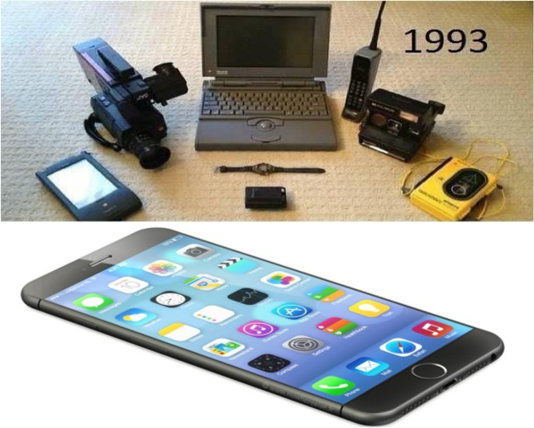







Beyond Moore DOE Internal Lab Focused Workshop:
LANL Capabilities and Interests
Antoinette Taylor and John Sarrao
Los Alamos National Laboratory

Slide 2
Co-design, broadly defined, is required for success, and LANL has significant expertise and breadth
Partnerships and external engagement are important
  User facilities, Centers & Institutes, industrial relationships a strength
  Beyond Moore is a problem well-suited to an ecosystem of Labs
LANL has significant co-design expertise and breadth
  Our materials strategy emphasizes controlled functionality
    With a particular focus on integrated nanomaterials and complex functional materials
  We have experience in translation and scaling
    Superconductivity Technology Center, Fuel Cells, Quantum Dots, Perovskite solar cells
  We are active in non-general-purpose algorithms and systems
    Probabilistic computing, resiliency, quantum algorithms, performance emulation
  Testbeds and technology exploration are central to our strategy
    Roadrunner, D-wave, Darwin, Trinity …

Slide 3
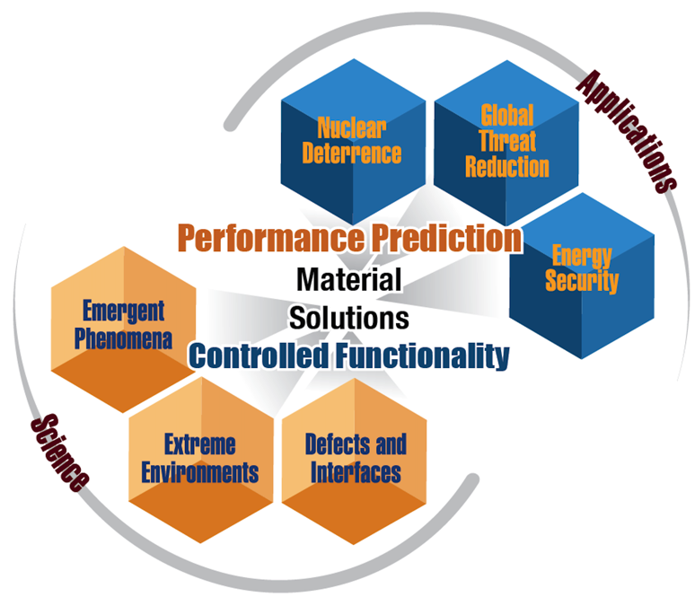


Goal of LANL’s Materials Pillar: Control of materials functionality in support of National Security
Nano-materials synthesis and characterization
Research with high magnetic fields
  Integrated Nanomaterials
  Complex Functional Materials

Slide 4












The Center for Integrated Nanotechnologies (CINT) emphasizes integration
Core Facility at Sandia
96,000 sq ft total
30,000 sq ft lab space
9,000 sq ft clean room
Gateway Facility at Los Alamos
36,500 sq ft total
11,000 sq ft lab space
Nanoscience Integration:
Functional
Nanomaterials
Co
CdSe
Composite Structures
Active, Functional Systems
500 nm
10 nm
nanometer
micron

Slide 5
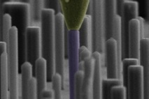
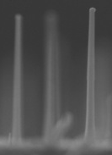
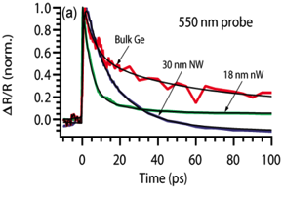
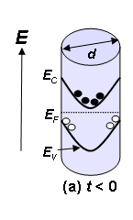
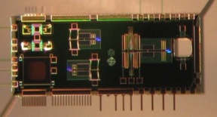
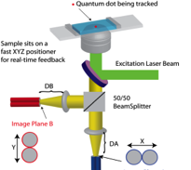
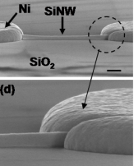
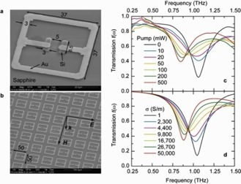

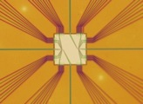
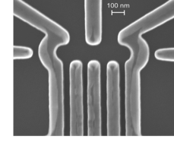
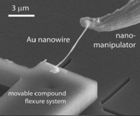
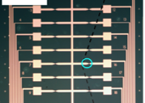
CINT differentiating strengths include…
Ultrafast photonics
Nano-manipulation & scanning probes
Nanofabrication
Discovery PlatformsTM
Carrier Dynamics
Electrical
Synthesis
Nanomechanics &
Thermal Transport
Conducting
probe
~ 30nm
~ 1 μm
Optical
Directed Assembly
THz Metamaterials
Quantum Computing &
Electrical Transport
Mechanical
CINT user
C. Volkert
project

Slide 6
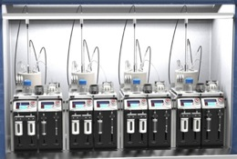
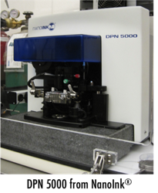
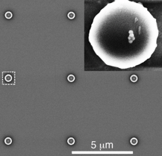
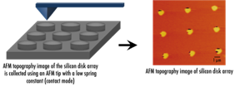
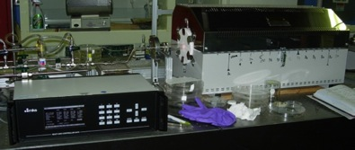
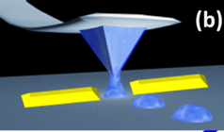

LANL’s synthesis capabilities span the mesoscale
Giant Quantum Dots (gQDs) and Hybrid Plasmonic-gQDs
Automated Nanomaterials Synthesizer: Computer-controlled synthesis and in situ/real-time diagnostic
Solution-phase processing for chemical manipulation of carbon nanotubes
CVD growth capability for carbon nanotube and large area graphene synthesis
Surface Chemistry and Functionalization: Defining surface environment and chemical functionality to optimize ability for materials integration and tune materials interactions
Dip-pen nanolithography (DPN): Precision nano/meso-scale integration
Example DPN Process

Slide 7
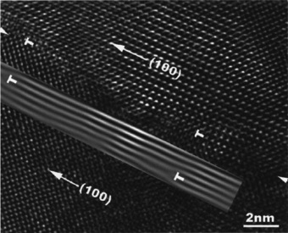
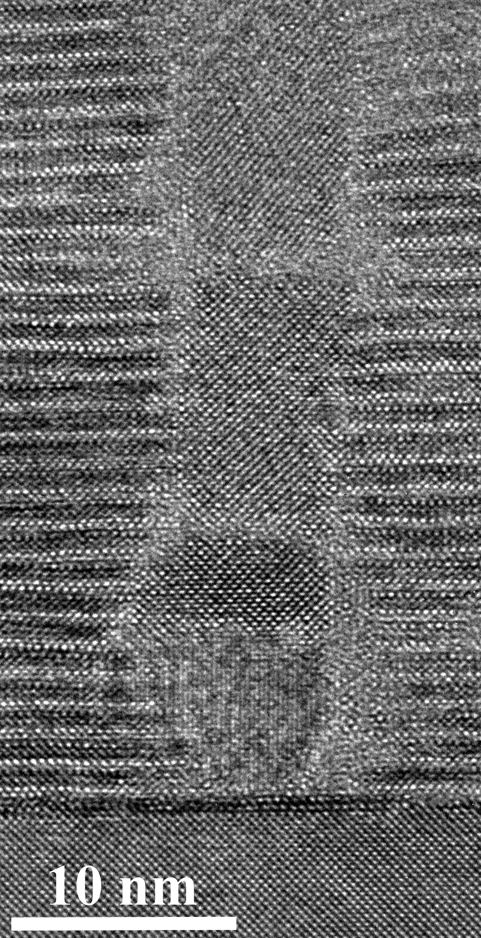
Thin film & composite capability enable device fab
Single crystalline YBCO on polycrystalline or amorphous substrates using IBAD MgO
Engineering of Self-Assembled Nanostructures
Particulate
Atomically smooth & clean interfaces
BZO second phases in epitaxial YBCO FILMS:
J. Driscoll et al., Nat. Mat. 3, 439 (2004) – 523 citations
B. Maiorov et al., Nat. Mat. 8, 398 (2009) – 151 citations
YBCO
STO
Laminar-like
S.R. Foltyn et al., APL 82, 4519 (2003) – 95 citations
Strain manipulation and control
Fabrication & characterization of epitaxial films of superconducting nitrides
Vertically aligned nanocomposite: switch from lateral to vertical strain.
Phase 1
Phase 2
Substrate
NbN:
G. Zou, et al., Chem. Commun. 10, 6022 (2008)
MoN:
Y.Y. Zhang et al., J. Am. Chem. Soc. 133, 20735 (2011);
N. Haberkorn et al., SuST 26, 105023 (2013)].
J. Driscoll et al., Nat. Mat. 7, 314 (2008) – 89 citations
S. Harrington et al., Nat. Nanotech. 6, 491 (2011).

Slide 8
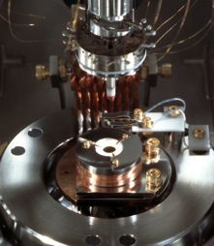
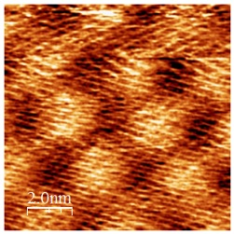
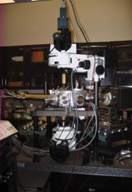
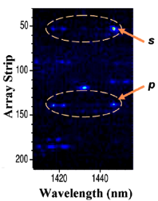
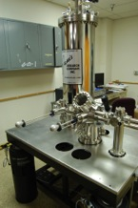
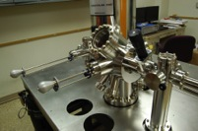
Microscopies – nanoscale spatial characterization and manipulation
Atomic/Magnetic Force Microscopy – chip structural, magnetic, electronic and thermodynamic characterization at the mesoscales:
UHV environment
Variable temperature: T=25÷600 K
Wide range of operation modes: STM, AFM, MFM, Scanning Thermal Microscopy
Coupled to ultrafast laser system for dynamic in situ manipulation
Near-Field and Confocal Optical Microscopy – manipulation at the sub-μm scales:
Broad spectral range: 400-1700 nm
UHV/Low-T capability: T~ 4 K
Magnetic field (5 Tesla)
Scanning photo-current microscopy/spectroscopy
Spin-polarized STM – characterization/manipulation at the atomic scales:
Variable Temperature 5-300 K
Vector Magnetic Field (~1.5 T Tesla)
Coupling to ultrafast laser system
Notes:
LANL posseses unmatched suit of capabilities for ultrafast nanoscale qubit fabrication, characterization and manipulation

Slide 9
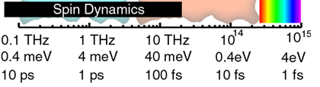
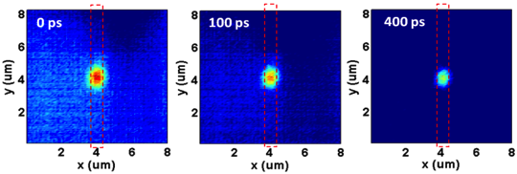
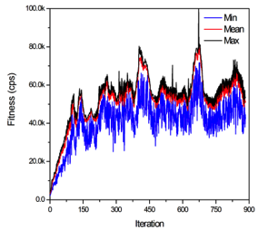
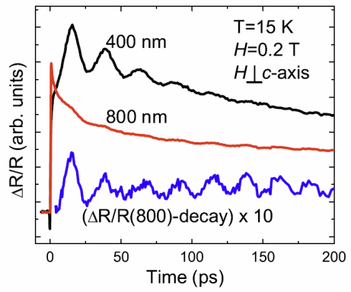
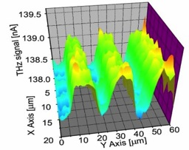
Ultrafast Spectroscopy – temporal/excited state characterization
Ultrashort optical pulses:
Probe dynamic limits of material and device performance Manipulate materials and device on fs time scales
Broadband Optical Spectroscopy
  Spanning infrared to ultraviolet
  Coherent control of pulse amplitude, phase and polarization
  Sub-micron imaging
  Spin specific probes
Ultrafast THz spectroscopy
  Coherent detection of amplitude and phase
  Apertureless THz-NSOM provides sub-μm resolution
Single Si nanowire dynamics
Coherent magnons
in Ba_{0.6}Sr_{1.4}Zn₂Fe₁₂O₂₂
Coherent control
of plasmon localization
THz NSOM on Si/Au

Slide 10
LANL possesses broad complex materials and device modeling capabilities
Electronic, magnetic, optical properties of complex functional materials
Spin detection: Spin noise, Nonequilibrium dynamics
Nanomaterials, Metamaterials, Casimir physics.
Organic electronics and spintronics; device physics.
Techniques: QMC, DFT, Quantum Annealing, etc.
Condensates: BEC, ultra-cold gases.
Quantum communication, cryptography, algorithms.
(D. Dalvit, A. Piryatinski, S. Trugman, N. Sinitsyn, D. Mozyrsky, J.-X. Zhu, S.Tretiak, A. Balatsky)

Slide 11
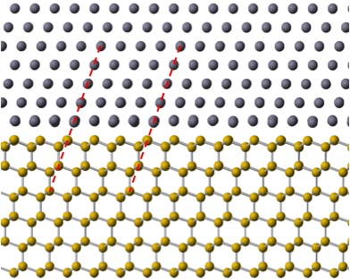

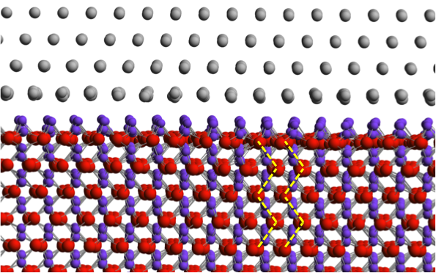
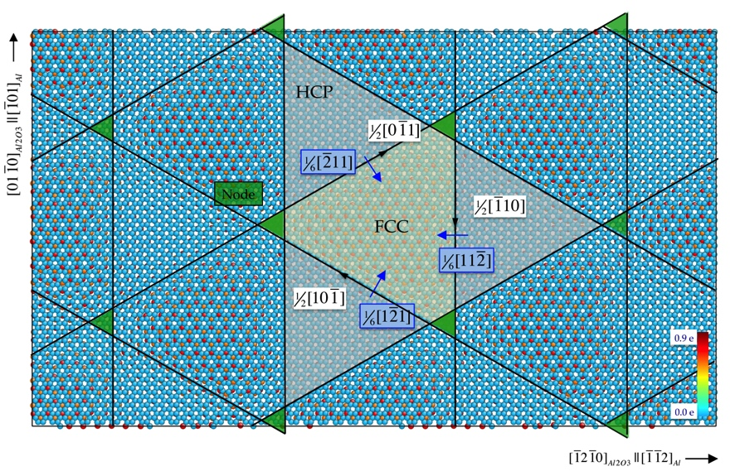

Interfacial modeling of Materials in Superconducting Qubits- Epitaxial Aluminum Interfaces
Atomistic models of structures & defects at Al interfaces in Qubits materials
Interfacial properties employing angular metallic or mixed metallic + ionic potentials
Al-Si(111) interface
Al-sapphire interface
Relaxed interface supercell
2-domains + super dislocations at interface
Relaxed interface supercell
Simulated STEM image
in good agreement w/ experiment
3 sets of dislocations at interface
Notes:
Expand on existing density functional theory (DFT) calculations with molecular dynamics (MD) simulations using the state-of-art advanced atomistic models, to understand the atomistic structures and associated interface defects at epitaxial aluminum interfaces such as Al on sapphire and Al on silicon.

Slide 12
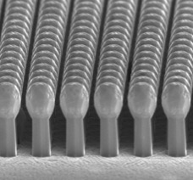
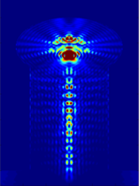
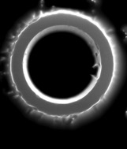
High performance detectors with nanostructures
Small sizes and efficient carrier separation in three-dimensional architecture can lead to enhanced sensitivity and faster response in wide wavelengths.
Vertical / Radial heterostructures
Enhanced photodetectors: UV to IR
Built-in light concentrators
Nanostructures for
radiation detectors
Concurrent achievements of enhanced light absorption and ultrafast carrier separation
Notes:
In addition to Rohit’s input on semiconductor nanowires for photonics, I describe a little details of detector research.
Vertically aligned semiconductor nano/microstructures can enhance performances of photo/radiation detectors.
The small size is useful for faster response due to smaller capacitance.
Vertically alignment enables us to fabricate highly dense photodetector arrays for high-spatial resolution.
In conjunction with radial p-n (p-i-n) junctions enhanced light absorption and efficient photogenerated carrier separation can be achieved.
*Rohit’s Ultrafast optical microscopy is useful to elucidate the carrier dynamics. We are working on that.
Recent results at CINT show that morphological control and three-dimensional architecture enhance light absorption in wide range of wavelengths.
The middle column of this slide is an example: Si radial p-i-n junction arrays.
The top-hat structures (match heads) enhance light absorption in visible and near-IR wavelengths up to 30%.
(Top-left: SEM image, Top-right: Light absorption profile calculated by FDTD solution (showing light concentrating effect due to match head), Bottom: Measured QE and calculated light absorption)
The target wavelengths can be tuned by change of materials.
I have the FDTD calculation capability.
*The results have been submitted to Nano Letters.
The three-dimensional structure can be optimized for radiation detectors.
A tubular semiconductor structure in which radiation detecting material fills the core region is suggested.
The selective lining (or filling) technique has been published in Nano Letters: J. Yoo et al., “Metal-lined semiconductor nanotubes for surface plasmon-mediated luminescence enhancement”, Nano Letters (2013).
In the article PL enhancement in UV regions in Ag-lined ZnO nanotubes was demonstrated. The same scheme was also confirmed in Si nano/microtubes.
The top-view SEM image in the right column shows Si tubes in which metal is selectively deposited on the inner walls.

Slide 13
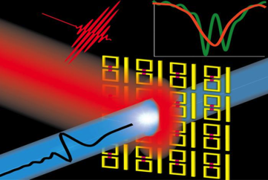
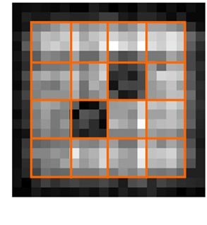
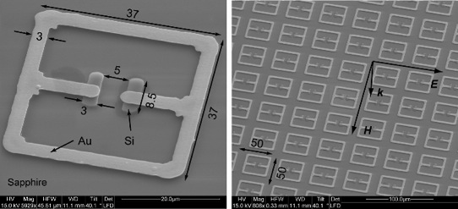
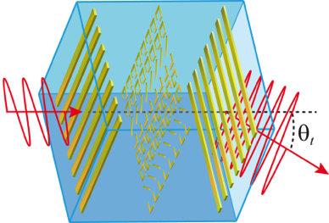
Electromagnetic metamaterials for device apps
  Metamaterials (MMs)
    Passive and active designs
    Dynamically tunable EM response
    Next generation THz technologies
  Hybrid materials for improved THz technology
    Superlattice based improved THz sources/detectors
    MBE-grown on-chip devices integrated with MMs
  Switchable electromagnetically induced transparency and tunable slow light (Nat. Commun. 2012)
Frequency Tunable Terahertz Metamaterials
(Nature Photonics 2008).
THz Spatial Light Modulator (Appl. Phys. 2009 and 2014.
Terahertz Metamaterials for Linear Polarization Conversion and Anomalous Refraction, (Science 2013).

Slide 14
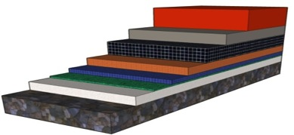
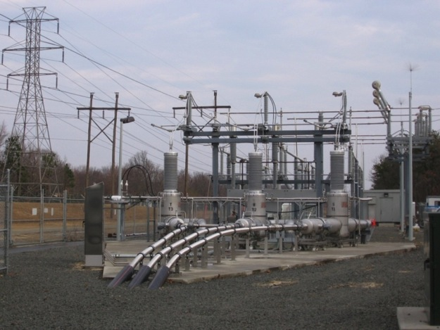
LANL developed and transferred manufacturing technology for superconducting cables
  Motivation
  no electrical resistance (cooled with liq N2)
  250x the current density of copper
  more powerful, efficient, smaller, lighter
  increased energy infrastructure security
Current decrease across GBs in YBCO mitigated by ion beam texturing
Stabilizer:Cu
YBCO
IBAD MgO
Anisotropy in current density controlled by vortex pinning defects
Substrate: Hastelloy
(Photo courtesy American Superconductor Corp.)

Slide 15
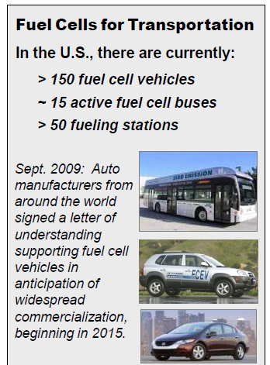
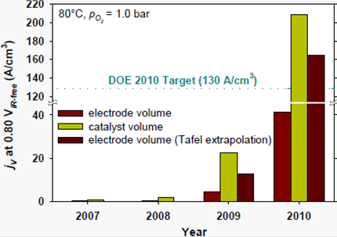
LANL’s fuel cell technology program is long standing & industry motivated
Fuel Cells R&D Projects Focus on Cost and Durability
Fuel cell durability
Electrocatalysis
Alternative membranes
Impurity effects
Water transport
Portable power
Lengthy History of Partnering with Major Developers:
General Motors, Ford, 3M, Delphi Automotive, W.L. Gore, BASF, SGL Carbon GMBH, UTC, AFCC, Ballard Power Systems, Ceramatec Inc., IRD Fuel Cells, Nissan Motor Company, Hyundai Motors Company, other National Labs, Universities
~ 90% of LANL Fuel Cell Funding is awarded by DOE EERE competitive solicitations.
Tremendous Progress in
Non Precious Metal Catalysis
LANL Breakthrough Thin Film Electrode
  (US Patents #4,876,115, #5,211,984 and #5,234,777)
  Used in virtually every PEM fuel cell today

Slide 16


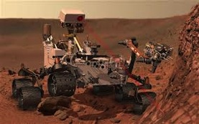


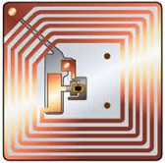
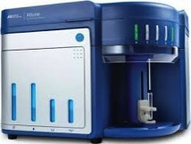






LANL has transitioned technologies to products
Curiosity (Rover)
  ChemCam
  Radioisotope Thermoelectric generator (RTG)
Programs
Hydrogen & Fuel Cells
  Electrode Los Alamos Type (ELAT)
  Battlefield Power
Flow Cytometry
  Attune Acoustic Cytometer
Products
Radio Frequency Identification
RFID developed for DOE, USDA, transitioned worldwide
Image/Pattern Recognition
GeniePro (tumor identification)
MrSID (Geographic imaging)
Software
Manufacturing
Reliability Technology/PowerFactoRE (manufacturing reliability)
KIVA (Computational Fluid Dynamics)

Slide 17

We have made multiple LDRD investments to enhance our co-design capabilities
FY11
FY15
Optimization Principles for Co-design applied to Molecular Dynamics
Develop framework for hardware-software co-design
Optimize main components: run time, problem size, simulated time duration, energy use, and hardware cost
Enable effective implementation of physics simulations on future novel computer architectures
Provide a basis for more decisive influence on hardware design
Scalable Co-design Performance Prediction for Computational Physics
Develop a performance-prediction capability that relies on modeling architectural and algorithmic details of a computational-physics code running on a specified HPC architecture
Also pursuing potential ASIC approaches←
Notes:
Caption: Overview of codesign performance prediction approach
Project Description
We will develop a performance-prediction capability that relies on modeling architectural and algorithmic details of a computational-physics code running on a specified high-performance computing (HPC) architecture. This capability will fundamentally benefit a large number of HPC code projects by providing techniques for rapid evaluation of novel algorithmic ideas; rapid evaluation of middleware "mapping" concepts; optimizing method & architecture parameters for performance; and perhaps most intriguing semi-automated code generation for crucial subroutines. After the project ends, the performance prediction capability will be useable with minimal additional effort for other computational physics domains and architectures of the generations after next, and for decision support in HPC platform procurement to test vendor proposals against request specifications.
Building the performance prediction capability is our first goal, which will have a focus on models for state-of-the-art and conjectured architectures. Our second goal is to use the capability to assess novel solutions to the key exa-scale challenges of the data motion/movement, high-parallelism, and fault tolerance applied to radiation transport and hydrodynamics methods.
Our initial algorithmic ideas that we will develop, model and assess for the applications include: Determining optimal ways to hide communication and/or memory latencies on specific devices for discrete ordinates mesh sweeps and analyzing tradeoffs of non-sweep-based algorithms that increase independent work units and data movement for deterministic radiation transport. Models of the random access of memory and stochastic work generation of a Monte Carlo fixed source calculation and various approaches to task-based parallelism for stochastic radiation transport. Rapid analysis of tree-code algorithms on different architectures for hydrodynamics.
An initial set of middleware technologies that we will develop includes: Polyhedral optimization methods to minimize data motion, load-balancing schemes vs. data movement requirements, static graph-based automated parallelization approach for innermost loop computations of physics domain codes, Just-In-Time Parallelization schemes and alternatives to checkpoint-restart paradigm for failure tolerance.
Tie to Mission
Our future computational physics code base for hydrodynamics and radiation transport are of fundamental importance to DOE and LANL. Maintaining LANL’s leadership role in national security will depend on our ability to consistently provide performance improvement in our codes for emerging architectures. Additionally, these techniques will be applicable to other application domains, in particular climate simulations and large-scale infrastructure simulations. Previous work related to AMD resulted in a successful transition of that project to the DOE Office of Science BES, which will now support the implementation and physics discovery work. Similarly in this project: If we are successful at identifying algorithmic variations with substantial predicted performance gains, programmatic sources, e.g., ASC, may be willing to support follow-on code development made possible by a successful LDRD project.

Slide 18




One element of our algorithms strategy : Mixing Classical & Quantum Approaches to Solve Real World Problems
Quantum Algorithms for Classical Physics
Quantum Algorithms for Classical Physics
Quantum-Motivated Algorithms for CMP
Quantum Algorithms for Quantum Chemistry
“Exponential Improvement in Precision for Hamiltonian Evolution Simulation”, D.W. Berry, A. Childs, R. Cleve, R. Kothari, and R.D. Somma, arXiv:1312.1414 (2013). To appear in 46th ACM Symposium on the Theory of Computing (2014).

Slide 19



We are exploring a potential realization of quantum annealing
A new paradigm to solve Big Data problems. Quantum annealing does not require universal QCs
Ising magnet
oscillating B
→
Superconducting qubits > 500
Ca₃Co₂O₆
Dwave
Cast problem as quadratic unconstrained binary optimization form
Map problem onto Ising Hamiltonian (specify couplings, field, …)
Anneal the physical qubit system
“Read out” the ground state

Slide 20

LDRD investment: Hybrid Quantum-Classical Computing
Breakthroughs in quantum technologies have yielded “quantum annealers.” They hold promise in optimization challenges, but do not behave ideally, are not fault-tolerant, and are poorly characterized.
Technical Approach
Develop new algorithms for challenging optimization problems
Develop methods for benchmarking quantum annealers based on the dynamics of phase transitions
Develop a quantum programming compiler
Conduct laboratory experiments of quantum annealing on physical systems that are ubiquitous in optimization
Notes:
Caption: Results demonstrate that, theoretically and numerically, quantum annealing is a very powerful method for optimization, sometimes outperforming classical computers by an exponential margin. In practice, there are some challenges: decoherence, noise, fluctuations in annealing parameters, non-zero temperature, etc.

Slide 21

Los Alamos has acquired a D-Wave 2 system in order to explore beyond CMOS technologies
D-Wave 2 system (1000+ qubits)
  Quantum annealing and related applications
  Co-design of future technologies
  Installed @ LANL
Shared resource usage model on open network
Focus is to develop collaborative network of people and ideas
Reciprocal model at LLNL for neuromorphic TrueNorth machine
  LANL is also acquiring a neutral network testbed from Nvidia

Slide 22
Crossroads will enable an increase in predictive capability for ASC while extending state of the art
Provide a significant capability improvement over current platforms (>> Sequoia, > Trinity) in key physics areas
  Improvement is a function of performance (total time to solution), increased geometries and physics capabilities
Increased capabilities drive computational improvements
  Higher fidelity models -> increased aggregate memory capacity
  While sustaining time to solution -> increases in computational capabilities, memory bandwidth & scaling characteristics
Improve performance of current and future programming models, overall science workflow efficiency, and manageability (reliability, resilience, energy, etc.)
Extend procurement methodology yet again beyond Trinity
  No FLOPS -> app performance
  No IO speeds -> 90% efficient
Notes:
What will Trinity do for the ASC program

Slide 23




Trinity is NNSA’s current flagship Advanced Technology System (& a sibling of Cori @ NERSC)
COMPUTE NODES
Intel “Haswell” Xeon E5-2698v3 | Intel Xeon Phi “Knights Landing”
9436 nodes | > 9500 nodes
Dual socket, 16 cores/socket, 2.3 GHz | 1 socket, 60+ cores, > 3 Tflops/KNL
128 GB DDR4 | 96 GB DDR4 + 16GB HBM
November 2015 #6 on Top500 8.1 PFlops (11 PF Peak)
Cray DataWarp
576 Burst Buffer Nodes
3.7 PB, ~3.3 TB/s
Cray Sonexion
Storage System
78 PB Usable, ~1.6 TB/s
Cray Aries ‘Dragonfly’ Interconnect
Advanced Adaptive Routing
All-to-all backplane & between groups

Slide 24
LANL’s architecture contributions extend beyond platforms to networks and storage
  First standards based 1 and 10 Gbit networking technology (HiPPI - High Performance Parallel Interface; HiPPI6400 →GSN Gigabyte System Network)
    Ethernet at the time was 10;100 Mbit
  First Parallel Scalable Back Bone (PaScalBB) network designed to allow multiple heterogeneous supercomputers to access parallel resources like parallel file systems globally
  First Quantum network
  First globally shared between multiple supercomputers parallel file system (Panasas)
  First parallel file system deployed that was based on the DARPA Object Storage System abstraction for extreme scalability (Panasas), used in most modern parallel file systems now like Lustre
  First demonstration of a Parallel Log Structured File System (PLFS)
  LANL-inspired burst buffers currently being deployed broadly
…enabling scientific discovery, new algorithms, and advanced applications at the leading edge of computational science

Slide 25
Our (relative) capability gaps create partnering opportunities
Our expertise tends towards complex materials; semiconductor fab is not a core competency
Our infrastructure for device prototyping/reliability testing is limited
Our approach to apps is domain-centric; software engineering is not our strongest suite
Our HPC production infrastructure is significant; exploratory “skunk works” footprint and bandwidth can be hard to come by

Slide 26







Summary: LANL Capabilities and Interests
Primary Expertise & Interest Areas
Broad capabilities in complex and quantum materials; making-measuring-modelling to devices
Algorithm development for novel architectures
Testbed exploration, including with partners
Most Differentiating Factor
“Culture” of co-design has a decade+ history
  algorithms and architectures
  Experiment-Theory-Simulation
Deep history in quantum physics: correlated materials to quantum information science
Main Contribution/Role
Balanced integration of materials and computing expertise
  Greater focus on far future, especially quantum, than next-gen CMOS
User facilities, Centers & Institutes, Testbeds provide venues for partnership/collaboration

Slide 28











Materials Physics and Applications Division develops new technologies that solve pressing energy and security challenges by exploring and exploiting materials and their properties, developing practical applications of materials, and providing world-class user facilities.
Materials Chemistry and Integrated Devices
  Hydrogen storage and fuel cell program
  Sensors: acoustic, hydrogen, HE
  Advanced separation technologies
  Actinide chemistry
Condensed Matter and Magnet Science
  National High Magnetic Field Lab-Pulsed Field Facility
  Strongly Correlated Materials (Actinides)
Center for Integrated Nanotechnologies
  Center for Integrated Nanotechnologies
  Center for Materials under Irradiation and Mechanical Extremes (CMIME)
  Laboratory for Ultrafast Materials and Optical Science (LUMOS)

Slide 29




















Materials Science & Technology Division develops innovative materials solutions for national security missions, integrating across materials synthesis, processing, structure, properties, and performance to benefit endeavors from R&D to component manufacturing
Metallurgy:
Corrosion, Interfaces, & Electrochemistry
Foundry,/Machining
Powder Metallurgy
Welding and Joining
Polymers and Coatings
Polymer R&D
Target Design and Fabrication
Materials Characterization and Forensics
Surface Science and Coatings
Materials Science of Radiation and Dynamic Extremes
Materials Modeling
Science of Defects in Materials
Crystal Growth and Material Preparation
Dynamic Materials Properties
Nuclear Materials Science
Dynamic Testing
Metallography and Microscopy
Surface Science

Slide 30



LANSCE: Capabilities contribute to LANL missions and the National/International research community

Slide 31




National High Magnetic Field Lab’s Pulsed Field Facility provides qualified users with magnetic fields up to 100T
Our mission:
Provide qualified users with Extreme High Magnetic Field research environment
Statistics:
150 users per year from all corners of the globe
$7M annual NSF-funded program
11 Scientific staff provide expert user support
40- 50 peer reviewed publications per year
1.43 GigaWatt Generator

