Slide 1







Solving the Information Technology Energy Challenge Beyond Moore’s Law
Search for a New Moore’s Law
Notes:
Get three things out of this longer talk
1) this is a real problem and it is urgent
2) there is something that can be done
3) DOE has the mission and the capability to play a lead role to solve this (industry/lab partnership)

Slide 2
Old Moore’s Law:
2x Transistor Density every 12-24 Months
at same power & cost!

Slide 3
The problem:
IT projected to challenge future electricity supply
Even worse if Moore’s Law ends!!!
Projection based on consumer electronics + data centers
More Moore’s
Big Idea
www.alliancetrustinvestments.com/sri-hub/posts/Energy-efficient-data-centres
www.iea.org/publications/freepublications/publication/gigawatts2009.pdf
Notes:
Talk about your need for success (the scare diagram)
Its not just about reducing power consumption. Its about being able to meet the needs (that you other guys are depending upon)
What if we couldn’t deliver that. What if industry could not deliver the expanded compute capability that you demand?
Why do we believe this will happen?
You’ve exceeded your carbon budget. No iPhone upgrade for you!
Yout guys are contributing to the problem: Charlie wants to put IOT packages on top of telephone poles
the biosphere thing wants sensor data and then back-end resources to process the data?
no soup for you charlie
Show the economoic and energy impact of employing even more pervasive IOT technology and associated data mining.
From the spreadsheet, total energy in 2030 is 33,000 PWhr, of which 9.5 PWhr is ICT related (28.6%).
Had 30% of of the project electric supply by 2030 just based on current trends and it went up to 50% with Moore's Law ending, but that part certainly much more speculative.
With Beyond Moore, we assume we can get ~ 2X reduction to 5.3 PWhr, which is 15.9% of 33 PWhr, but this number is ‘fungeable’. (we could assume more).
The reduction of 9.5 – 5.3 = 4.2 PWhr; 4.2 PWhr / 33 PWhr = 12.6%.
The graph is drawn a little lower, but I think it’s ok.
This is achieved with only a 3.5 - 6X reduction in energy per external data rate (Cisco reference) in 2030 vs. the existing trends, the spread depends on the ‘path’ to the energy savings. (greater in early years vs. later years).

Slide 4
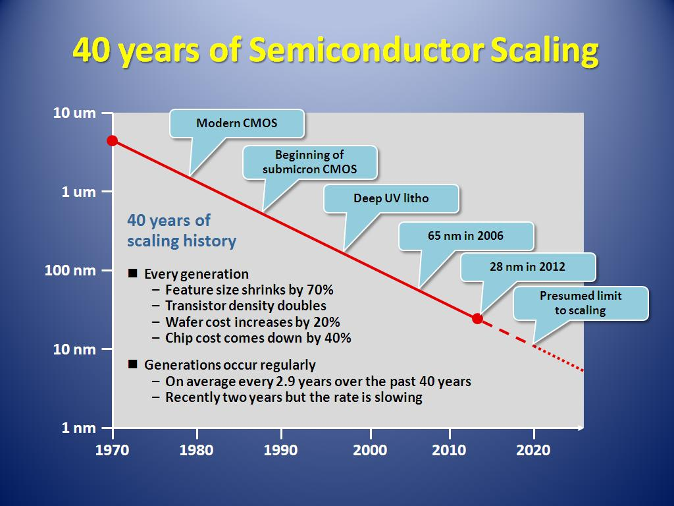
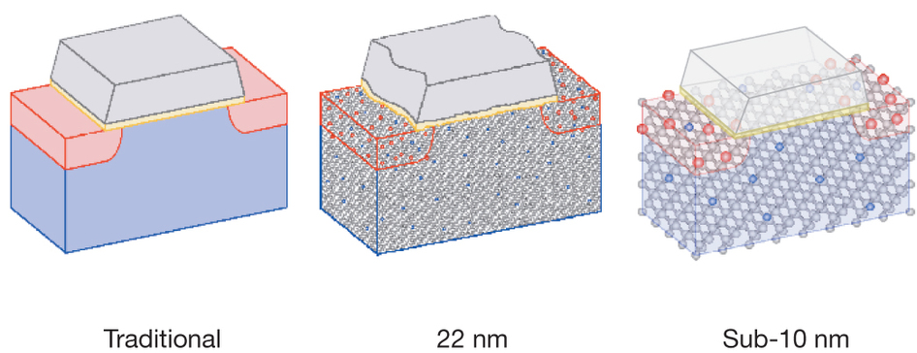
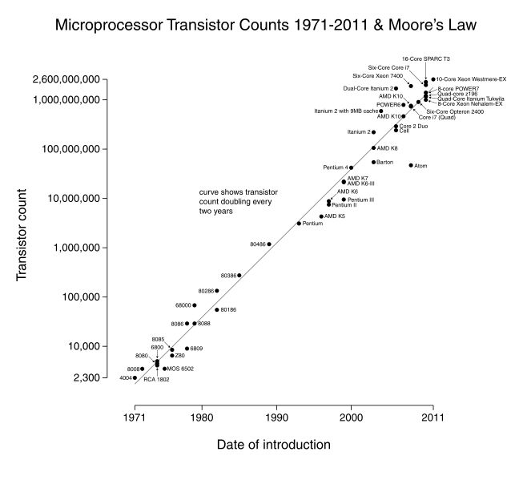
50
Atomic scale limit case for 2D Lithography Scaling
2027?
5nm
Notes:
This is why you should be scared.
Talked about electronics per unit density (that’s not where we are at)
We need this in case anyone asks about Moore’s Law and why we think scaling might be near an end.
Can’t build in 3D (need a new material system because of data movement)
Its not about how many electrons are needed to represent the information. Its about how much voltage needed for the switch to implement logic.

Slide 5
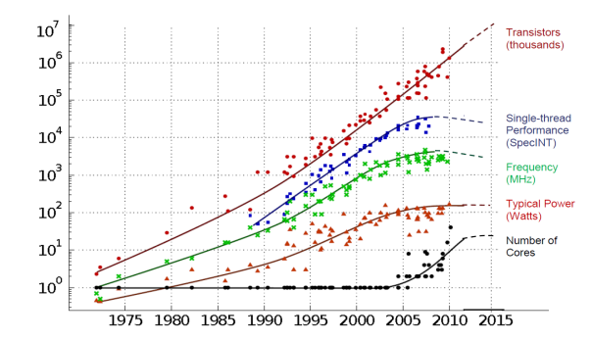
Technology Scaling Trends
(more flattening ahead)
Transistors
Thread Performance
Clock Frequency
Performance
Power (watts)
# Cores
Year
Figure courtesy of Kunle Olukotun, Lance Hammond, Herb Sutter, and Burton Smith
Notes:
Well at least we’ve got Moore’s Law (lithography scaling)
But in 2025 we won’t have that any more, and our current play of doubling processor cores that gets us to exascale is no longer going to be available as a source of technology scaling.
Could extend this if you build out in 3D! But energy density is already at the limits, so you cant.
And data movement goes lower if you have photonics or if you have lower voltages….

Slide 6
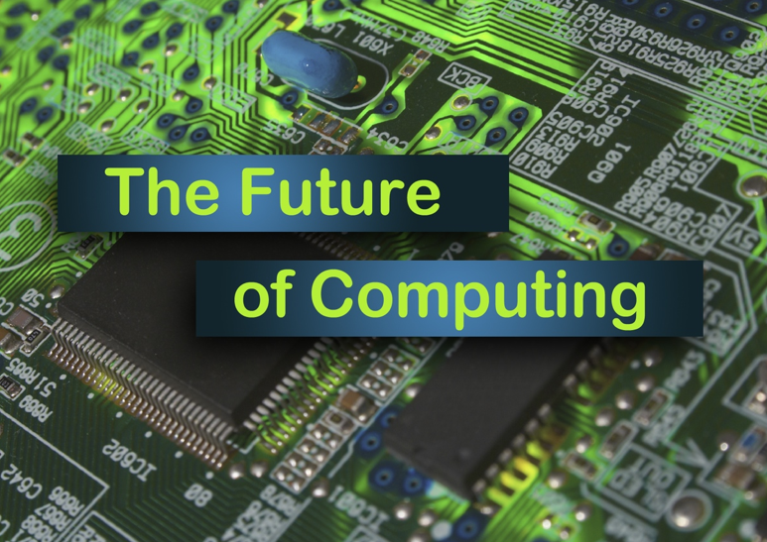
Post-Lithographic Scaling Options
There are other ways to continue Moore’s Scaling!
?
20+ years scaling
w/20 year lead
New Scaling Law for
10 years scaling
After 2025
Notes:
Comment on the Landauer Limit means another 8-12 orders of magnitude available.

Slide 7

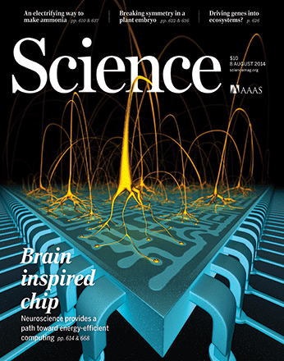

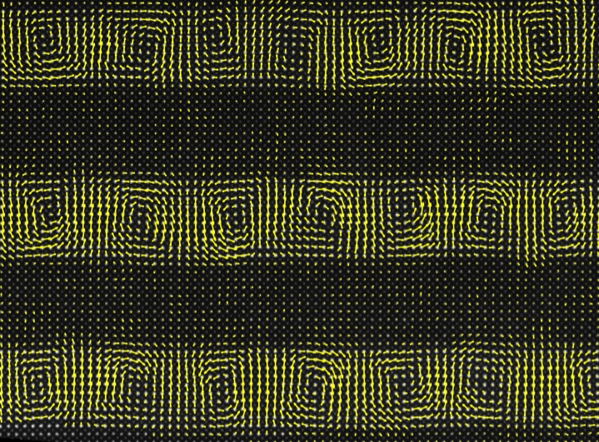
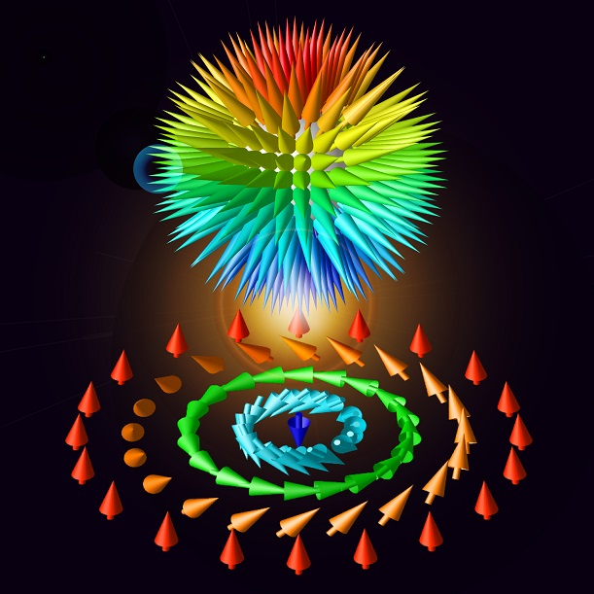
Fundamental Materials Science Drivers
Manipulate information at the limits of Energy : 1 AttoJoule switch
Design of hierarchical ground states for multistate memories and logic
Energy-efficient synthesis of new forms of matter with tailored properties
Control of correlations
and emergent behavior @mV scale
Control of electron wavefunctions
Notes:
Attojoule device is 6 orders of magnitude lower than today’s devices.

Slide 8
The Opportunity
Fundamental Science
(BES)
Computing
Science
(ASCR)
Manufacturing
Science
(AMO)
Leverage unique capabilities in material science
Scientific user facilities
Computational approaches to materials design
Grand challenges driven research
Advanced computing
Multiscale computing benchmarking and modeling
Next-generation heterogeneous architectures
New programming models and application software
Move revolutionary low energy devices and architectures
from Lab to Fab
Accelerate development and manufacturing base
for electronic devices
Create public-private partnerships with electronics industry
Notes:
WHY DOE instead of industry?
Big semiconductor companies follow low risk evolutionary approaches: too slow to meet energy needs
Small companies lack the resources and scale for this challenge
Needs to be more visual
Need to change goals with columns

Slide 9
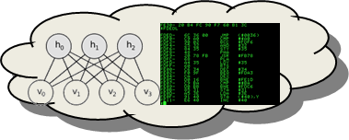

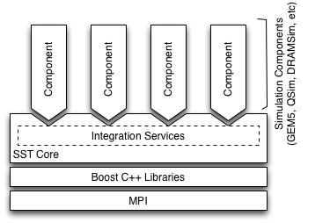
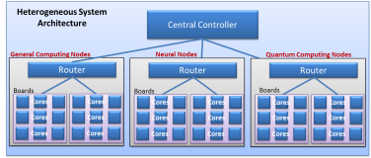
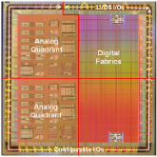

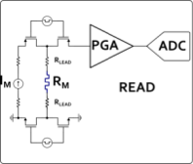
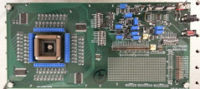
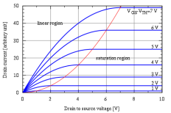
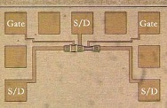

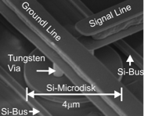
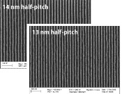
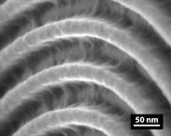
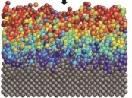

Beyond Moore Codesign Framework
Application Performance Modeling
10,000x improvement:
20 fJ per instruction equivalent
Modeling
Computer System Architecture Modeling
Next generation of Structural Simulation Toolkit
Heterogeneous systems HPC models
Systems
Component Level Models
Gem5, McPAT, HiHAT, CACTI, NVSIM
Component Fabrication
Processors, ASICs
Photonics
Memory
Circuit/IP Block Design and Modeling
SPICE/Xyce model
Test Circuit Fab and Measurement
Subcircuit measurement
Compact Device Models
Single device electrical models
Variability and corner models
Devices
Device Measurements
Single device electrical behavior
Parametric variability
TEM/EELS
Device Physics Modeling
Device physics modeling (TCAD)
Electron transport, ion transport
Magnetic properties
Device Structure Integration and Demonstration
Novel device structure demonstration
Process Module Modeling
Diffusion, etch, implant simulation
EUV and novel lithography models
Process Module Demonstrations
EUV and novel lithography
Diffusion, etch, implant simulation
Materials
Atomistic and Ab-Initio Modeling
DFT – VASP
MD – LAAMPS
Fundamental Materials Science
X-ray: XRD, XPS, HAXPES
Microscopy: TEM, SEM, EELS
Scanning probe technique
Experimental
Notes:
Explain how this integrated framework leverages the labs strength and MISSION, and engages both modeling and experimental science
There are many indiviual activities happening in each of these areas, but there is nothing that integrates them together.
In the Charter of the National Strategic Computing Initiative, the DOE is identified as a lead agency for computing systems,
with a mission to create integrated efforts that LEAD to fully integrated systems.
It is our job… it is our MISSION to address this first order energy challenge...

Slide 10
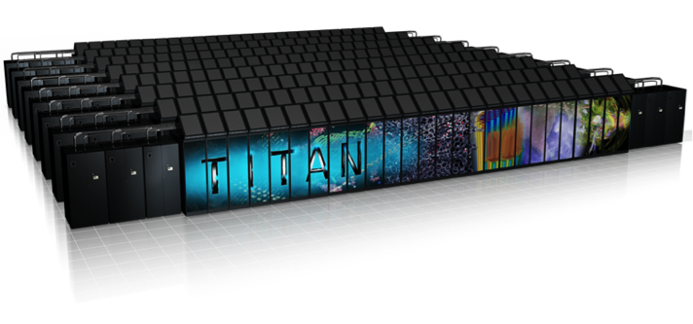

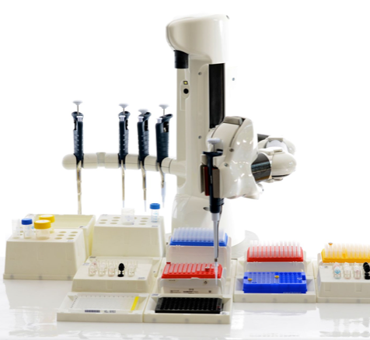
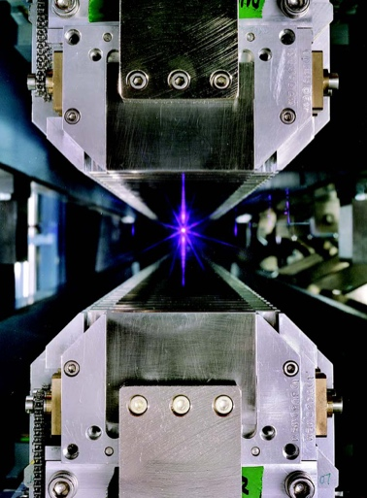
Advanced Materials
Discovery
(material simulation codes, leadership computing, …)
Synthesis
(Nanofab, Nanoscale Centers, …)
Characterization
(Light Sources, electrons, photons, neutrons, …)
Notes:
Materials (BES): Finding New Materials with Better Electronic Properties
Artisinal materials development → here is the industrial scale process that we are proposing (Blake)
Lets turn Blake into a solid state guy (none of that squishy biomolecule stuff)

Slide 11
Advanced Materials
Discovery
(material simulation codes, leadership computing, …)
Goal: Accelerate discovery of materials with improved properties for energy efficient electronics by factor of 1000x.
Synthesis
(Nanofab, Nanoscale Centers, …)
Characterization
(Light Sources, electrons, photons, neutrons, …)
Notes:
Materials (BES): Finding New Materials with Better Electronic Properties
Chris, we’d never do this in the real presentation. But we wanted to put this up to see if this addresses questions that came up in the last review regarding concrete targets (what can we do)?

Slide 12
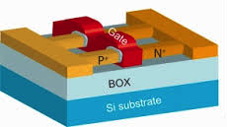

Advanced Devices and Manufacturing
Model
(New Computational Model/Simulation, Massive Compute)
Fabricate
(EUV/EUREKA, e-Beam MESAFab, …)
Test
(3D Tomography, Ion-beam
Spectroscopy, etc…)

Slide 13
Advanced Devices and Manufacturing
Model
(New Computational Model/Simulation, Massive Compute)
Goal: Discover new devices with manufacturing path to enable next 30 years of Moore’s scaling.
Fabricate
(CXRO, EUV/EUREKA, MESAFab, …)
Test
(3D Tomography, Ion-beam Spectroscopy, etc...)
Notes:
Enable another 30 years of scaling
Break through
Deep sub-nanometer
Note: we don’t want BES to go from being a science power house to being engineers
This is where AMO comes in. This is where our public-private partnership comes in. (HPC4MFG example)
Discover new devices and scalable manufacturing path to enable next 30 years of scaling

Slide 14
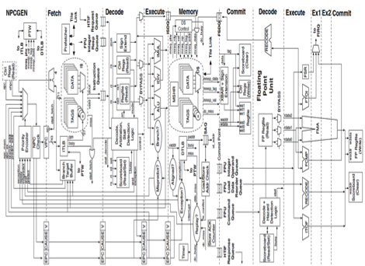
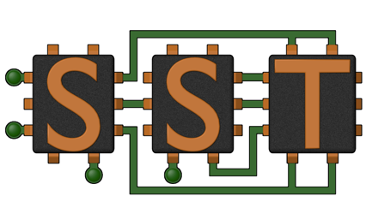
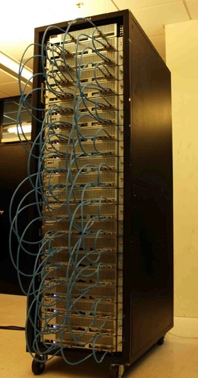
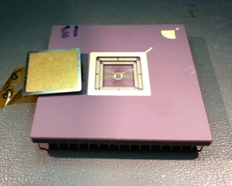
Architecture & Algorithms
Architectural Simulators
(SST, Chisel, models, codesign...)
Synthesis/Prototype
(OpenSOC, MESAFab)
Benchmarking
(Benchmark, analyze, applications)

Slide 15
Architecture & Algorithms
Architectural Simulators
(SST, Chisel, models, codesign...)
Goal: Accelerate discovery and validation of architecture improvements using new device technologies. (scale-bridging)
Synthesis/Prototype
(OpenSOC, MESAFab)
Benchmarking
(Benchmark, analyze, applications)
Notes:
Goal: Understand impact of micro-scale device technology and new materials on macro-scale architecture and system performance. (scale-bridging)

Slide 16
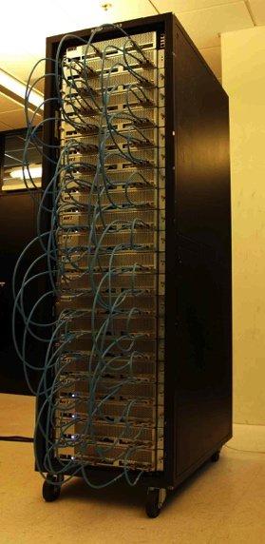
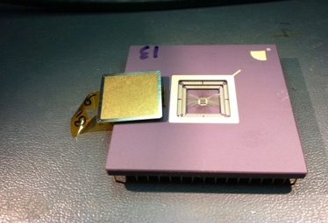
National Lab Partnerships Opportunities
Today’s CMOS
Voltage limit
Better Materials
Interesting materials!!!
Better Devices
More Efficient Computing Architecture
Notes:
Only DOE can do this
We have many disconnected programs in these areas.
But codesign involves connecting these areas together and making it an explicit part of the devleopment process.

Slide 17
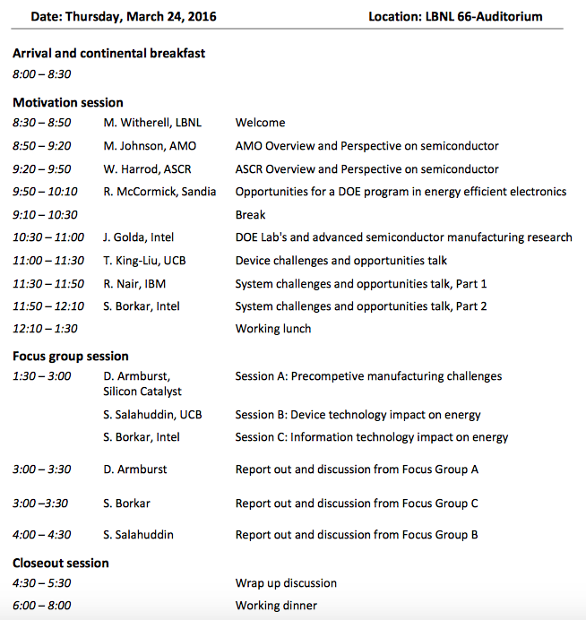
Building a Public-Private Partnership
Notes:
Working apart, we will not reach our goals.
Requrires an integrated effort, and DOE is the right place to do it because they already have the base capabilties in each area
And they have a mission to integrate.

Slide 18

SUMMARY
100’s fewer power plants
Looming end of Moore’s Law creating rapidly growing energy gap
Coordinated public-private partnership will drive breakthroughs by leveraging multiple DOE Office leadership and Lab capabilities
Success IS: continued growth and affordability of our information economy, with US Economic impact in Trillions$

Slide 19
BACKUP
Notes:
Add Moore’s Law to backup

Slide 20
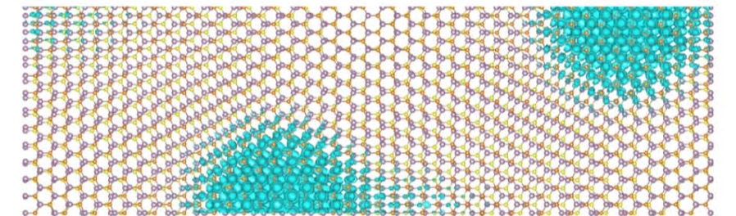
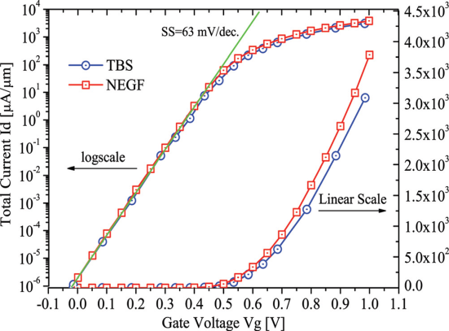
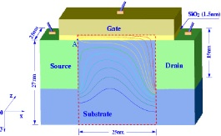
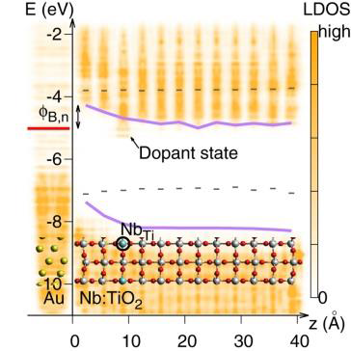
Atomistic holistic device simulation
Atomistic DFT simulations, beyond TCAD
Useful for new materials and designs
Whole device with >100,000 atoms
Petascale to exascale HPC
Codes exist, need to be integrated
LS3DF + FSM for > 10,000 atoms DFT
I/V curve (LCBB for million atoms)
HP4mfg
with Global
Foundry
MoS₂ for TFET (PEtot_trans for transport calc.)
Integrate the existing codes to form a package for holistic ab initio device simulation

Slide 21
Longer-Term Impacts
HPC data mining and “Inverse Design” are starting to become “standard business practice”.
Exascale success will enable bigger applications to drive demand for large scale compute cycles and energy.
The countries that can circumvent the energy challenges to enable the HPC applications that will discover future disruptions in Manufacturing, Climate, Medicine, and Energy will dominate the future world economy.
“Beyond Moore’s Law” technologies will also address the energy challenges of the ~21M IoT units to be deployed by 2020 (vampire loads).
“Traditionally disruptions are caused by emergence of a different kind of material, different kind of process, or a different way of doing something. Those cited here are expected to completely upstage the worldwide economy by 2025,”
Dr. Sadasivan Shankar, prominent Intel materials scientist, “In Silico Inverse Design”
http://www.hpcwire.com/2015/06/15/fixating-on-exascale-performance-only-is-a-bad-idea/

Slide 22
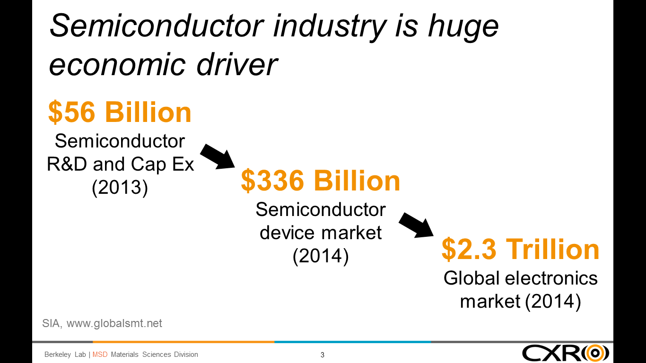
The semiconductor industry is crucial to the U.S. economy. Semiconductor sales constitute a $336B/yr. economic engine driving the $2.3T/yr. global electronics industry. Semiconductor products are currently the second largest class of U.S. exports; U.S. companies account for more t

Slide 23
IT already accounts for 5% of global electricity usage and growing fast
In 2012, ICT usage consumed 4.7 percent of electricity worldwide, amounting to approximately 920 TWh (1 TWh is a terawatt-hour or 1012 watt-hours)
  Source: The EINS Consortium. Overview of ICT energy consumption (D8.1). Report FP7- 2888021. European Network of Excellence in Internet Science. February 2013.
  Van Heddeghem, W., Lambert, S., Lanoo, B., Colle, D., Pickavet, M., and Demeester, P. Trends in worldwide ICT electricity consumption from 2007 to 2012. Computer Communications 50 (2014), 64-76.

Slide 24
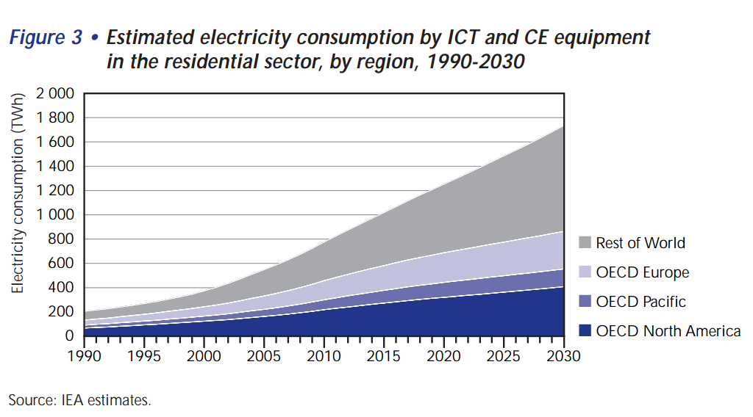
Gadgets and Gigawatts report
https://www.iea.org/publications/freepublications/publication/gigawatts2009.pdf

Slide 25
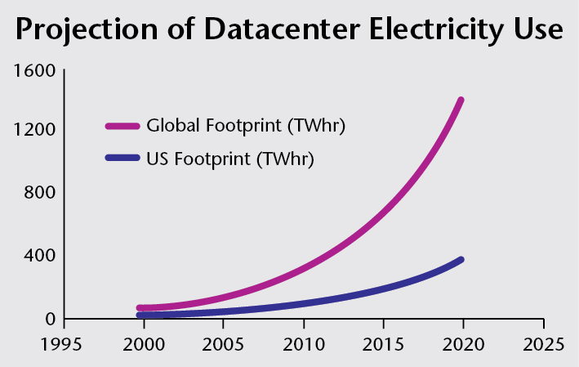
Datacenter electricity use also exploding
Energy efficient data centers, Harriet Parker, SRI Analyst, 19 February 2013
www.alliancetrustinvestments.com/sri-hub/posts/Energy-efficient-data-centres

Slide 26
Result of Big Idea
Fundamentals & Devices: (BES/AMO)
  Materials and devices for 20fJ per effective instruction (vs. 200pJ/instruction today)
Computing: (ASC/ASCR)
  Accelerate the development and introduction of next generation computing via device-to-arch framework
Manufacturing: (EERE/AMO, NNSA)
  enhance US position in semiconductor manufacturing
Overall Energy Savings: (USA)
  “Cut 2030 ICT energy usage by 50%”
  Enable continued growth of mobile connectivity and application of HPC to our info economy (keep up with the rest of the world)

Slide 27
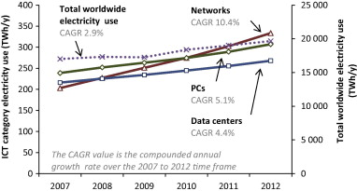
Fig. 5. Evolution of worldwide electricity use of networks, PCs and data centers (solid lines, left axis) and total worldwide electricity use (dotted line, right axis). Over the last five years, the electricity consumption in all three ICT categories increased at a rate higher than the total worldwide electricity consumption. In 2012 each category accounts for roughly 1.5% of the worldwide electricity consumption. Note that, since some of the data points between 2007 and 2012 are based on interpolations, small variations might not show up in the intermediate years

Slide 28
Coming explosion of always “on” IoT devices
Table 1: Internet of Things Units Installed Base by Category (Millions of Units)
Source: Gartner (November 2015)
Category | 2014 | 2015 | 2016 | 2020
Consumer | 2,277 | 3,023 | 4,024 | 13,509
Business: Cross-Industry | 632 | 815 | 1,092 | 4,408
Business: Vertical-Specific | 898 | 1,065 | 1,276 | 2,880
Grand Total | 3,807 | 4,902 | 6,392 | 20,797

Slide 29
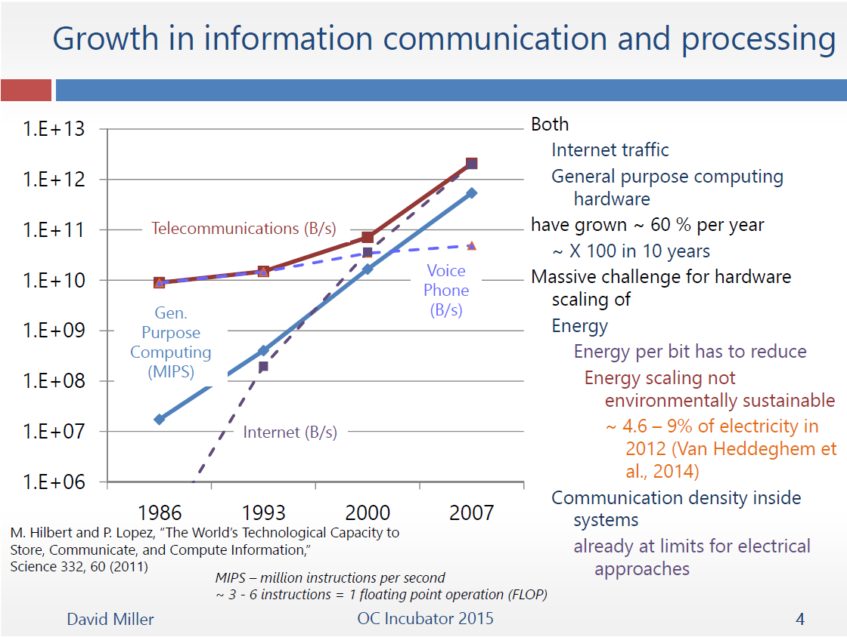

Slide 30

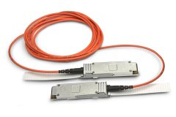
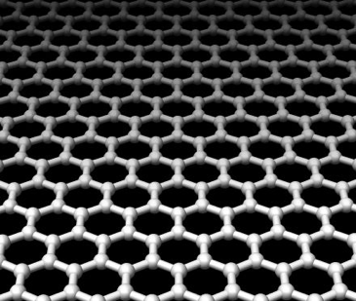
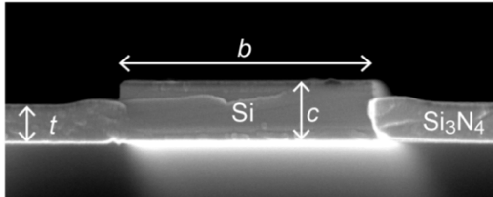
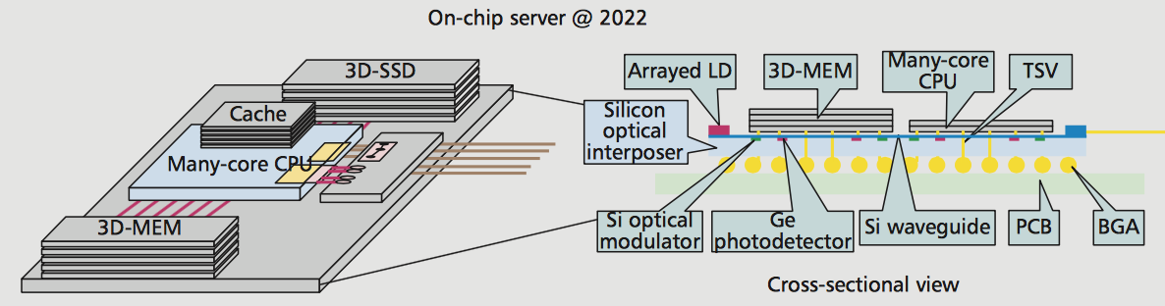
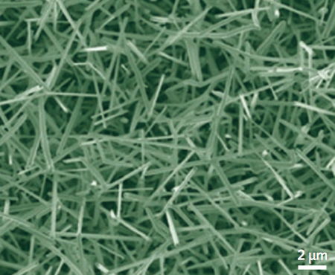
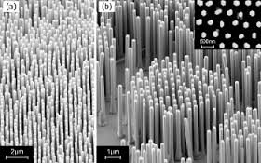



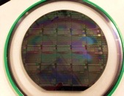


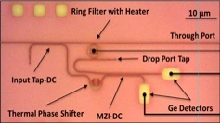




Beyond Moore’s Law Photonics
- > $1/Gb/s
- 25 pJ/bit
Both Too High
10-20 years: Need “Beyond Moore” Photonics
Scale Energy and Cost by 10⁴
  → 1 fJ/bit optics complete (>25,000X equivalent)
  0.01¢ Gb/s ($10¢/Tb/s) (>10,000X equivalent)
New Materials, Devices, Components
Today’s Petascale computing utilize optical transceivers for the ‘network’ interconnect
5 -10 years: Commodity Integrated Photonics
Interface to LV-CMOS and beyond-Moore’s transistor devices
  TFETs, Quantum, Neuromorphic, etc.
Optical switching, routing, computing
Optical modeling infrastructure
  Optical materials, devices → sub-systems → application impact
Hetero-Integrated CMOS photonics manufacturing
Drastically lower the cost of packaging
Higher data rate per optical IO, further reduction
25 pJ/bit → < 1 pJ/bit optics total (> 25X)
$1/Gb/s → 10¢ Gb/s ($100/Tb/s) (10X)

Slide 31
The path: near and long term
Need more efficient materials/devices for next 10-20+ years
Revolutionary Heterogeneous HPC architectures & software
Photonic
ICs
More efficient architecture in first 10 years

Slide 32
The path: near and long term
Materials with hierarchical ground states
Attojoule Switch
Atomic scale
Control of correlations
Computing with Electron wavefunctions
Photonic
ICs

Slide 33
Atomic-scale
Control of Correlations
Attojoule
Switch
Hierarchical Ground States
Compute with Electronic
Wave-functions
y
Spintronics
Neuromorphic
Quantum
Carbon
Nanotubes
Graphene
Analog
New Models of Computation
z
New Devices and materials
Adabiatic
Reversible
PET
Dark Silicon
Dataflow
TFETs
Approximate
Computing
Superconducting
3D Stacking
Adv. Packages
Reconfigurable
Computing
CMOS
System on Chip
General Purpose
Dark Silicon
NTV
x
New Architectures and Packaging

Slide 34
Attojoule
Switch
y
Spintronics
Carbon
Nanotubes
Graphene
New Devices and materials
PET
TFETs
CMOS
System on Chip
3D Stacking
Reconfigurable
Computing
General Purpose
Dark Silicon
NTV
x
New Architectures and Packaging

Slide 35
Complex Landscape
SRC
IARPA
NSF
DOE/National Labs
Support
Collaborate
Partnerships
Early Adoption
Industry
DARPA
Academia

Slide 36







Multi-Lab Engagement
Ramamoorthy Ramesh
Patrick Naulleau
John Shalf
Horst Simon
Supratik Guha
Rick Stevens
Jeff Nichols
Gary Grider
John Sarrao
Toni Taylor
Lou Terminello Nathan Baker
Malin Young
(F.B.) Rick McCormick
Bruce Hendrickson
Dave Sandison
Rob Leland
Trish Damkroger

Slide 37
Area | Activity | LBNL | Sandia | ORNL | ANL | LLNL | PNNL | LANL
Materials (BES) | Discovery (materials genome, material simulation codes, leadership computing…) | ✔ | ✔ | ✔ | ✔ |  |  | ✔
 | Synthesis (Nanoscale Centers, Nanofab, etc…) | ✔ | ✔ | ✔ | ✔ | ✔ | ✔ | ✔
 | Characterization (Electron, photon, neutron) | ✔ |  | ✔ | ✔ | ✔ | ✔ | ✔
Devices (AMO) | Model (HPC4Mfg, HPC) | ✔ | ✔ | ✔ | ✔ | ✔ | ✔
 | Fabricate (MESAFab, CXRO/EUREKA…) | ✔ | ✔ | ✔ | ✔ | ✔
 | Test (Light sources/APS/ALS/LCLS) | ✔ | ✔ |  | ✔ |  |  | ✔
Architecture (ASCR/ASC) | Simulate (SST, FPGA, architectural simulators) |  | ✔ |  |  | ✔ | ✔ | ✔
 | Integrate/ prototype (Chisel, OpenSOC, MESAFab) | ✔ | ✔ |  |  | ✔
 | Benchmarking (benchmark, analyze) |  | ✔ | ✔ | ✔ |  | ✔ | ✔

Slide 38
The problem:
IT projected to challenge future electricity supply
~40% of 2014 world electricity
Projection based on consumer electronics + data centers
www.alliancetrustinvestments.com/sri-hub/posts/Energy-efficient-data-centres
www.iea.org/publications/freepublications/publication/gigawatts2009.pdf

