Slide 1
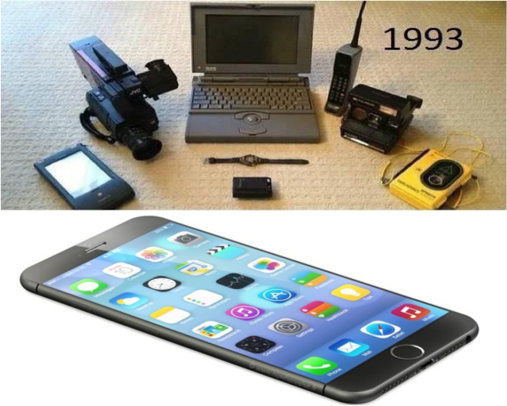







Beyond Moore DOE Internal Lab Focused Workshop
Argonne Capabilities and Interests

Slide 2
Argonne overview (for purposes of BMC)
Scientific User Facilities:
  APS: X-ray science (APS-U coherent X-rays)
  ALCF: exascale computing, algorithms, architecture
  CNM: Modeling and theory, Nanofabrication and devices, Quantum and Energy Materials, Nanophotonics and biofunctional structures, X-ray microsopy, Electron microscopy center
Battery Hub, JCESR – partnerships with industry
New incubators for industrial parterships – NDW, ACCESS,…
Strategic initiatives:
  Materials for Energy (Materials and Molecules for Manufacturing)
    In-situ (X-ray) synthesis – MBE, sputter, MOCVD, PLD
    Integrated Imaging Initiative
    Computational Chemistry and Materials

Slide 3
Argonne Capabilities and Interests Summary Slide
Expertise and interest
Materials – growth and synthesis
Materials – characterization
Materials – modeling and theory
Architecture – design and modeling
Differentiating factors
Hybrid-oxide MBE, thin films, magnetic systems
In-situ X-ray PLD, oxide MBE, exploiting APS capabilities
Large range of modeling expertise QMC, large-scale DFT, MD, mesoscale
System and software expertise
Main Contribution/Role
Materials growth, especially oxide systems and in-situ characterization
Characterization: structural (X-ray, TEM, scanning probe), electrical, BLS, Kerr microscopy, FMR,…
Large-scale modeling – DFT (including excitations – GW, MBPT), MD (including reactive force-field, generation of potentials and force fields), mesoscale modeling (including elastic properties, microstructural evolution), QMC of correlated systems, vdW systems
Micro-architecture innovation, architecture design, modeling and analysis

Slide 4
Argonne Gaps
No real semiconductor lab, semiconductor devices
Small cleanrooms (expanding one – sensors)
Device testing
Reliability testing

Slide 5
Argonne – particular interests
Materials for low-power electronics, ionics and Mottronics, low-voltage switches
  MBE growth of oxides: ionic conductors, correlated oxides
  Magnetic thin films, spin-orbit systems – spintronics, skyrmionics
Materials modeling and theory
  Large-scale electronic structure: light-matter interactions, charge transport, thermal transport, resistive switching, battery processes/electrodes
  Molecular dynamics: electrolytes, functional nanostructures
  Mesoscale modeling: microstructural evolution, synthesis, ferromagnets/ferroelectrics
Computer/device architecture
  Design, testing, evaluation

Slide 6
Argonne – particular resources
Advanced Photon Source (SUF) – built up in situ growth systems (MBE, sputter, PLD, MOCVD), new developments in X-ray scattering (ptychography, diffuse scattering,…), APS-U adds high-intensity coherent beam (coherent diffraction)
Center for Nanoscale Materials (SUF) – nanofabrication, probe microscopy
Electron Microscopy Center (SUF) – aberration-corrected TEM and LTEM
Argonne Leadership Computing Facility (SUF) – Mira, Aurora,…also catalysts and subject matter experts
Resources in Materials Science Division (growth, patterning, characterization)

Slide 7
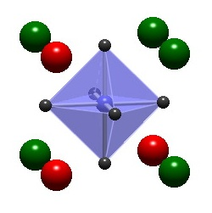
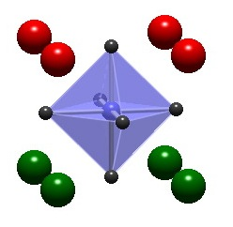
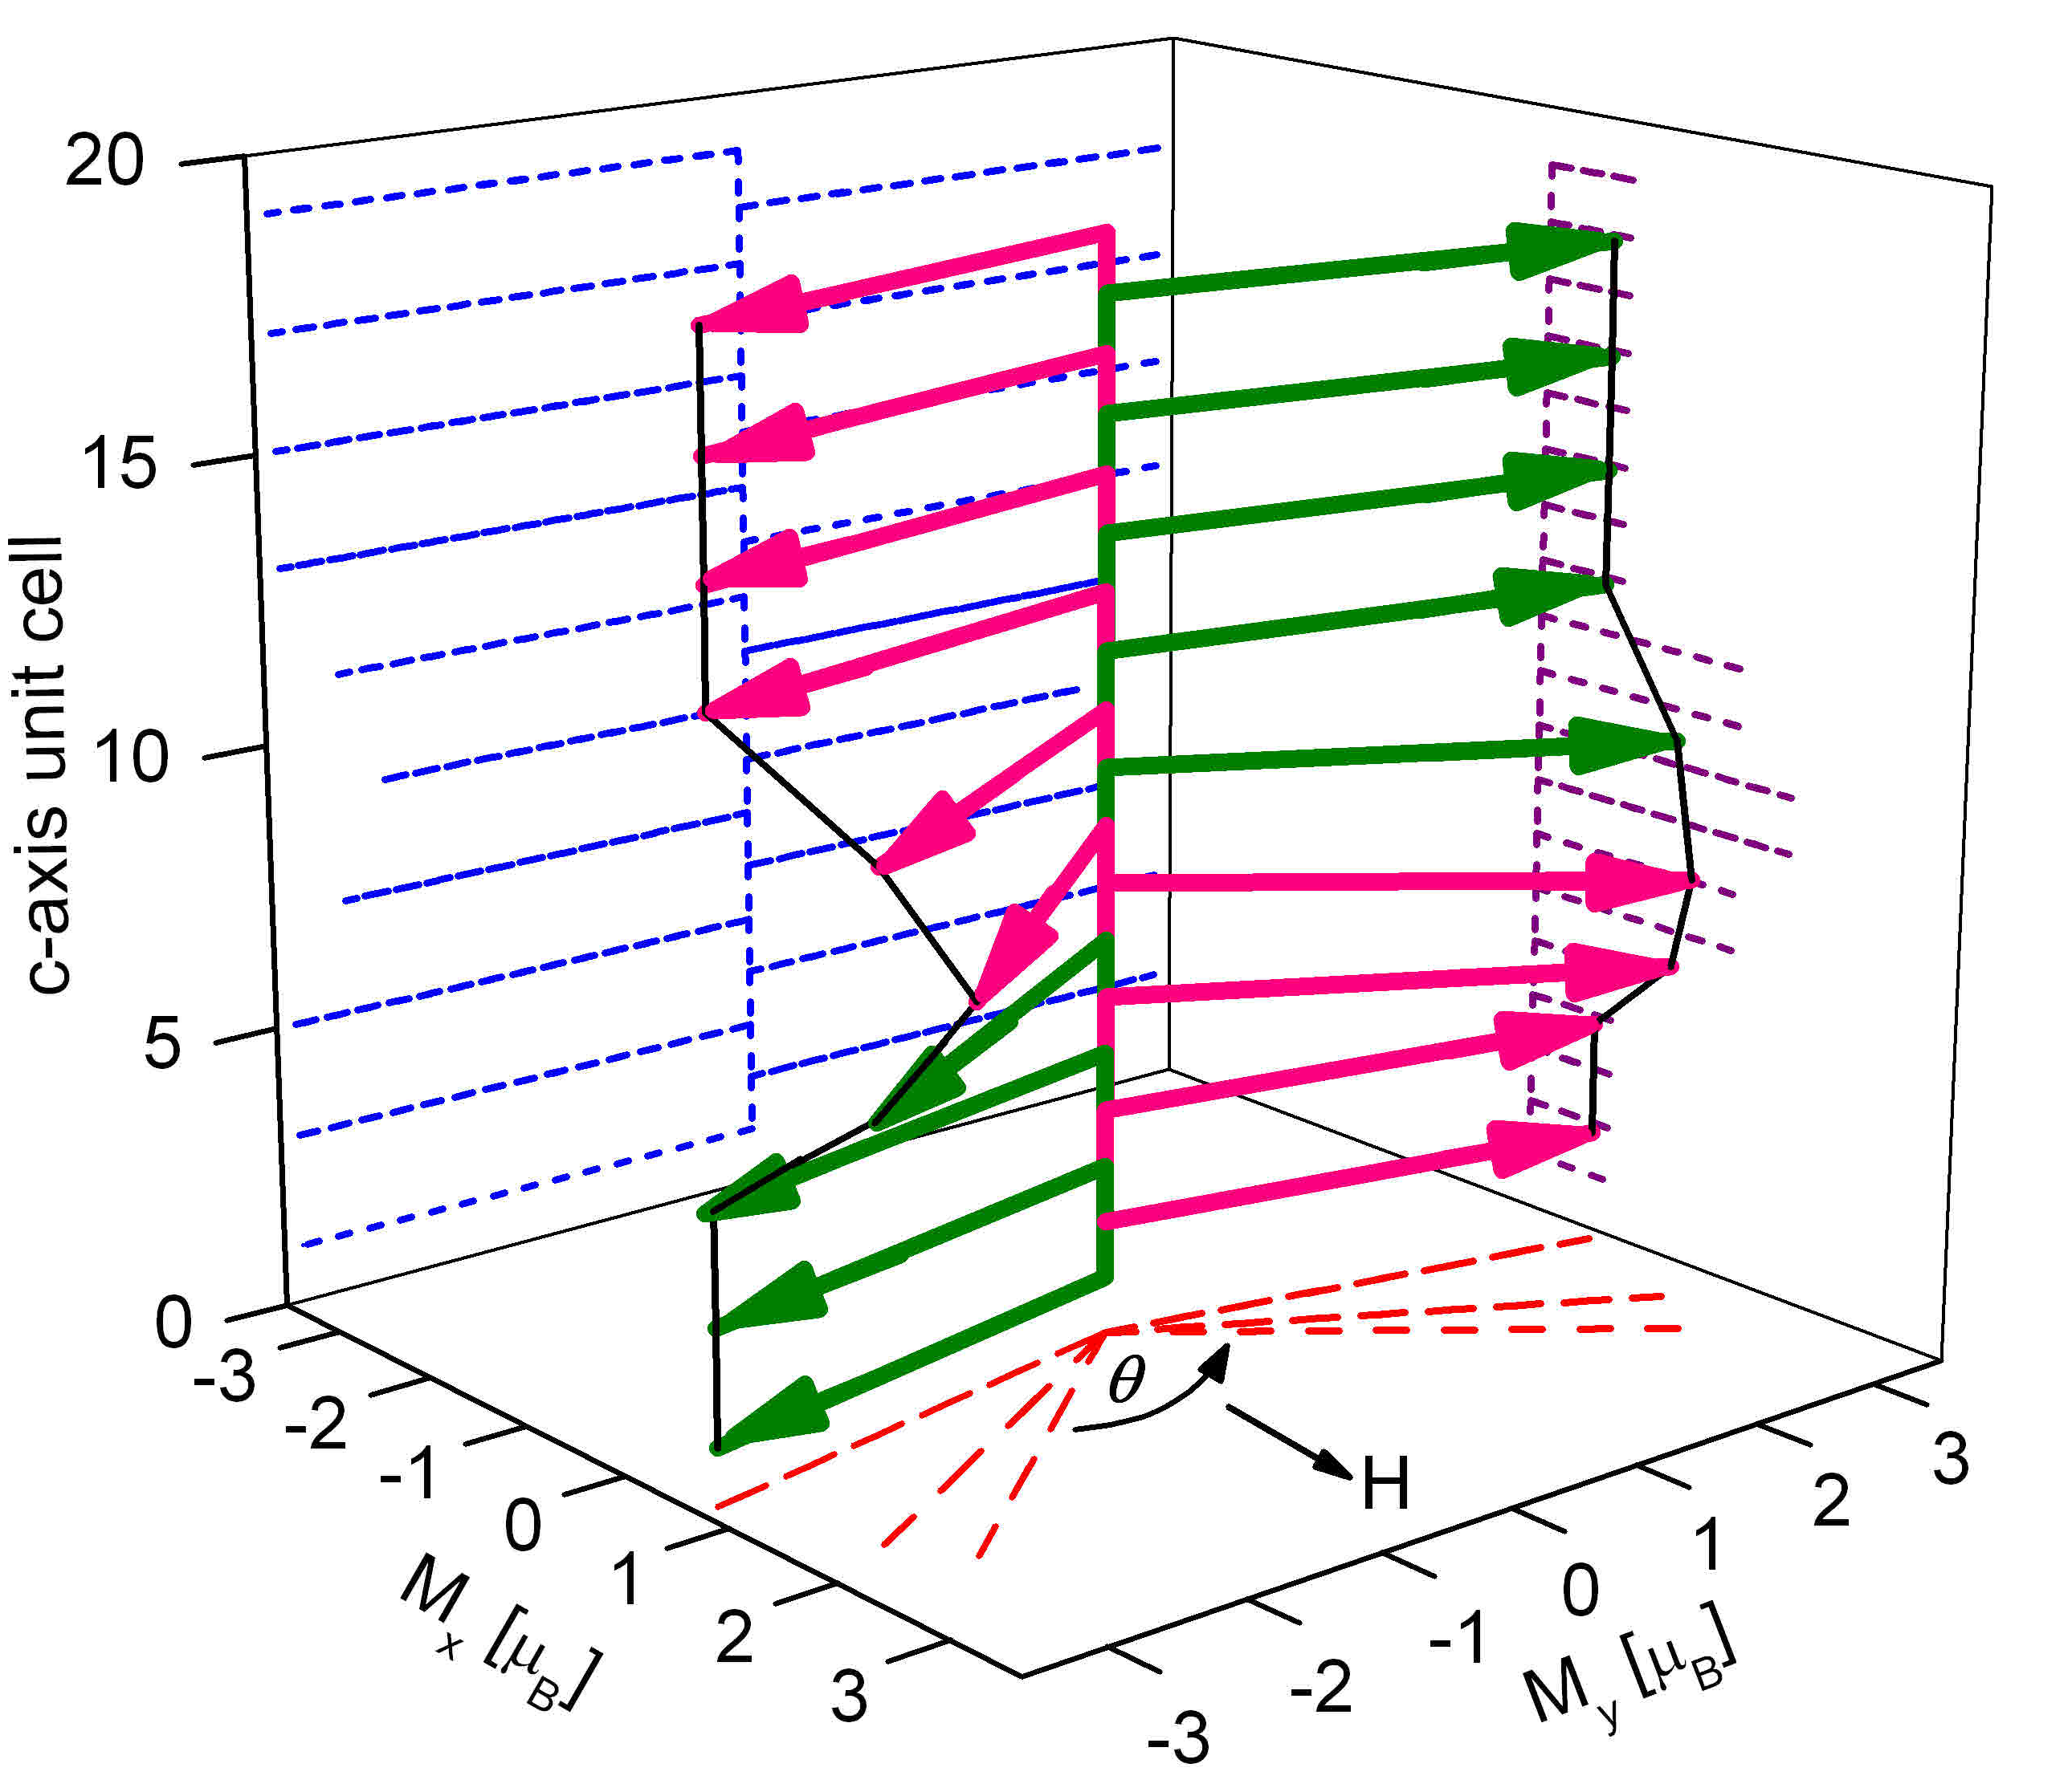
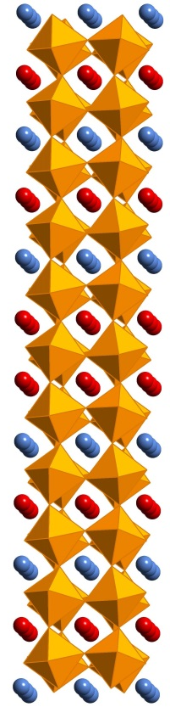

MBE Synthesis: realizing concepts in model systems
(Anand Bhattacharya)
Conceive
Discover
Synthesize
What is the role of cation disorder?
Explore
LaMnO₃/SrMnO₃
Create model materials systems with oxide-MBE
Canted magnetic state
PRL 107, 167202 (2011).
Magnetic structure; T_{N} increases by 70 K
Nat. Mater. 8, 892 (2009).
Notes:
The complex oxides are some of the most promising and interesting materials for energy. Digital Synthesis is a way to tailor complex oxides with new and novel properties. So how does this work? In our program, the conception of a new ‘digital oxide’ begins with asking a simple question. For example, we have asked - what is the role of disorder in the properties of manganites? We can address this by synthesizing a model system like the one in this figure, with single unit cell precision. Next, we explore the structure and properties of this material. With the amazing tools available to us now, we can in fact find out where all the atoms are in our sample, what the bonds between them are doing, and how their spins are arranged. This, coupled with other measurements leads to new insights and discovery of novel properties. For example, we have shown that manganite superlattices made this way can have record high Neel temperatures. In the last review period, we realized a canted magnetic state that was predicted by deGennes in his seminal paper, and pointed out as one of the outstanding quests in the field of manganites in Elbio Dagotto’s book on the subject. This process repeats as we refine our questions and improve our understanding of these materials, and our ability to design new properties.

Slide 8
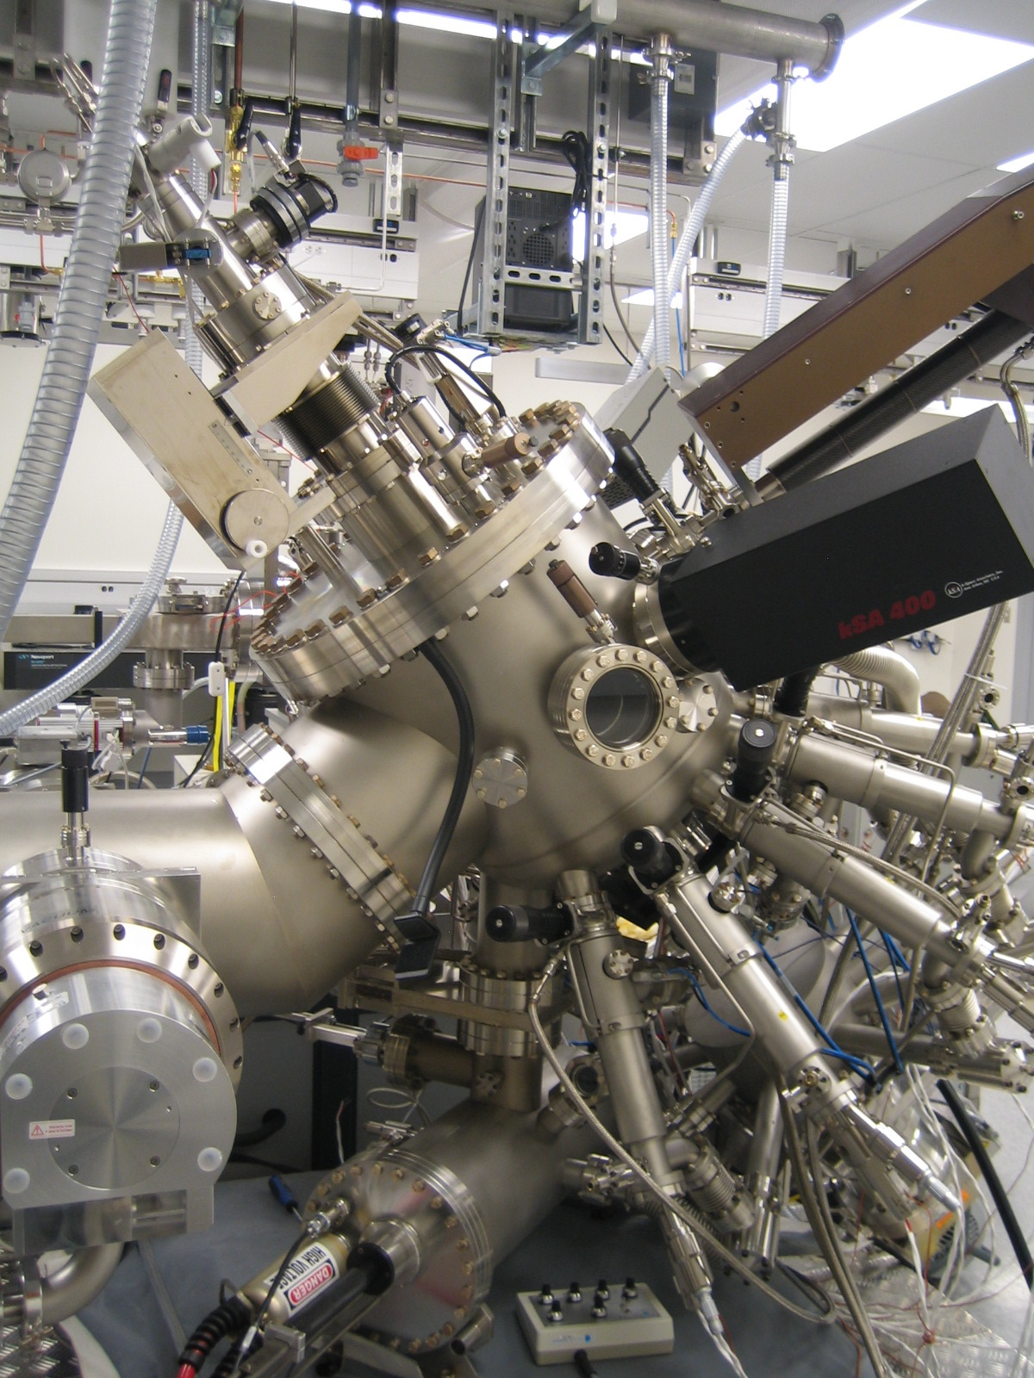

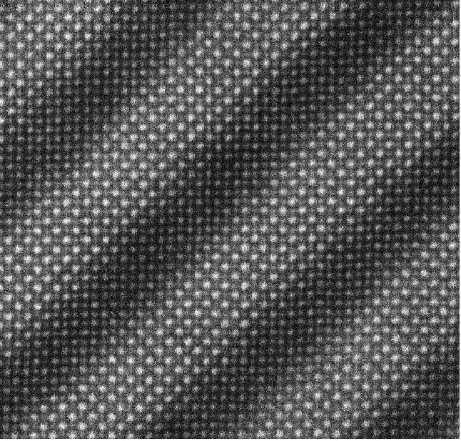
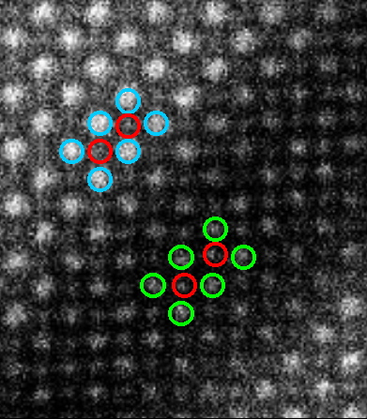
O₃-assisted MBE @ CNM
RHEED oscillations, LaMnO₃
LaMnO₃/SrMnO₃ superlattice
nano.anl.gov
ozone
Mn
Sr
La
Notes:
8

Slide 9
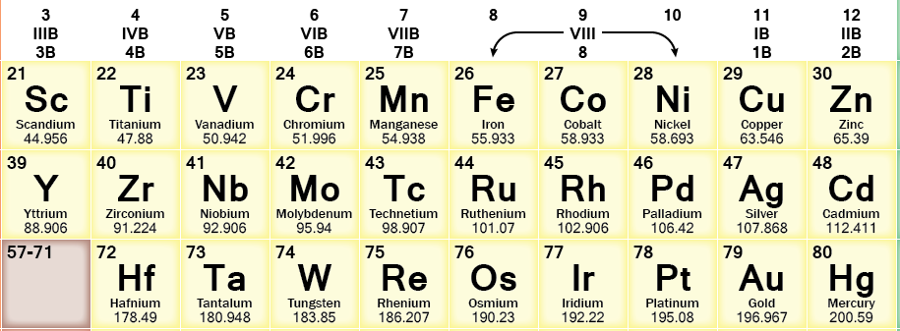
New Hybrid Oxide-MBE at MSD
RHEED
OZONE
Knudsen cell
RF Sputtering Gun
differential pumping
O₃-MBE
‘Hybrid’-MBE
Will enable the growth of 4d and 5d oxides - Iridates, Ruthenates, WO₃, Tantalates
Notes:
Now the 4d and 5d oxides are very interesting from the point of view of SOC, because they have a higher atomic number. But these are also at the frontier of new concepts in Condensed Matter Physics, as you will hear tomorrow. Currently, our ‘conventional’ MBE capabilities will not allow us to acess most of these materials. So we came up with the concept of a hybrid sputter MBE, which is shown here.

Slide 10
Capabilities and Interests Summary Slide
(Dillon Fong)
Primary Expertise & Interest Areas
In situ X-ray studies of synthesis of complex oxide heterostructures
  Defect engineering of oxide heterostructures
In situ X-ray studies of defect transport and surface processes in complex oxides
Surface X-ray diffraction, X-ray absorption spectroscopy, X-ray photoelectron spectroscopy
X-ray technique development
Most Differentiating Factor
Exploiting the high brightness, energy tunable X-rays from the Advanced Photon Source

Slide 11
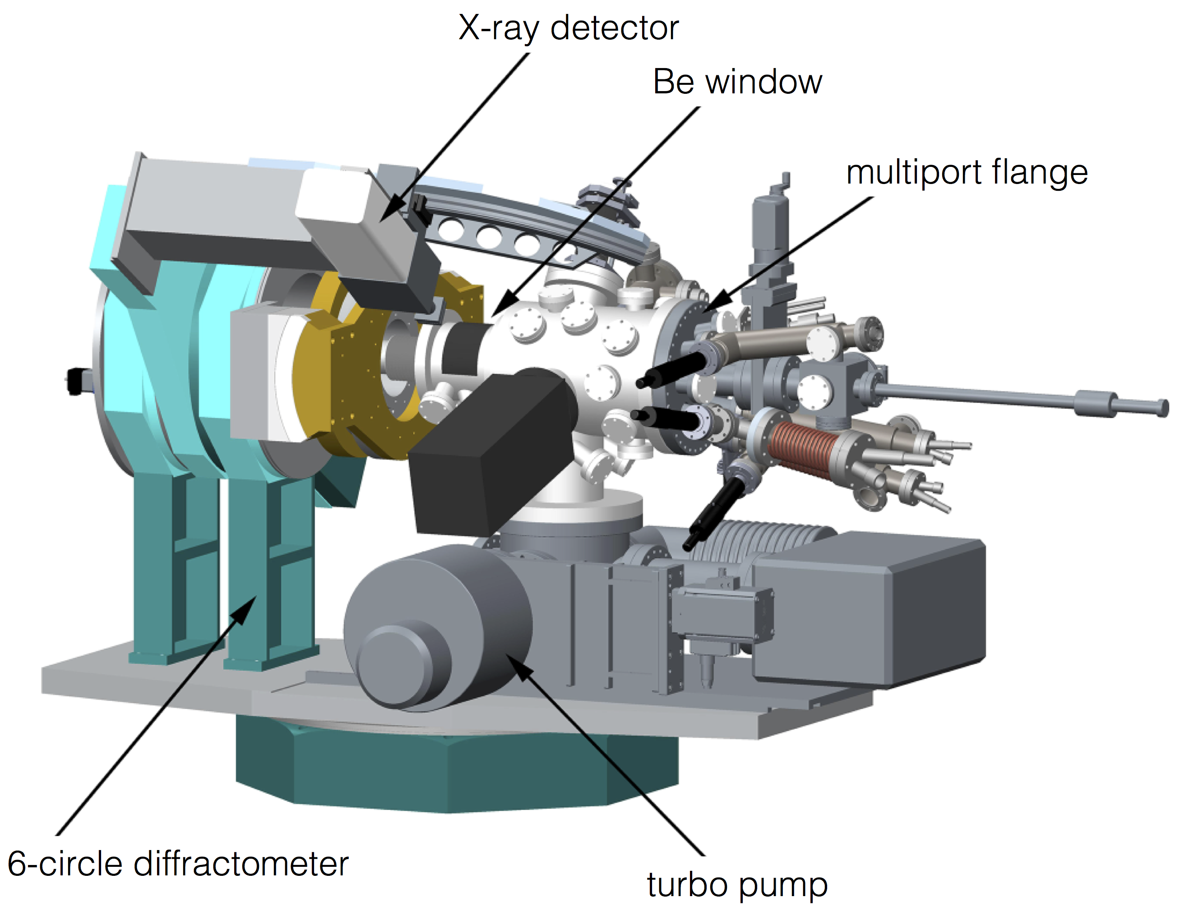
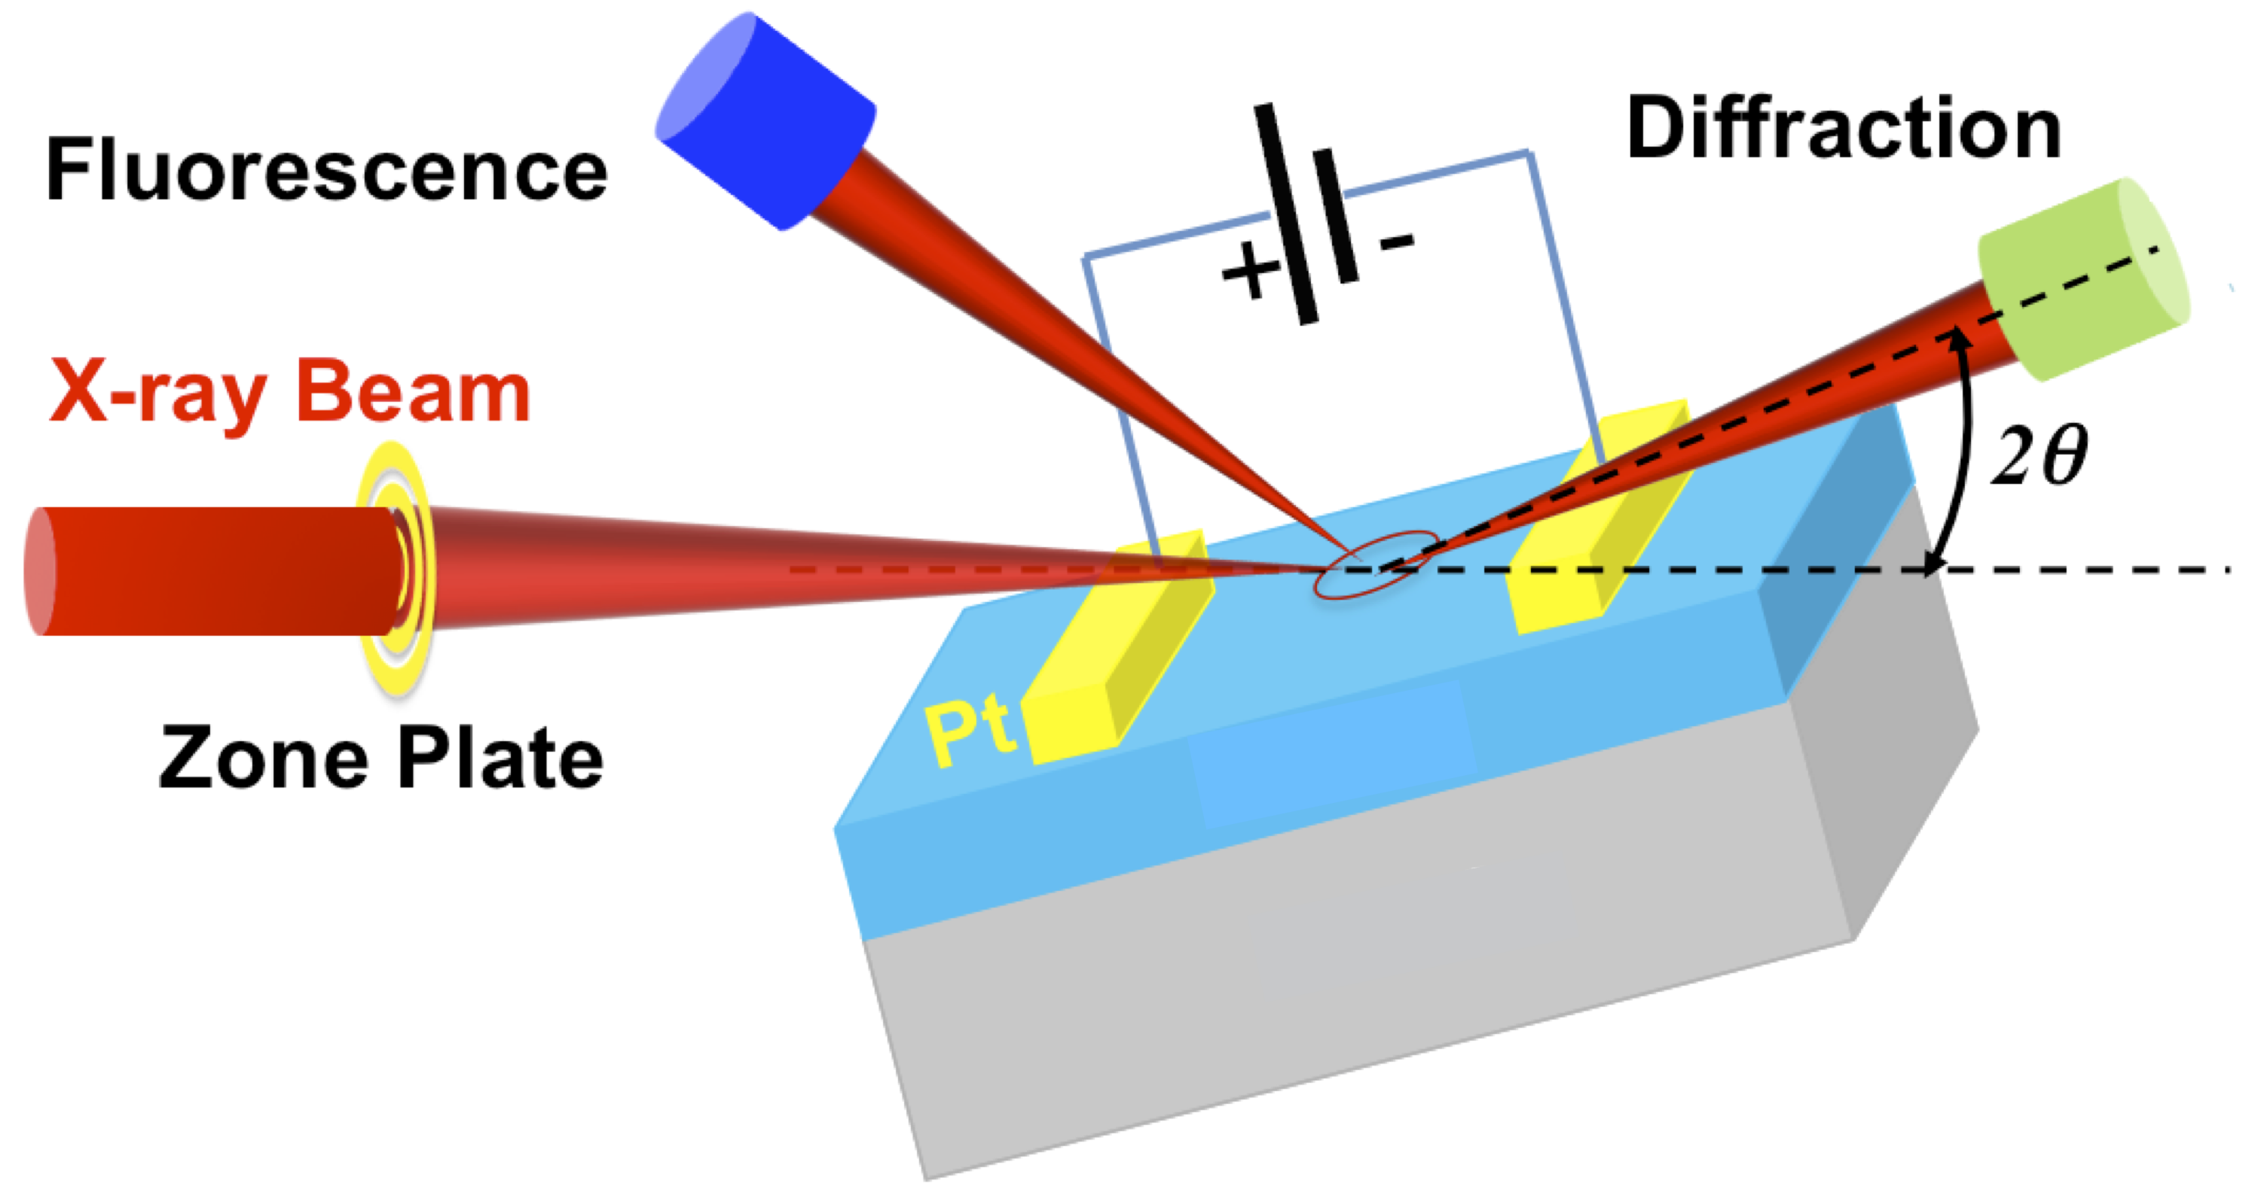
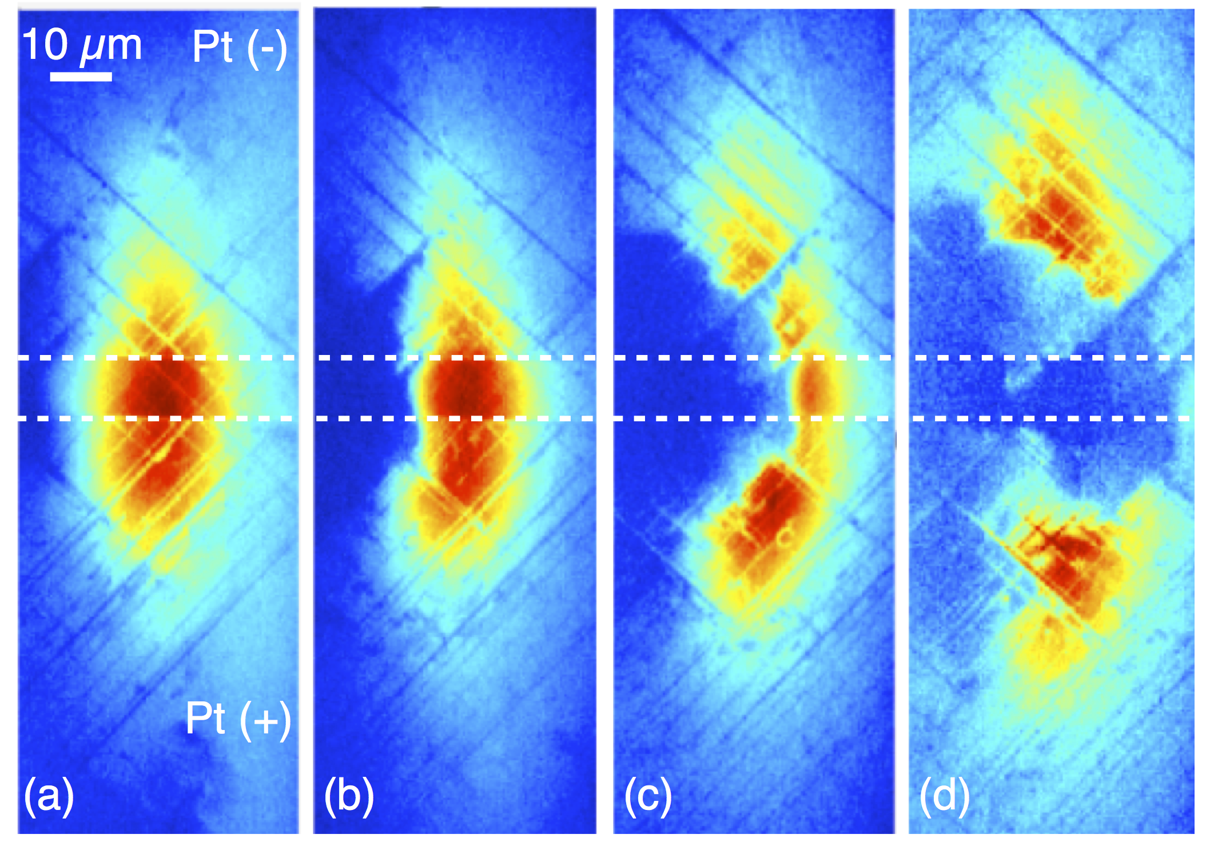
In situ X-ray Capabilities
Pulsed laser deposition system with in situ X-ray
diffraction and hard X-ray photoemission spectroscopy
Oxide molecular beam epitaxy system with in situ X-ray
diffraction and X-ray absorption spectroscopy
In situ focused beam X-ray diffraction and absorption
spectroscopy during electrical characterization (~ 50-200 nm spot)
In situ, time-resolved full-field X-ray diffraction during electrical characterization (sub-second resolution)

Slide 12
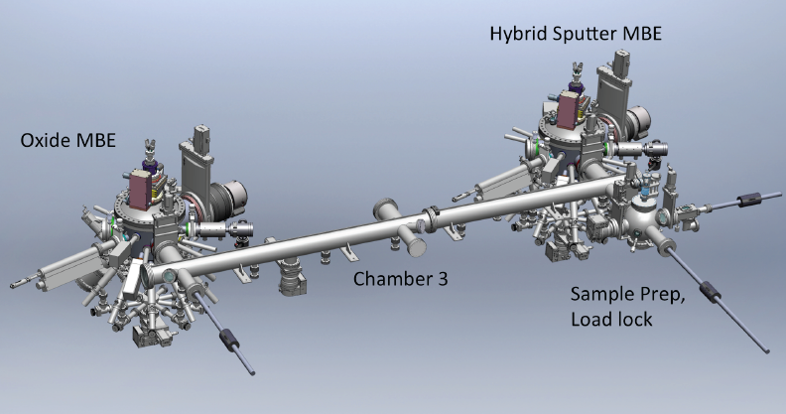
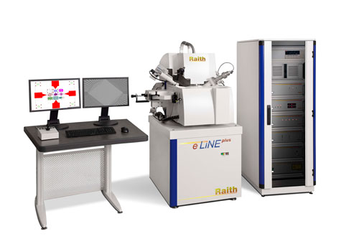
(Magnetic) Thin Films
(Axel Hoffmann, Val Novosad, Suzanne te Velthuis)
Unique infrastructure & facilities
Oxide growth, metal film growth
High resolution e-beam lithography

Slide 13
THIN Film growth and device fabrication
Wide variety of deposition tools: Sputtering, e-beam, MBE
Unique infrastructure & facilities
Oxide growth, metal film growth
High resolution e-beam lithography

Slide 14
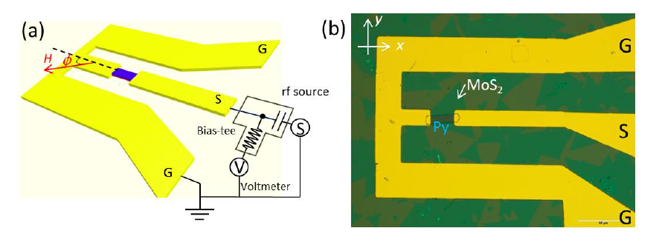
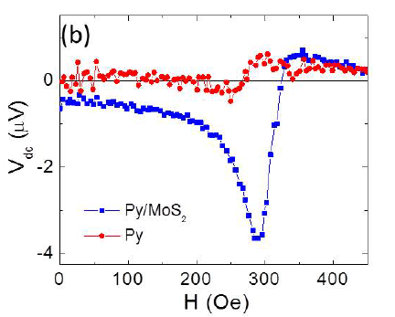
Interfacial spin-orbit torques
Efficient pathway to magnetization manipulation
E.g., 2D Materials (MoS₂)
Unique infrastructure & facilities
Broadband microwave characterization
Micromagnetic simulations
Flexible thin film growth
Expertise in spin Hall effects
and spin pumping
W. Zhang et al.,
APL Mater. 4, 032302 (2016)

Slide 15
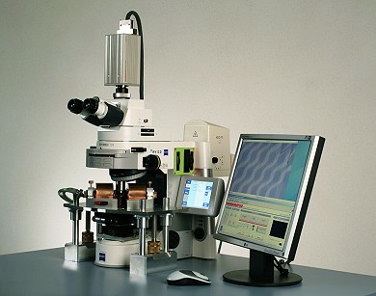
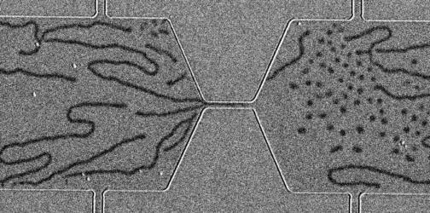
Direct imaging of magnetization structures
Look at real time transformation of domains
Unique infrastructure & facilities
Wide-field magneto-optic imaging systems
Ultrafast Cameras (ns time resolution)
Expertise in controlling magnetic interactions for tailored properties
W. Jiang et al.,
Science 349, 283 (2015)

Slide 16
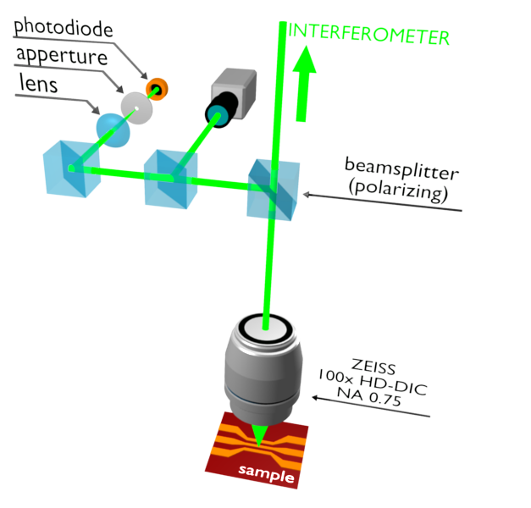
Spatial Imaging of Magnetization Dynamics
Brillouin Light Scattering for resolving magnon flows
Unique infrastructure & facilities
Spatially resolved inelastic light scattering for detection of spin waves (magnons)
Enables real space maping of magnetization dynamics
1 GHz to 1 THz, 50 MHz resolution
250 nm spatial resolution
K. Vogt et al.,
Nat. Commun. 5, 3727 (2014)

Slide 17
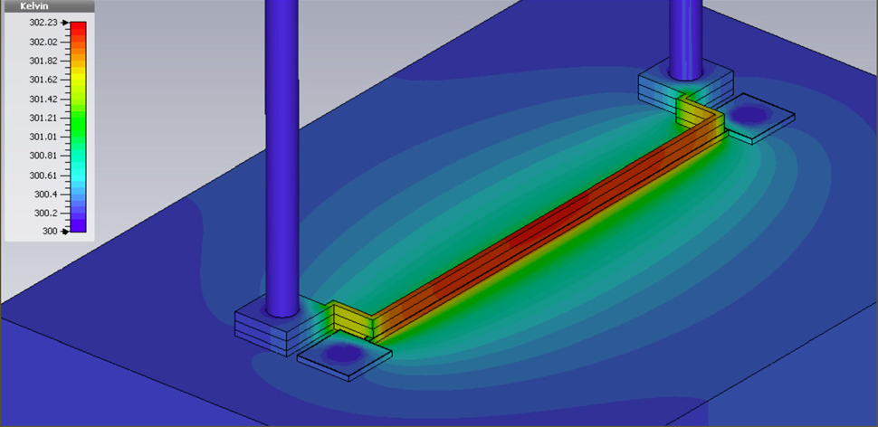
Coupled spin and heat currents
Opportunities for energy scavenging or heat management
Unique infrastructure & facilities
Novel on-chip design for
studying spin Seebeck effects
Dedicated setup for longitudinal
spin Seebeck effects in
unpatterned multilayers
Dedicated high-resolution lithography
for complex device fabrication
S. Wu et al.,
J. Appl. Phys. 117, 17C509 (2015)

Slide 18
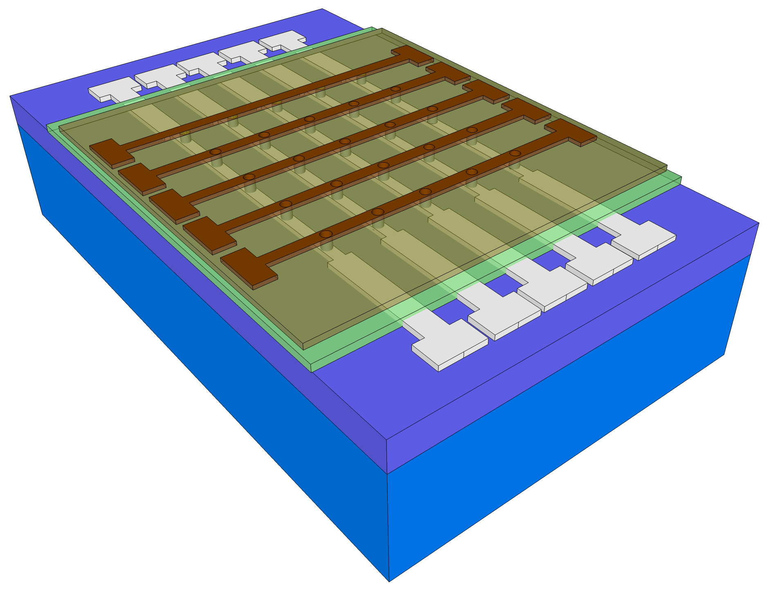
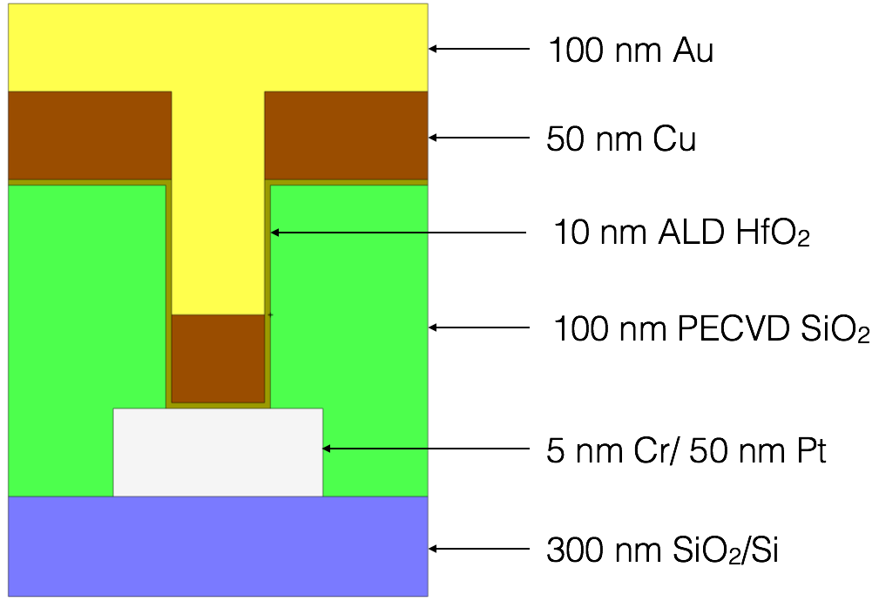
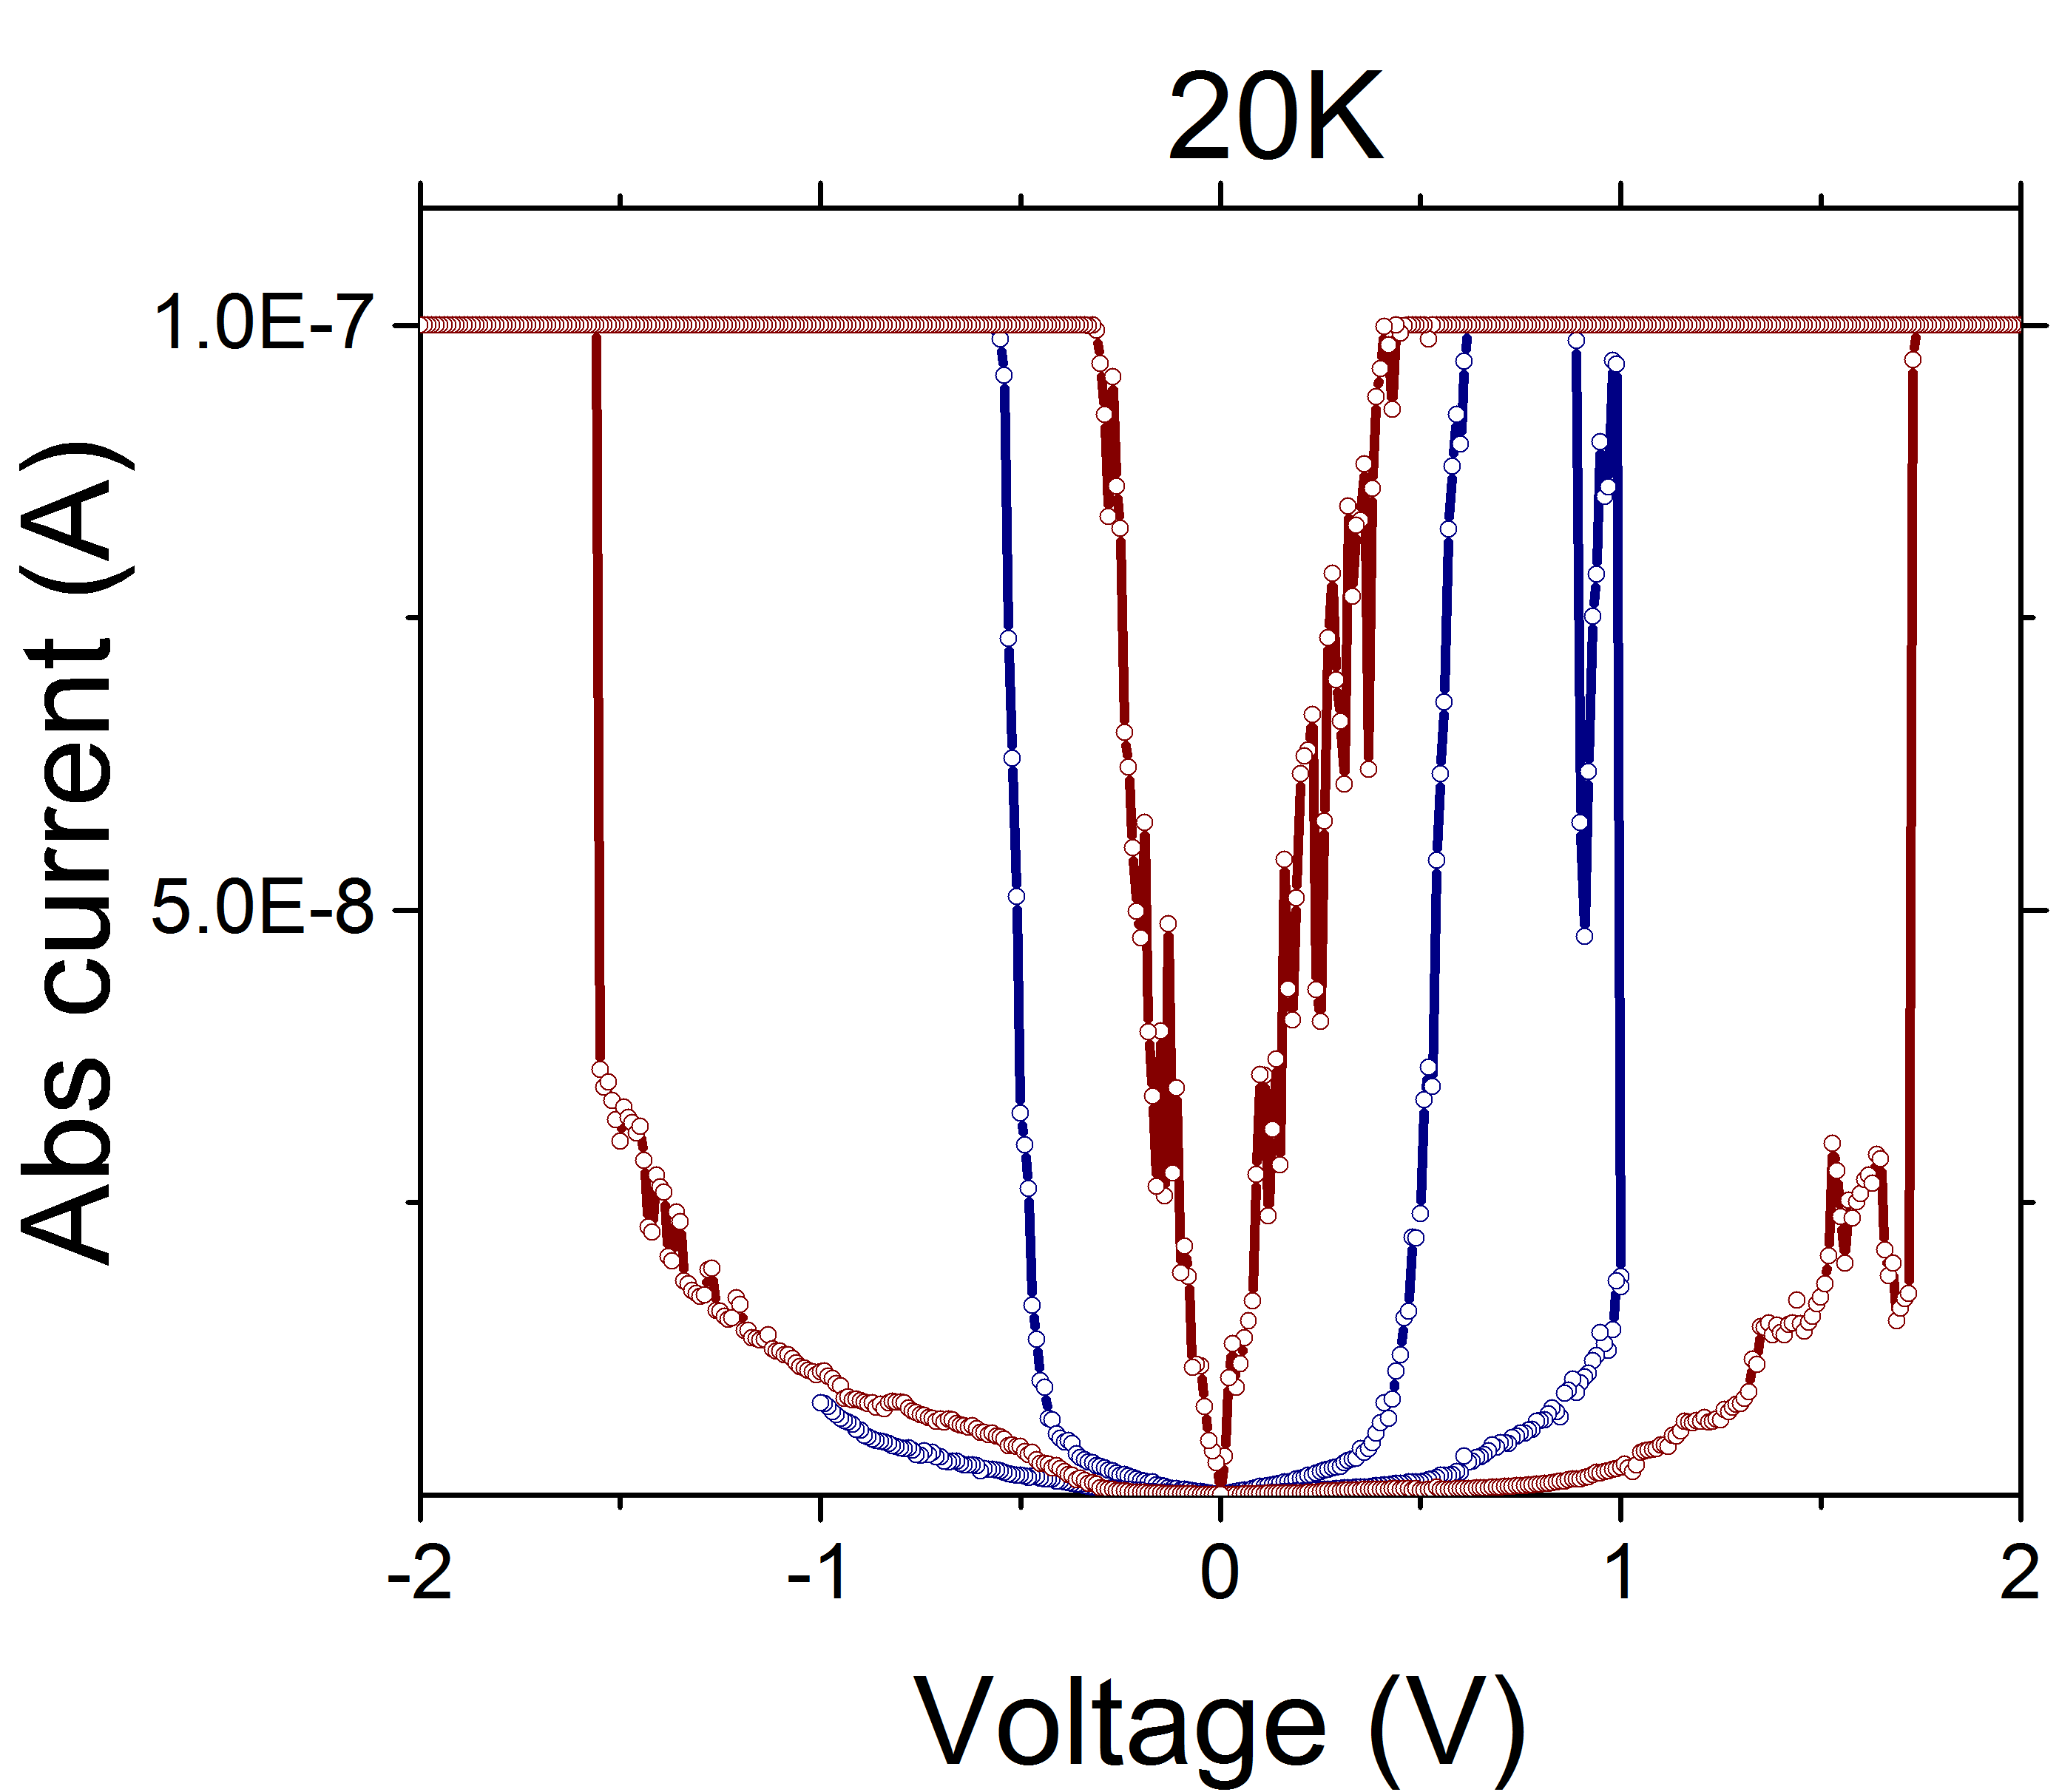
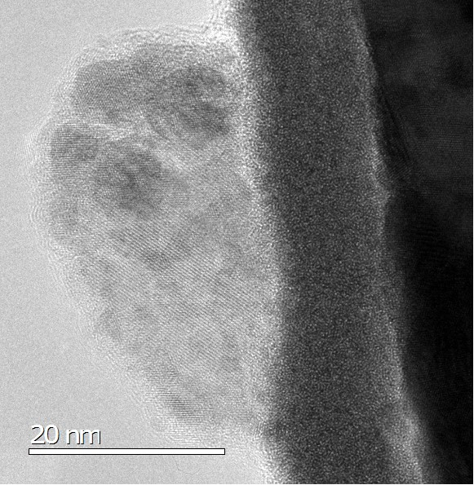
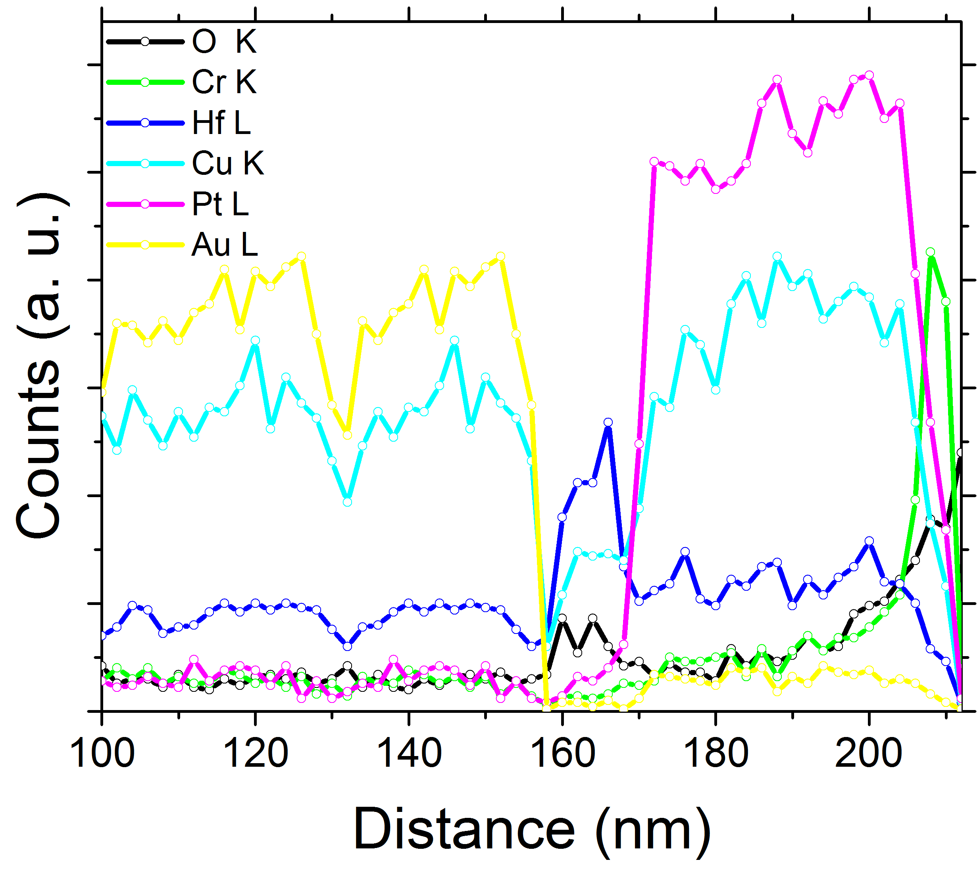
Nanoionics-based low voltage switches
(Supratik Guha)
Crosspoint array
Single device
Low voltage and energy switches:
Energy efficient computing – basis for future non-volatile memories.
Neuromorphic computing – resistive switching synapses.
Low voltage switching in Cu:HfO₂
Exploring low voltage switching
Exploring underlying material science
Au/Cu
HfO₂
Pt
Au/Cu
HfO₂
Pt
Cr
TEM: Yuzi Liu, Argonne National Lab
20 nm
Tunable ON/OFF ratio and hysteresis
Cu diffusion profile in HfO₂

Slide 19
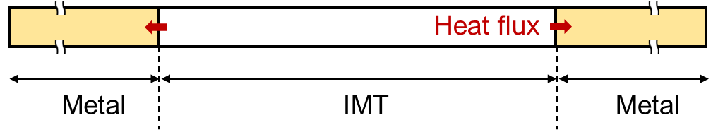
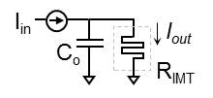
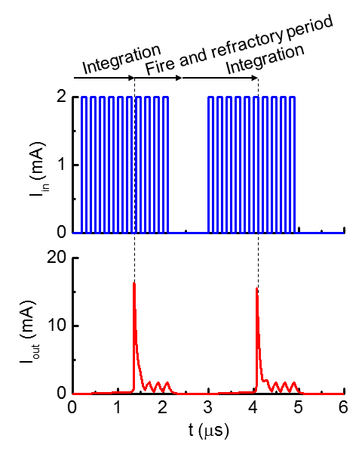
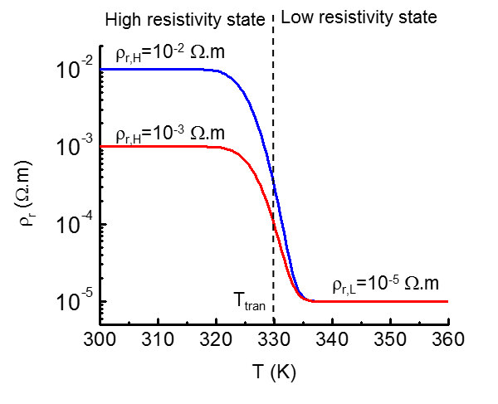
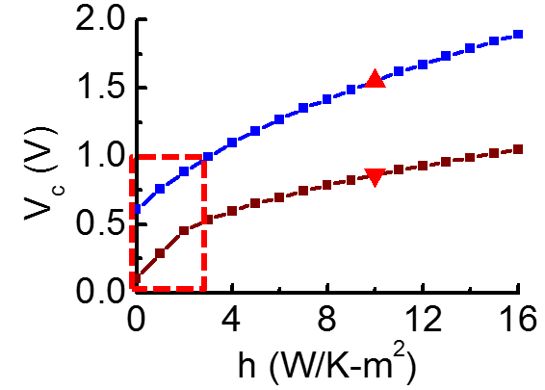
Insulator-Metal Transition (IMT) Electronics
[Lin et al, submitted for publication]
Unique resistivity-temperature relationship
A model coupling multiple physics:
  IMT material properties
  heat transfer
  joule heating
Statistic and dynamic simulation of electronic device and circuit (eg. Artificial Neuron)
Artificial Neuron prototype
Device engineering for sub-1-V switching
h represents heat loss through sidewall

Slide 20
Materials growth capabilities
Research MBE system
Magnetron sputterer
Compact 21 DZ cluster.
Twelve sources.
Automatic platen transfer robot.
Real-time continuous precise remote control and monitoring by Process Control Software.
AJA UHV magnetron sputtering system.
Evaporation and sputtering sources.
Computer controlled sputter process.
Oxide and Chalcogenide (Sulfur and Selenium) compatible deposition system.

Slide 21
Electrical characterization
Cascade REL-4800 8-inch Precision Probe Station with Heated Chuck
  Temperature from ambient to 200 ºC
  Setup for four-probe Hall measurement
  AC high-sensitivity Hall measurement
Keysight B1500A Semiconductor Analyzer
  I-V measurement: resolution of 1 fA / 0.5 μV
  C-V measurement: frequency range from 1 kHz to 5 MHz
  Ultra-fast IV measurement : Waveform generator with 10 ns programmable resolution

Slide 22
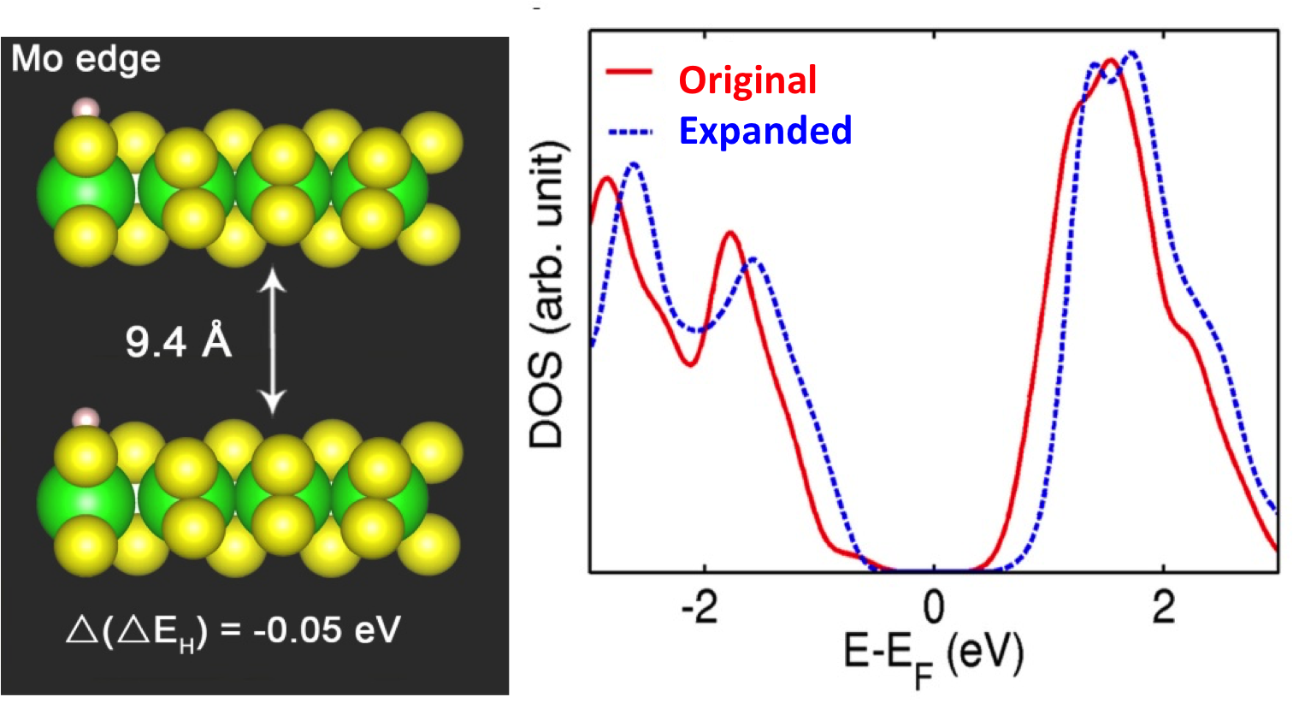
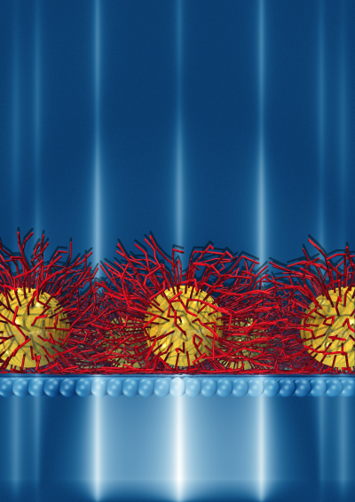
Center for Nanoscale Materials’ Theory and Modeling Group: Capabilities and Expertise
First-principles calculations of static (e.g., structures, energies) and dynamic (e.g., charge transport) properties
Large-scale reactive molecular dynamics, coarse-grained modeling, kinetic Monte Carlo mesoscale simulations
Electrodynamics and quantum dynamics of light/matter interactions
Growing component in applying data science/machine learning techniques to a variety of problems of interest in imaging, force-field fitting, molecular dynamics analysis, etc.
Notes:
Cornerstone Capabilities; Current Activities; User research - what is the most popular current user research, which user community you want to grow or attract

Slide 23
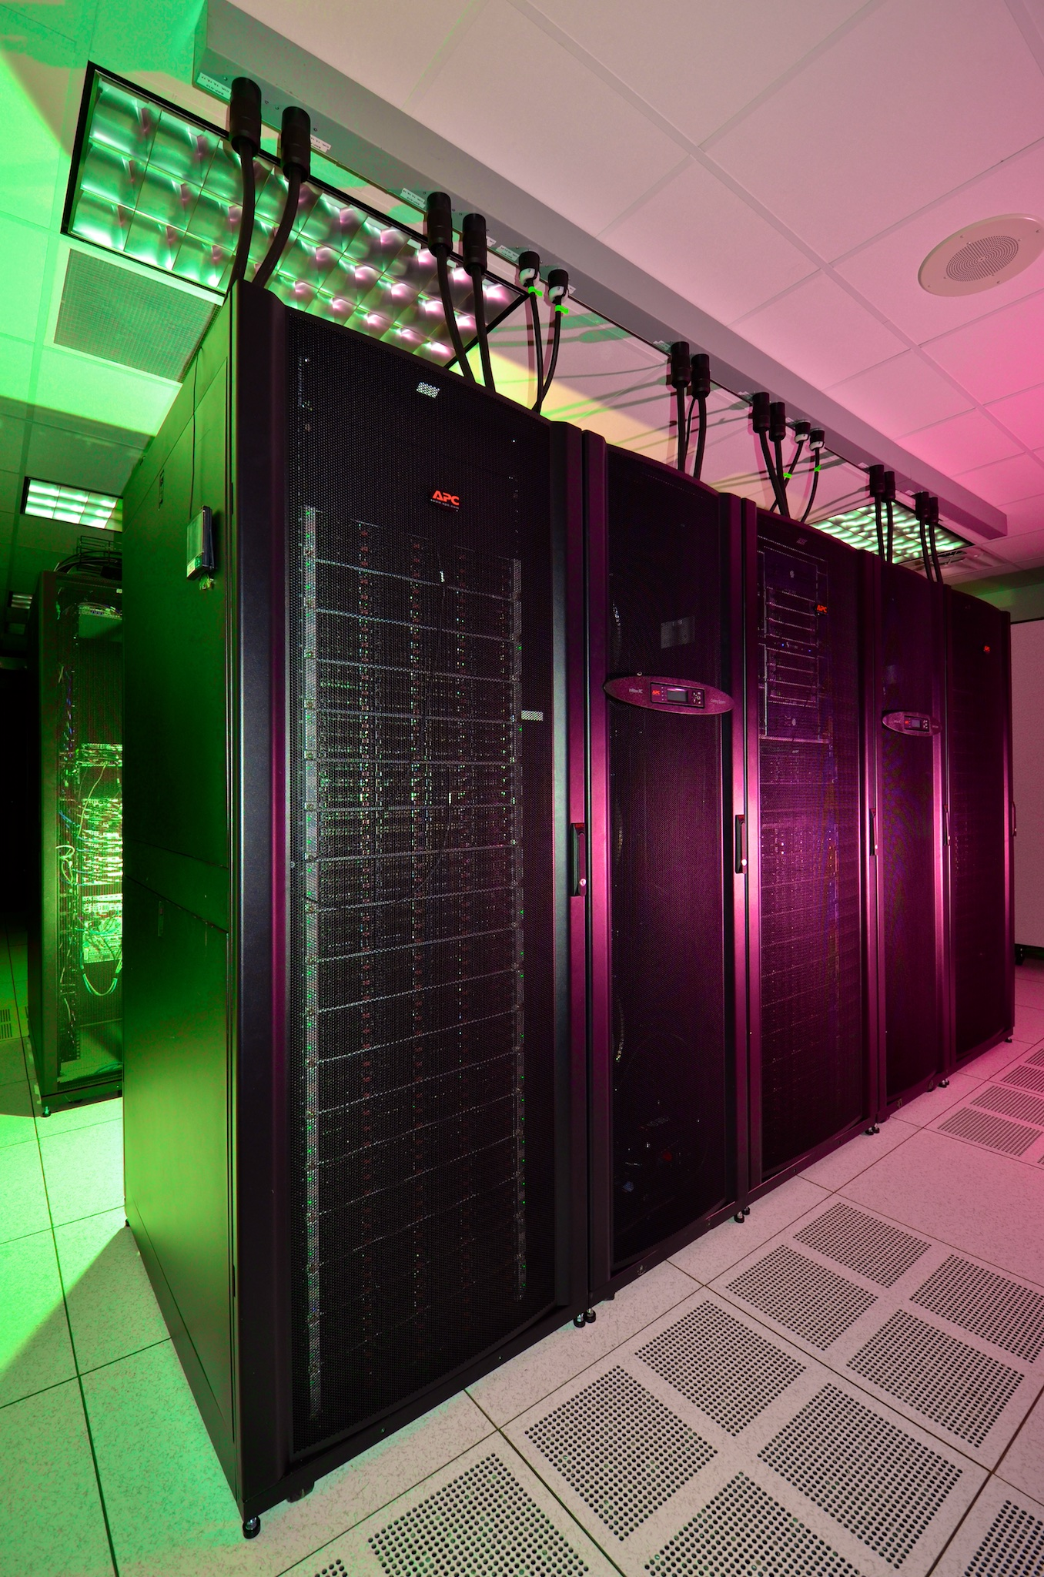
Capabilities and Expertise (cont.)
Computational Environment
2100-core HPC (high performance computing) cluster Carbon
  available to Facility Users under CNM proposal system
Numerous applications for several fields:
  Electronic structure: VASP, Siesta, MolPro, NW-Chem, Q-Chem, Octopus, ATK
  Molecular dynamics: LAMMPS, NAMD, Amber, HOOMD
  Electrodynamics: Meep, Lumerical, ddscat
  Home-grown software: force field fitting, kinetic Monte Carlo, quantum and electrodynanics

Slide 24
Theory and Modeling: Materials Science Division, Institute for Molecular Engineering, ALCF
Large-scale first-principle electronic structure and excitations (GW and MBPT) – applications to light-matter interactions (X-ray scattering, photovoltaics), charge and thermal transport
Large-scale ab initio molecular dynamics – liquid-solid interfaces and charge transfer process at interfaces
Quantum Monte Carlo simulations – correlated oxides, quantum chemistry, 2D layered systems
First-principle transport and non-equilibrium Green’s functions – applications in resistive switching/memristors
Kinetic Monte Carlo – synthesis modeling
Micromagnetic modeling – magnetization dynamics, magnons and spin transport, spin torque effects, spin-Hall
Mesoscale modeling – inhomogeneous ferroelectric/elastic/ferromagnetic systems, microstrutural evolution
Soft condensed matter – non-equilibrium evolution of polymers, fluids, colloids
Notes:
Cornerstone Capabilities; Current Activities; User research - what is the most popular current user research, which user community you want to grow or attract

Slide 25
Argonne Capabilities and Interests
(Andrew Chien)
Primary Expertise & Interest Areas
Novel Computer architecture: accelerators, interconnects, memory hierarchies
Power-efficient, Resilient design and modeling
Performance Modeling and analysis
Design and Prototyping (soft, fpga, ...)
Programming Models and Efficient Implementation
Most Differentiating Factor
Creative “out of the box” architecture design capability
Large-scale design and implementation capability (e.g. Synopsys, ASIC, FPGA, etc.)
Breadth of system and software expertise (middleware, OS, compilers, networking, etc.)
Depth of cross-layer expertise from devices up through applications
Deep industrial experience (technology, business)
Main Contribution/Role
Micro-architecture innovation suitable for new materials and devices
Systems perspective to identify viable opportunities for new technologies success
Efficient, but insightful, rigorous analysis exploiting deep cross-layer expertise

Slide 26
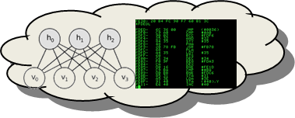
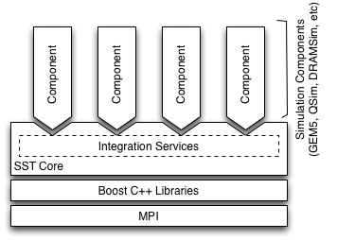
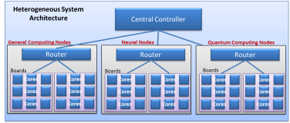


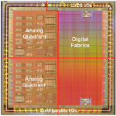
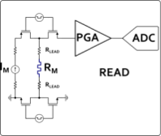
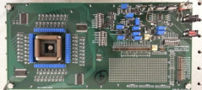
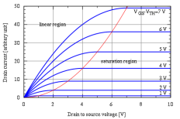
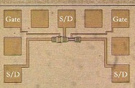

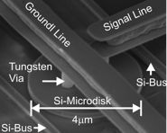
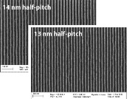
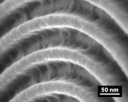
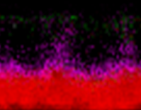
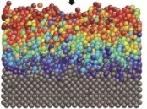
Beyond Moore Co-design Framework
Modeling
10,000x improvement:
20 fJ per instruction equivalent
Experimental
Application Performance Modeling
Computer System Architecture Modeling
Next generation of Structural Simulation Toolkit
Heterogeneous systems HPC models
Systems
Alg & SW Environments
Component Level Models
Gem5, McPAT, HiHAT, CACTI, NVSIM
Component Fabrication
Processors, ASICs
Photonics
Memory
HW & Circuit Archs
Circuit/IP Block Design and Modeling
SPICE/Xyce model
Test Circuit Fab and Measurement
Subcircuit measurement
Devices
Compact Device Models
Single device electrical models
Variability and corner models
Device Measurements
Single device electrical behavior
Parametric variability
TEM/EELS
Common & logic devices
Device Physics Modeling
Device physics modeling (TCAD)
Electron transport, ion transport
Magnetic properties
Device Structure Integration and Demonstration
Novel device structure demonstration
Materials
Process Module Modeling
Diffusion, etch, implant simulation
EUV and novel lithography models
Process Module Demonstrations
EUV and novel lithography
Diffusion, etch, implant simulation
Materials
Atomistic and Ab-Initio Modeling
DFT – VASP
MD – LAAMPS
Fundamental Materials Science
X-ray: XRD, XPS, HAXPES
Microscopy: TEM, SEM, EELS
Scanning probe technique
Example modelling and characterization activities within an MSCD framework
Notes:
Explain how this integrated framework leverages the labs strength and MISSION, and engages both modeling and experimental science
There are many indiviual activities happening in each of these areas, but there is nothing that integrates them together.
In the Charter of the National Strategic Computing Initiative, the DOE is identified as a lead agency for computing systems,
with a mission to create integrated efforts that LEAD to fully integrated systems.
It is our job… it is our MISSION to address this first order energy challenge...

Slide 27
Instructions for Capabilities and Interests Presentation
30 minute presentation
15 minute Q&A session
Discuss your lab’s expertise in each of the following areas. Please highlight funded programs, unique facilities, differentiation from industry, etc
  Implications for Algorithm and Software Environments
  Hardware and Circuit Architectures
  Devices
  Materials
What is your lab’s most differentiating factor?
What do you see as your lab’s main contribution?
Complete Summary Slide

Slide 28
MBE : Synthesis of model systems for science
(A. Bhattacharya)

Slide 29
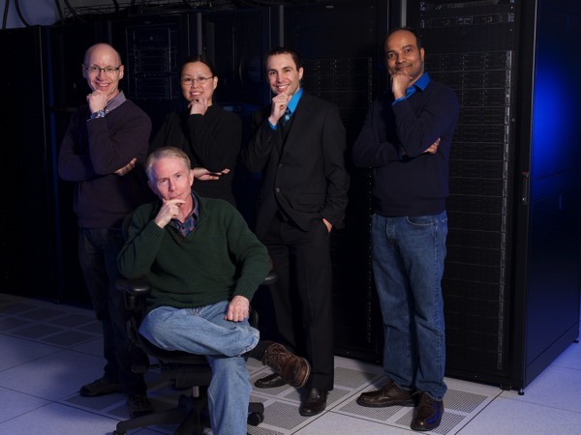
Theory and Modeling Group
Current Staff
Permanent Staff
Stephen Gray (Group Leader)
Subramanian Sankaranarayanan
Maria Chan
Pierre Darancet
Michael Sternberg
Notes:
Highlight Tal has signal processing background.

